Slide 1

REDCap for Research Data Collection and Management
Advanced User Session for NJACTS
Han Wu, MS
Data Architect
Office of Research, New Jersey Medical School
December 9, 2020

Slide 2
Advanced Use
REDCap can be lightweight, but can go BIG
  Compliance with 21 CFR Part 11, HIPAA
  Small database -> Large database in high complexity
  Feasible, Flexible and All-purpose
  Serving all needs
Notes:
5 minutes, 10:40am
REDCap is a secure web application for building and managing online surveys and databases. While REDCap can be used to collect virtually any type of data in any environment (including compliance with 21 CFR Part 11, FISMA-Federal Information Security Management Act of 2002, HIPAA), it is specifically geared to support online and offline data capture for research studies and operations. The REDCap Consortium, a vast support network of collaborators, is composed of thousands of active institutional partners in over one hundred countries who utilize and support their own individual REDCap systems.

Slide 3
REDCap in response to COVID-19 Pandemic
REDCap can serve essential missions
  Randomized controlled trial (RCT)
  Case reporting and Contact tracing
  Return to Work (Research) daily screen questionnaire
  14-day COVID-19 Vaccine safety monitoring

Slide 4
REDCap in response to COVID-19 in the United States
The CDC, several institutes of the NIH, and more than a dozen state health departments are using REDCap for COVID-19 symptom tracking and monitoring.
Seattle’s public health authority is using REDCap surveys to support COVID-19 testing and aggregate reporting, and the Department of Health in the state of Washington is using REDCap to support community-based testing sites.
The University of Washington’s Institute of Translational Health Sciences is using REDCap for community surveillance, first responder tracking, and monitoring of COVID-19 in pregnant women.
The REDCap Mobile App is being used for drive-thru COVID-19 testing in Tacoma, Washington, by the Tacoma-Pierce County Health Department for symptomatic critical service workers.
Vanderbilt University Medical Center’s Occupational Health group is using REDCap surveys, delivered via email, to monitor any employees thought to have been exposed to COVID-19. The initial survey gathers general information about the employee’s exposure and inquires if they are symptomatic, and twice-daily follow-up surveys screen for symptoms.

Slide 5
REDCap in response to COVID-19 in the United States
The Ohio Department of Health and local health departments in Ohio are using REDCap to monitor people exposed to COVID-19.
The American Association for Cancer Research is using REDCp surveys to organize information on cancer patients infected with COVID-19 as rapidly as possible.
The Pediatric Infectious Diseases Transplant Network (PIDTRAN) through its Coordinating Center at St. Jude Children’s Research Hospital, in collaboration with Children’s Hospital of Philadelphia, Seattle Children’s Hospital and Chicago Children’s Hospital have created a survey to capture epidemiologic and clinical information about ALL cases of pediatric COVID-19 infections in the United States.
The University of Maryland is using a survey tool for employees to report COVID-19 exposures or illness, which triggers symptom monitoring and contact tracing prompts and sends instructions about quarantine, isolation or return to work. They are expanding this to support daily symptom monitoring for employees returning to campus.

Slide 6
REDCap in response to COVID-19 around the world
World Health Organization (WHO) is using REDCap version of ISARIC’s Novel Coronavirus (COVID-19) CRF to manage COVID-19 data obtained through examination, interview and review of hospital notes.
The Royal Melbourne Hospital in Melbourne, Australia has several novel applications, including 1) Using REDCap to monitor patients with pulse oximetry at home through an automated SMS system using Twilio integration, 2) Using REDCap and Twillio to register patients in COVID clinic drive-thru, capturing the Mobile phone number to feedback pathology results to, and 3) Using REDCap to log movements into and out of shared spaces within the workplace using QR codes.
South Africa’s National Institute for Communicable Diseases is using REDCap for COVID-19 contact tracing.
Notes:
Those are the examples about how REDCap has been used in response to the pandemic during this challenge time.
5 minutes, 10:40am

Slide 7
Enhanced Form Design
Form Rich Formatting Using HTML+CSS+Field Embedding
Objective:
How to make your form user-friendly and appealing
How to fit existing intake forms to REDCap
Notes:
njacts_demo (Demo NJACTS) user account Demo user: njacts_demo, NJacts2020
15 minutes, 10:55am

Slide 8
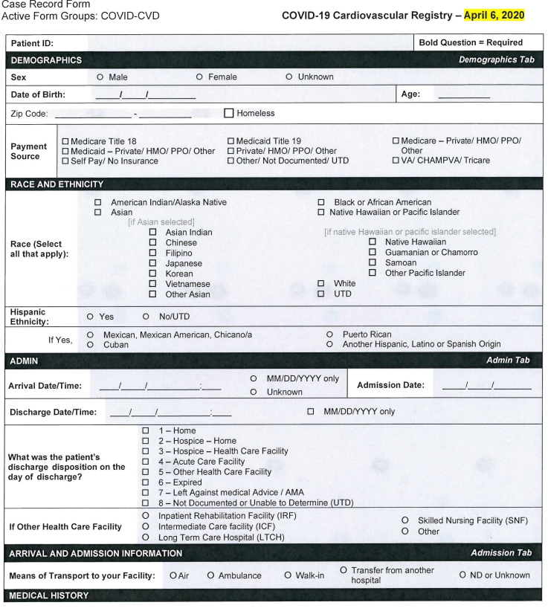
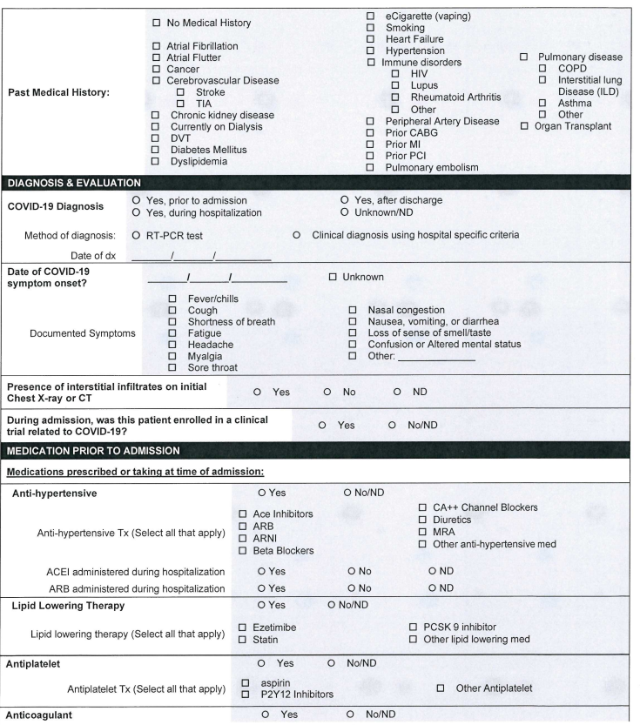
Form Rich Formatting Using HTML+Field Embedding
Notes:
Reference: American Heart Association
Next demo basic form -> adding Enhanced style to Survey Setting -> adding grouped section by table, adding Descriptive section using Embedding Fields

Slide 9
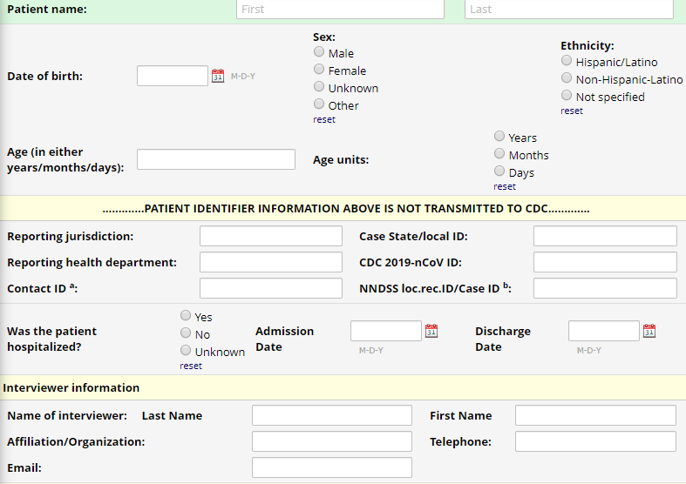
Embedding Field
Enhanced Form Design
Reposition fields on the form using Embedding Field optionally with Action Tags
Field Embedding allows you to reposition field elements on a survey page or data entry form so that they get embedded in a new location on that same page
Make the form look exactly how you want
Notes:
Switch back to browser, Demo how to convert the previous version of simple/sequential form to above formatting, walkthrough the Before vs After
Action tags and Embedding Field:
What is Field Embedding?
The 'Field Embedding' feature in REDCap is the ultimate way to customize your surveys and data collection instruments to make them look exactly how you want. Field Embedding allows you to reposition field elements on a survey page or data entry form so that they get embedded in a new location on that same page. Embedding fields gives you greater control over the look and feel of your instrument. For example, you may place fields in a grid/table for a more compact user-friendly page, or you can position some fields close together in a group if they are related. See the screenshots below for examples of what field embedding looks like and how to utilize this powerful feature.
How to embed a field
The steps below illustrate the basic template for embedding a field.
First, create the field. The field must exist first before it can be embedded elsewhere. Note: You do not necessarily have to add a Field Label to the field because that label will ultimately be hidden when the field gets relocated elsewhere on the page.
Place the REDCap variable name of the field you wish to embed inside braces/curly brackets - e.g., {date_of_birth} - and place it in the Field Label, Field Note, Section Header, or Choice Label of another field on that same instrument. Field embedding will not work across instruments but only on the current instrument/survey being viewed. If on a multi-page survey, then the embedded field must be on the same survey page as its host field. We encourage you to utilize the rich text editor heavily to get the field to look exactly how you want.

Slide 10
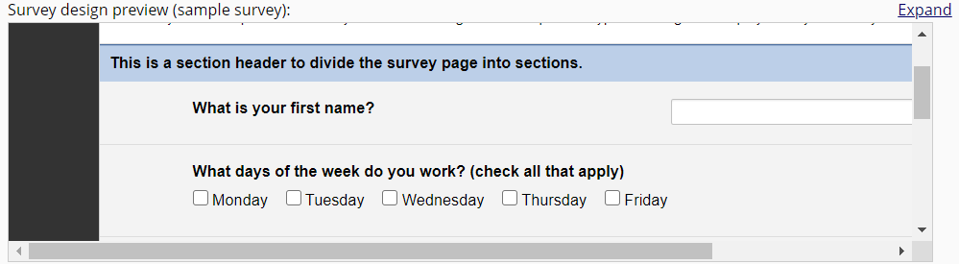
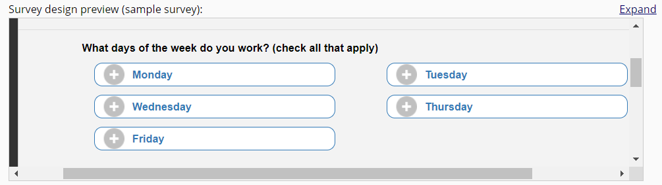
Enhanced Form Design
Default style vs Enhanced style
Notes:
Enhanced style is mobile friendly and tablet friendly
15 minutes, 10:55am

Slide 11
Survey Queue and Branching Logic
Objective:
How to deal with multi-survey project
understand how to use Survey Queue, optionally adding Branching Logics/Conditions
Notes:
10 minutes, 11:05am

Slide 12
Survey Queue and Branching Logic
Using STOP action
Survey Notifications (for team)
Survey Queue (for multiple survey forms)
Notes:
ASI vs. Survey Queue
ASI: Emails survey link to your participants (based on conditional logic)
Survey Queue: compiles a customized link of all surveys into one link, does NOT email the link to participants
Tip: It is very common to use ASI’s and Survey Queue together: survey queue to link surveys together, and ASI to send ONE link to participant (usually first survey)
The Participant List option allows you to send a customized email to anyone in your list and track who responds to your survey.
Requires participant email address
Each participant receives a unique survey link to complete the survey
Responses can be anonymous (email address separate from data) or identified
To identify a response, provide an Identifier when adding each participant to the participant list (must click 'Enable' under ‘Participant Identifier’ first)
Participant Identifier displays as a separate field in the exported data
Use caution if using both the Participant List and ASI’s – if you add the same email to both, you may inadvertently create duplicate records in your study.
Tip: All survey responses collected are considered anonymous unless you 1) are using Participant Identifiers or 2) have enabled the designated email field for invitations.

Slide 13
Survey Queue and Branching Logic
A landing page for many surveys
Survey based branching logic
Ability to define logic across event
Notes:
10 minutes, 11:05am
ASI vs. Survey Queue
ASI: Emails survey link to your participants (based on conditional logic)
Survey Queue: compiles a customized link of all surveys into one link, does NOT email the link to participants
Tip: It is very common to use ASI’s and Survey Queue together: survey queue to link surveys together, and ASI to send ONE link to participant (usually first survey)
The Participant List option allows you to send a customized email to anyone in your list and track who responds to your survey.
Requires participant email address
Each participant receives a unique survey link to complete the survey
Responses can be anonymous (email address separate from data) or identified
To identify a response, provide an Identifier when adding each participant to the participant list (must click 'Enable' under ‘Participant Identifier’ first)
Participant Identifier displays as a separate field in the exported data
Use caution if using both the Participant List and ASI’s – if you add the same email to both, you may inadvertently create duplicate records in your study.
Tip: All survey responses collected are considered anonymous unless you 1) are using Participant Identifiers or 2) have enabled the designated email field for invitations.

Slide 14
Collecting data at multiple Timepoints
Objective:
Understand Longitudinal and Repeating Instruments
Understand what is Arms, how to define events
Notes:
15 minutes, 11:20am
Arm
Form vs. Instrument
I will use the terms interchangeably
Survey is not the same. In REDCap, survey is used to describe an instrument or form that is taken by a participant

Slide 15
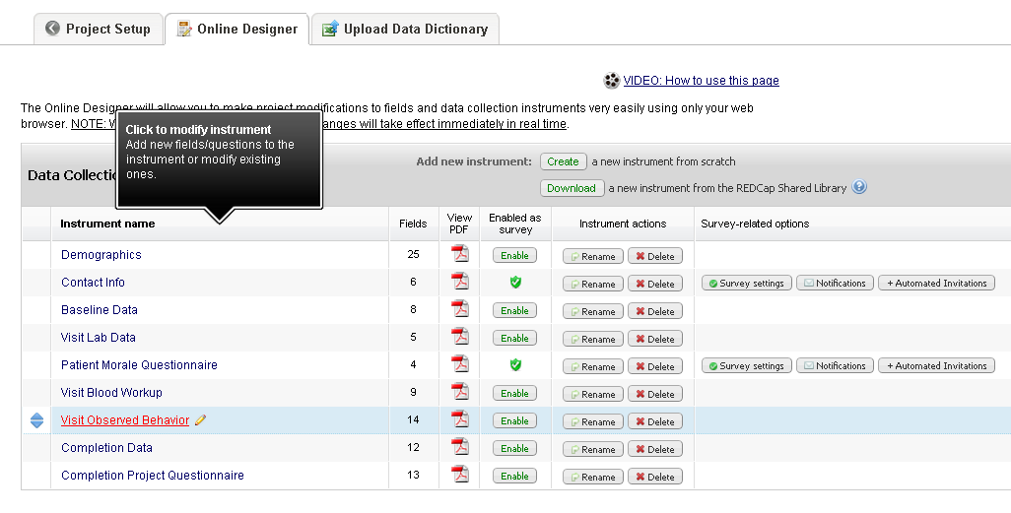
Collecting data at multiple Timepoints
Multiple Survey per Project
Notes:
You can add more instruments and enable multiple survey forms on single project

Slide 16
Before repeating instruments: two choices for project design
Collecting data at multiple Timepoints
Classic Project: only one of each instrument
  But you can always make a copy of an instrument
Longitudinal Project: forms can live within a repeating container called an event
Notes:
two choices for project design

Slide 17
Switching to Longitudinal Project
Collecting data at multiple Timepoints

Slide 18
Setting up longitudinal project
Collecting data at multiple Timepoints
1
2

Slide 19
1. Define events (and arms)
Collecting data at multiple Timepoints

Slide 20
2. Assign forms to events
Collecting data at multiple Timepoints

Slide 21
Arms
Collecting data at multiple Timepoints
What is “Arm” in Redcap
Why would I use Arms?
  Intervention Group vs Control Group in clinical trial study
  Case study: using Arms to model the relationship between patients and their caregivers
Notes:
What are “arms” in REDCap?
In REDCap an “arm” is a construct that allows study events to be grouped into a sequence. A REDCap project has one arm by default although this is only evident if your study is longitudinal.
Why would I use arms in REDCap?
Traditionally study arms (in a clinical trial for example) represent different sequences of assessments or treatments undertaken by the study participants. For example, in a clinical trial:
The intervention group may have a different study visit schedule from the control group.
The control group may not be subject to the same clinical procedures as the intervention group.
Both these scenarios would be handled by creating two different arms in REDCap and defining their event sequence and/or event CRFs to be differently in the two arms.
What else can I do with study arms?
For example, using Arms to model the relationship between patients and their caregivers in a pediatric study.
The study required the patient to answer a set of forms both before and after treatment.
The patient’s parents also needed to answer the same forms before and after treatment.
Two study arms: one called “patient” the other “parent”.
Each study arm contains “before” and “after” events
Each study form was then allocated to each event in each arm.
Each patient/parent pair was allocated a study ID and this ID was used to perform data entry for both the patient and their parent. When the data was exported for analysis the parent and the patient were each represented by a row of data and the two rows for the pair could be linked by the study ID.

Slide 22
Longitudinal Record Home Page
Collecting data at multiple Timepoints

Slide 23
So what’s wrong with longitudinal project?
Longitudinal projects impose a structure on data collection that make it difficult to collect ad-hoc data
You must add an event and add that form to the event (these are schema design operations) before you can capture data at a new timepoint
Since longitudinal forms must repeat within their event containers, it is clumsy to create forms that repeat independently of other forms
Notes:
Difficult to collect data whenever you want to, it has to follow the preset timepoints.

Slide 24
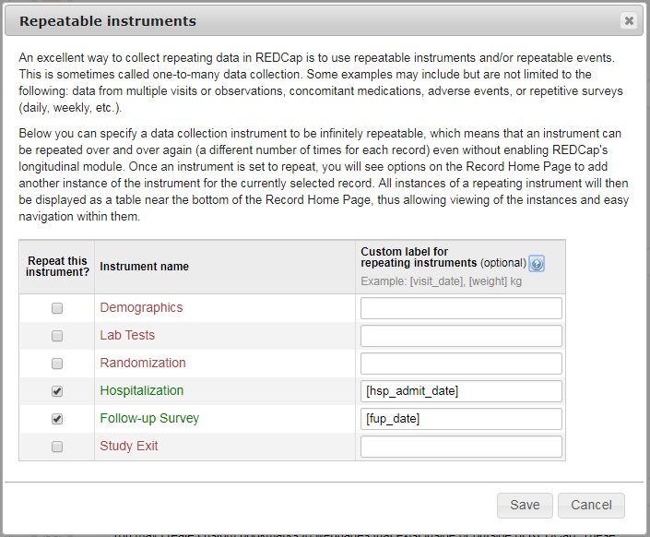
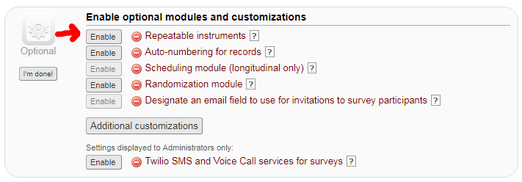
Collecting data at multiple Timepoints
Introducing Repeating Instrument

Slide 25
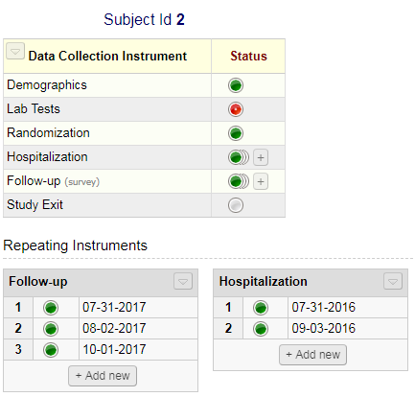
Adding instances
Collecting data at multiple Timepoints
Click Add new button or click [+] icon

Slide 26
Advantages that Repeating Instruments bring...
Collecting data at multiple Timepoints
Longitudinal projects impose a structure on data collection that make it difficult to collect ad-hoc data
  Repeating instruments make it easy to collect ad-hoc data
You must add an event and add that form to the event (these are schema design operations) before you can capture data at a new timepoint
  No schema change necessary to add a timepoint
Since longitudinal forms must repeat within their event containers, it is clumsy to create forms that repeat independently of other forms
  Every repeating instrument repeats independently of every other repeating instrument
Notes:
15 minutes, 11:20am

Slide 27
Automated Survey Invitations (ASIs), Alerts and Notifications
Objective:
How to automate survey invitations
Setup conditional alerts
Notes:
10 minutes, 11:30am
Activity: move to production! Collect real data

Slide 28
Automated Survey Invitations (ASI)
Automated Survey Invitations
  Introduction
  Step 1 – Composing the message
  Step 2 - Conditions
  Step 3 – Scheduling
  Step 4 – Activation
Alerts and Notifications
  Introduction
  Initial Setup
  Creating a new alert
  Example email
  Editing and options
  Notification log
Alerts and Notifications for Longitudinal Projects

Slide 29
ASIs - Introduction
When to use Automated Survey Invitation?
  Initial Baseline Survey is filled in and the patient is scheduled for a 3 month clinic appointment
  Patient fills in a survey regarding how they feel pre-op, ASIs can be sent 6, 12 and 18 months post-surgery
  The participant indicates that they are feeling depressed, a survey can be sent every 6 hours
The ASI will only work on records that meet the criteria AFTER the ASI has been abled.
Notes:
Because some ASIs can be extremely complicated, it is highly encouraged to test, test and test…and then test some more!

Slide 30
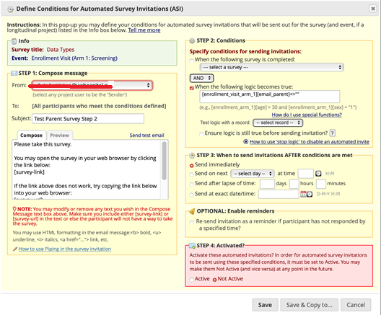
Automated Survey Invitations (ASIs)
Notes:
This is the Automated Survey Invitation set up screen. There’s a lot of information here so we’ll go through the various components individually. I’m using a longitudinal project just to show the complexity that is possible within a project. ASIs will work in a standard project as well.

Slide 31
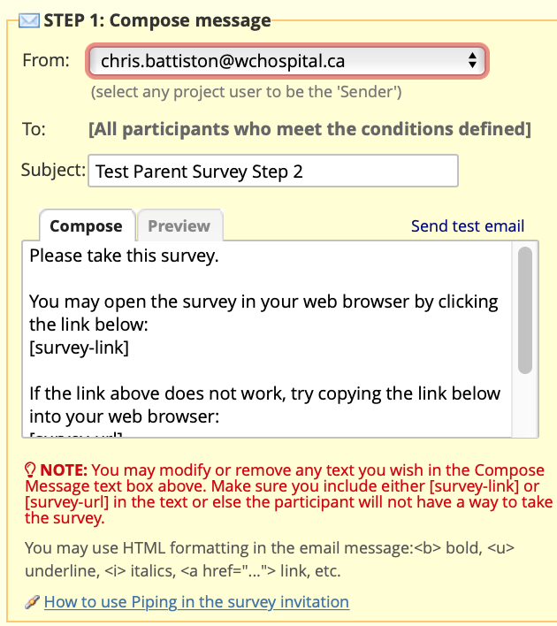
ASIs – Step 1 – Compose the Message
Notes:
The first step in setting up the ASI is setting up the actual message. If there are multiple people on the project, you can specify who the message is from.
Next, you fill in the Subject and the actual message. As the note says, be careful if you’re modifying or deleting any of the text to keep in the [survey-link] otherwise the person won’t have a way to go into the survey.
You can use basic HTML formatting and Piping to make the ASI even more user-friendly, and have the “From” field show any person who is a user in the project (this is really handy if you have different surveys, for example Social Work and Diet, and this way the participant can reply directly back to the member of the study team.

Slide 32
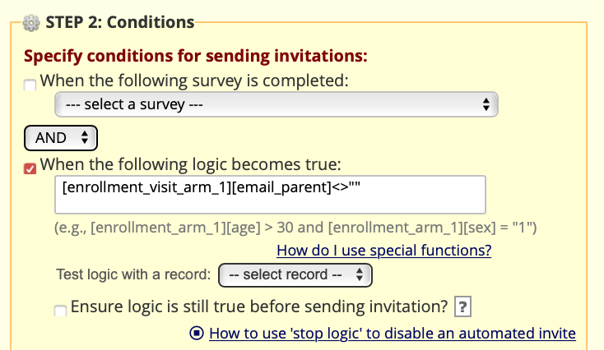
ASIs – Step 2 - Conditions
Notes:
The second step is building the criteria and conditions for the survey to be sent out. You can build as complex or as basic conditions you need. This can include conditional logic or calculations (ie 30 days after surgery). One thing to test and to ensure is a requirement of the project is the Ensure logic is still valid before sending.
If you click on the “?” to the right of the Ensure Logic, you’ll get a pop up indicating that this setting is optional for Automated Survey Invitations. When enabled, REDCap will re-evaluate the logic against the record's data values whenever the record values are changed AFTER the invitation has been scheduled but BEFORE it has been sent to the respondent. And if the logic is no longer true (i.e., if the data values have changed during the time after the survey invitation was scheduled), it will not send the invitation to the respondent but will instead delete it (as if it had never been scheduled). Additionally, if the invitations get deleted due to this setting, then the invitations *may* get scheduled again later if data values are changed such that the logic evaluates as true again. Enabling this setting provides you with greater control over when and how invitations get sent when using conditional logic for Automated Survey Invitations.
Please be careful using this. I had one project where the Invitations were scheduled to go out at 6am every Monday. The Project Administrator decided that she wanted this feature turned on, and as a result some patients ended up not getting an invitation at all (the ASI was based on a field that the participant could go in and revise, and as such, the logic came back as “FALSE” and didn’t send the email).

Slide 33
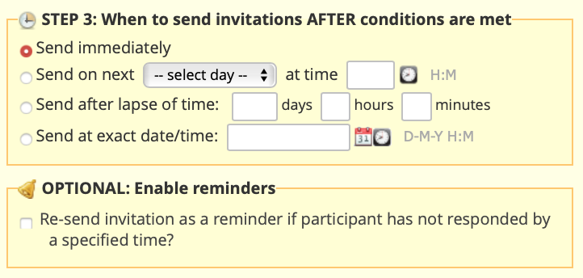
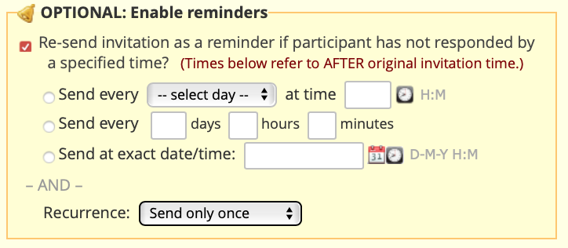
ASIs – Step 3 - Scheduling
Notes:
The third step is to specify when the invitation will be sent out. You can specify whether the email will be sent out as soon as the criteria is met, or on a specific date and time (for example, send all emails at 6am on Monday); after a specific amount of time has lapsed (3 days after the conditions are met) or send all the emails at an exact date and time (for example, July 12, 2020). You can also indicate that the participant should get a reminder; you can specify when the reminder should be sent and how often it should be sent.
I would recommend that if you’re using the “Send on Next day at time” option, that the Invitations are sent out at a non-peak time (for example, at 6am) to avoid potential bottlenecks on the server. I would also suggest that in the previous survey, a message is added (using Branching Logic with the same conditions as the ASI) that the message will be sent out at this date and time, and to check the Spam / Junk / Clutter folders if not in the Inbox.

Slide 34
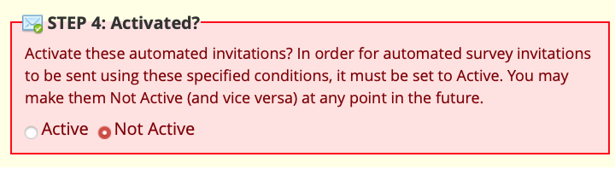
ASIs – Step 4 - Activation
Notes:
The final step is activating the ASI. You can click on the Active radio button and then click Save. Your ASI is now ready to be used!

Slide 35
Alerts and Notifications (A&Ns) - Introduction
When would you use Alerts and Notifications?
  Study looking at teen suicide ideation – email sent to the Social Worker and project team if a participant indicates “Yes”
  Email sent to the surgeon if the participant indicates a 7 or higher on the pain scale
  Clinical secretary gets notified when a patient selects a date for a follow-up visit
Notes:
The Alerts & Notifications feature allows you to construct alerts and send customized email notifications. These notifications may be sent to one or more recipients and can be triggered or scheduled when a form/survey is saved and/or based on conditional logic whenever data is saved or imported. When adding/editing an alert, you will need to 1) set how the alert gets triggered, 2) define when the notification should be sent (including how many times), and 3) specify the recipient, sender, message text, and other settings for the notification. For the message, you may utilize customized options such as rich text, the piping of field variables (including Smart Variables), and uploading multiple file attachments.
While similar in many respects to Automated Survey Invitations, Alerts & Notifications allow for greater complexity and have more capabilities. For example, alerts apply to both data entry forms and surveys, and they also allow for more options regarding who can be the recipient of a notification (project users, survey participants, etc.).

Slide 36
Alerts and Notifications (A&Ns) - Introduction
What’s the difference between an ASI and Alerts?
  ASIs are dependent on a survey being filled out; Alerts use either Forms or Surveys
  More options as to who can receive them
Notes:
The Alerts & Notifications feature allows you to construct alerts and send customized email notifications. These notifications may be sent to one or more recipients and can be triggered or scheduled when a form/survey is saved and/or based on conditional logic whenever data is saved or imported. When adding/editing an alert, you will need to 1) set how the alert gets triggered, 2) define when the notification should be sent (including how many times), and 3) specify the recipient, sender, message text, and other settings for the notification. For the message, you may utilize customized options such as rich text, the piping of field variables (including Smart Variables), and uploading multiple file attachments.
While similar in many respects to Automated Survey Invitations, Alerts & Notifications allow for greater complexity and have more capabilities. For example, alerts apply to both data entry forms and surveys, and they also allow for more options regarding who can be the recipient of a notification (project users, survey participants, etc.).

Slide 37
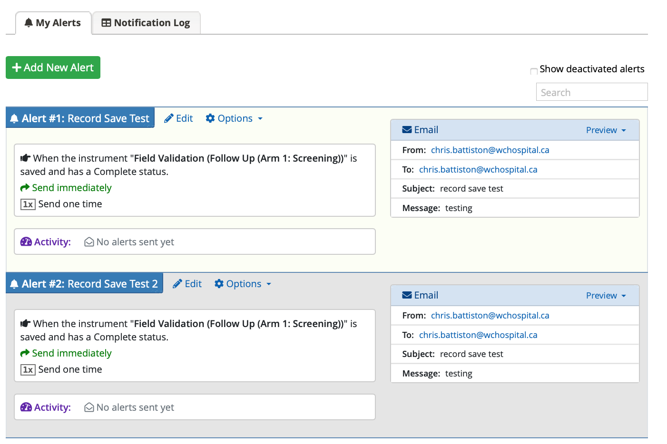
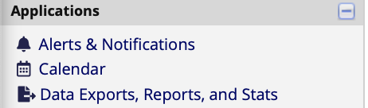
A&Ns – Step 1
Notes:
To get started with creating alerts, click the 'Add New Alert' button to view all the settings that must be defined for a given alert. Once an alert has been created, it immediately becomes active and may be triggered at any time thereafter.

Slide 38
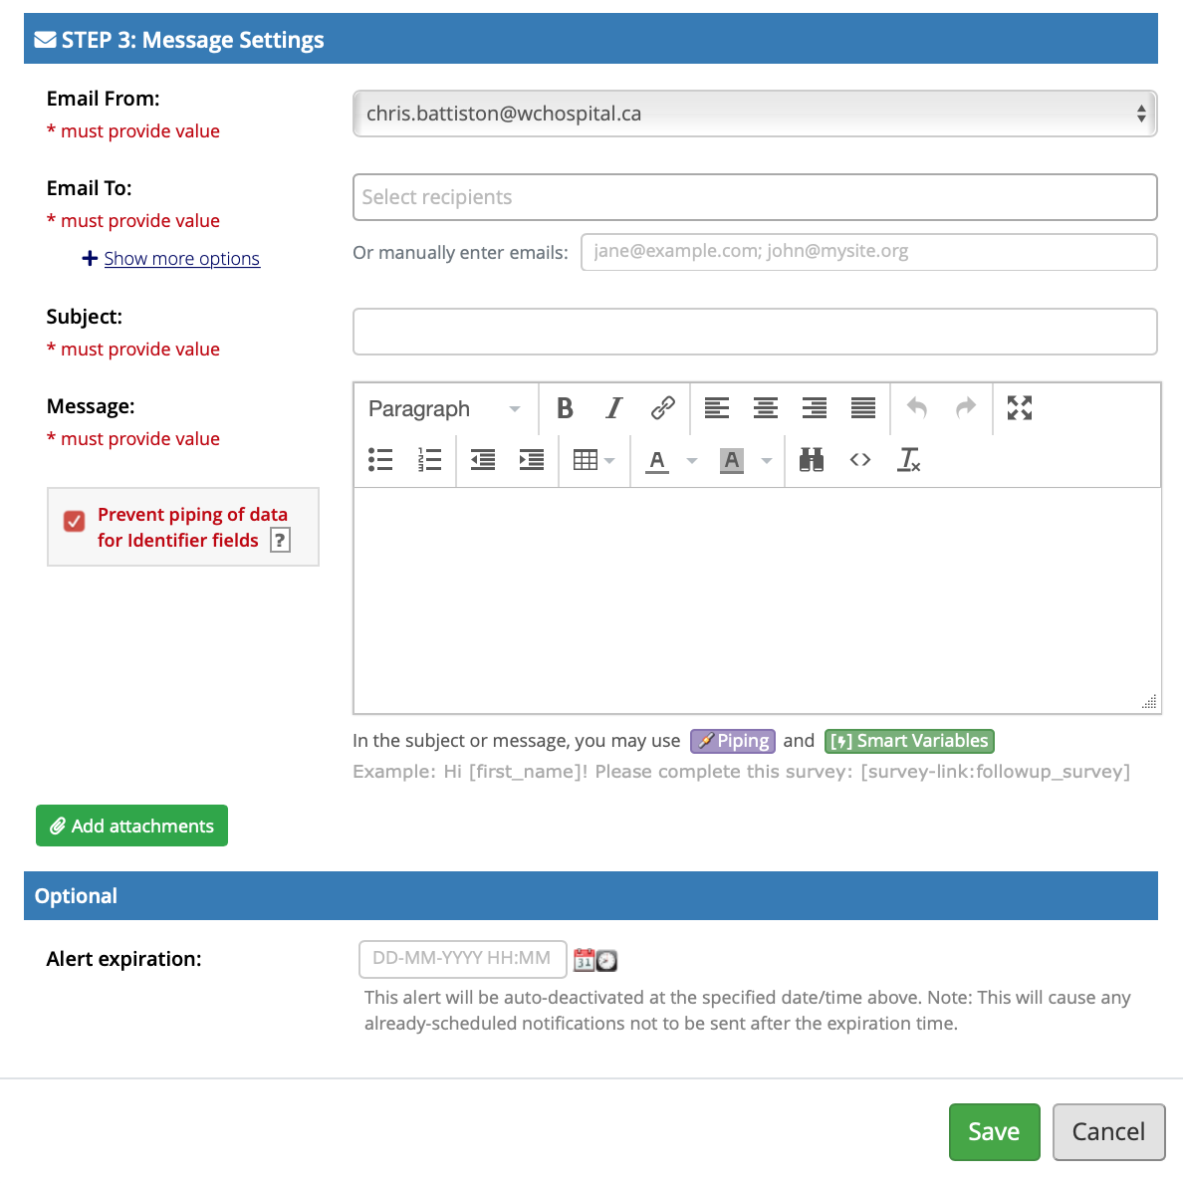
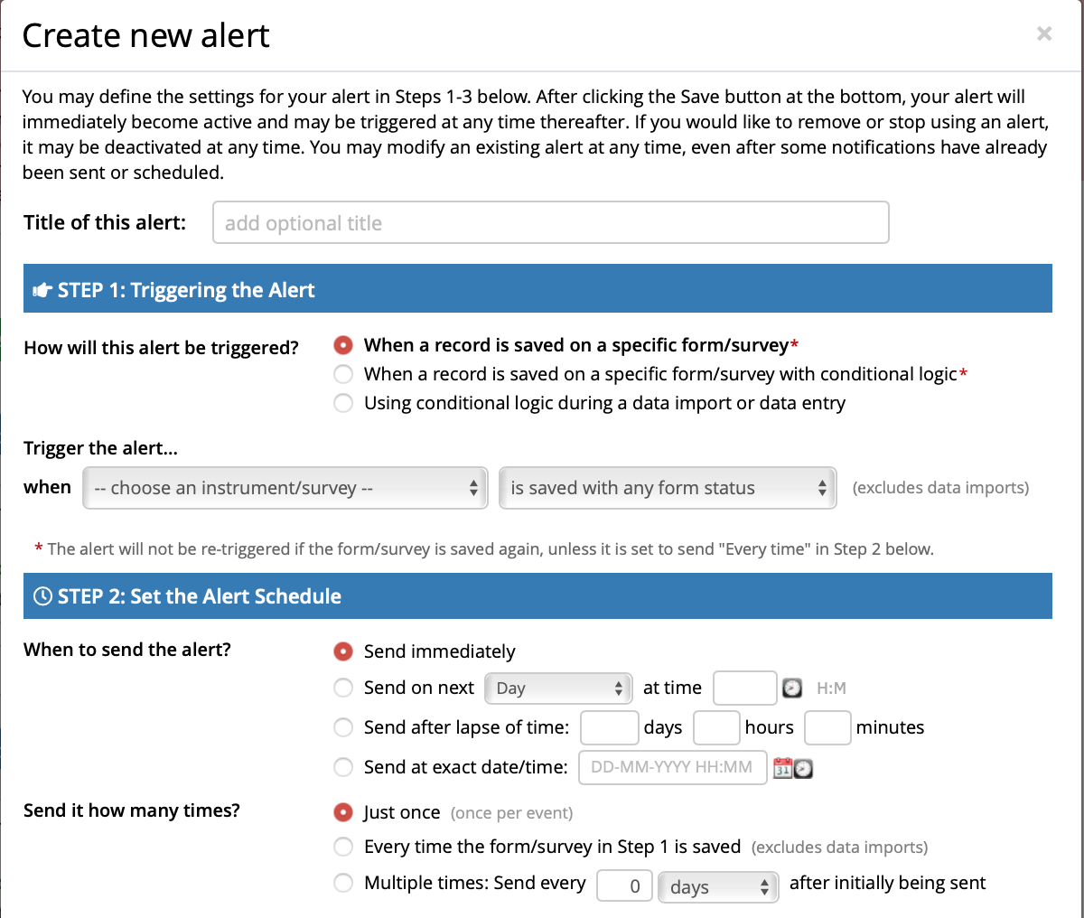
A&Ns – Creating a new alert
Notes:
There are 6 sections:
• Title of this alert
• Step 1: Triggering the Alert
• Step 2: Set the Alert Schedule
• Step 3: Message Settings
• Message Attachments
• Optional Automatic Alert Expiration
Enter the title of the alert; I tend to use FORM_TRIGGER_DESCRIPTOR (For example, DEMO_AGE_Under18)
2) Specify the trigger for the alert. There are 3 options to trigger the alert:
• When a record is saved on a specific form/survey
• When a record is saved on a specific form/survey with conditional logic
• Using conditional logic during import or data entry
Set the Alert Schedule by defining when the alert/notification should be sent (including how many times).
Specify the recipient, sender, message text, and other settings for the notification. For the message, you may utilize customized options such as rich text, the piping of field variables (including Smart Variables), and uploading multiple file attachments. If you click on the “Show More Options” link under the “Email To:” label, you’ll be provided fields for CC and BCC. If the Checkbox “Prevent Piping of data for Identifier Fields” is selected (which is the default), any field variables (e.g. date of birth) that exist in the alert’s subject or message will not have their value piped if the field has been flagged as an Identifier. In this case it will replace the data with [*DATA REMOVED*].
Optional Automatic Alert Expiration: you can require that the alert will be auto-deactivated at a specified time.
Click Save

Slide 39
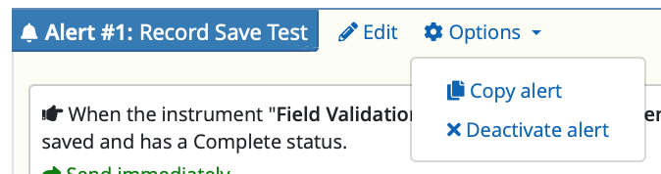
Alert Maintenance
Notes:
In the Alert Box, there are options to edit the alert, copy the alert and deactivate the alert. If you would like to remove or stop using an alert, see the Options->Deactivate Alert setting, which will prevent the alert from being triggered anymore. It may also be re-enabled at any time, in which case it becomes immediately active again.

Slide 40
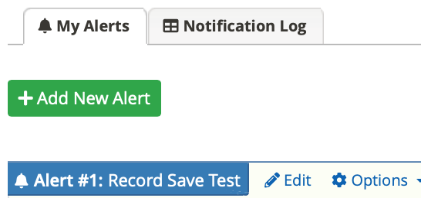
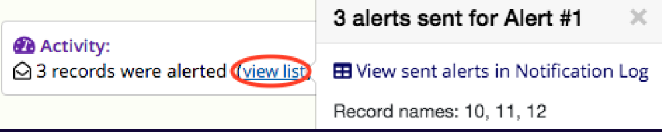
Notification Log
Notes:
To view the alert activity, click on the “Notification Log” tab or click on “view list” in the Activity box (NOTE: View List does not show up until at least 1 alert has been triggered)
Second screen shot taken from University of Florida’s documentation.

Slide 41
Notification Log
Notes:
Screenshot taken from University of Florida’s documentation; same screen as the Survey Notifications but now with additional types of events. Click on the View Past Notifications to see those that are already sent, and Future Notifications to see the ones that will be sent later. NOTE: because the data that Alerts and Notifications are based on is potentially highly dynamic, it’s recommended that the Future Notifications not be used for troubleshooting etc; a record that didn’t have a trigger today may have one tomorrow.

Slide 42
Alerts and Notifications and Longitudinal Projects
You can choose the Event and / or the Arm associated with the instrument/survey to trigger when the alert is sent.
  Example: [event_1_arm_1][field]
  [baseline_arm_1][age]
Notes:
As usual, REDCap allows for a huge amount of flexibility and adaptability within various projects. When you have a longitudinal project, the way we will access the data will be slightly different – but if you’ve done piping in a longitudinal project, you already know the basic syntax.
Go into the Longitudinal Project you created and click on the Alerts and Notifications link under applications.

Slide 43
Alerts and Notifications – Longitudinal

Slide 44
Triggering the Alert
Notes:
Example of how to set up an alert using the Consent field on the Initial Data form

Slide 45
Creating the message
Notes:
Example of the Message Settings – screen shot from the University of Florida. Note that the screen is similar to the Standard Project Alerts and Notifications, but that the information in the Message box has longitudinal-specific piping.

Slide 46
Alerts&Notification Logging
Notes:
10 minutes, 11:30am;
As with other notifications, the Event and Arm are both documented in the Log, making troubleshooting and verification relatively simple.

Slide 47
Reminders and Recap
REDCap @ RBHS
  https://research.njms.rutgers.edu/redcap
Training Videos and Tutorial
  https://research.njms.rutgers.edu/redcap/index.php?action=training
  https://research.njms.rutgers.edu/redcap/index.php?action=help
Cite REDCap in Papers
  https://projectredcap.org/resources/citations/

Slide 48
Reminders and Recap
Recommended to explore:
Randomization
e-Consent
Twilio SMS
Notes:
5 – 10 minutes 11:40am

Slide 49
Questions?
redcap@njms.rutgers.edu
or hw289@njms.rutgers.edu
(973) 972-5237
Office of Research MSB-F633
New Jersey Medical School​
185 S Orange Ave, Newark, NJ 07103

