Slide 1
REDCap for Research Data Collection and Management
Basic User Session for NJACTS
Han Wu, MS
Data Architect
Office of Research, New Jersey Medical School
November 13, 2020

Slide 2
Introduction
REDCap is a secure web application for building and managing online surveys and databases.
Developed at Vanderbilt in 2004; NIH grant support
Collect virtually any type of data in any environment
Compliance with 21 CFR Part 11, FISMA, HIPAA
Support online and offline data capture for research studies
Standard database platform in all 60 CTSA awarded institutions
Notes:
REDCap is a secure web application for building and managing online surveys and databases. While REDCap can be used to collect virtually any type of data in any environment (including compliance with 21 CFR Part 11, FISMA-Federal Information Security Management Act of 2002, HIPAA), it is specifically geared to support online and offline data capture for research studies and operations. The REDCap Consortium, a vast support network of collaborators, is composed of thousands of active institutional partners in over one hundred countries who utilize and support their own individual REDCap systems.

Slide 3
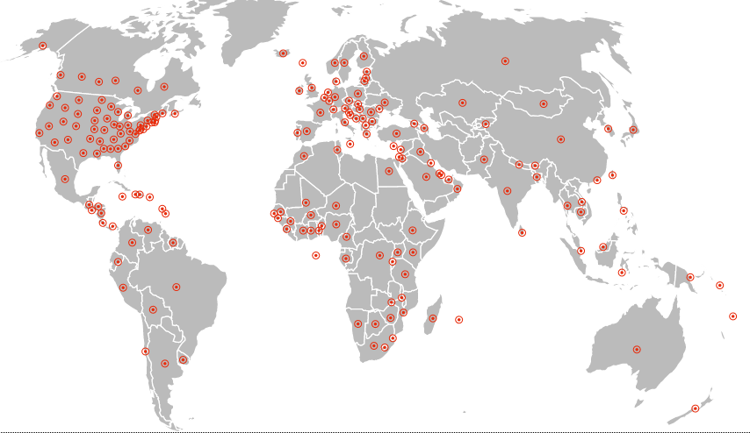
Introduction
4,641 active partners in 139 countries
Over 1 million projects
Over 1.5 million users
Notes:
In a nutshell: The REDCap Consortium has 4,641 active partners in 139 countries. REDCap software has generated over 1,044,000 projects from over 1,504,000 users. 11,786 journal articles cite REDCap.

Slide 4
Introduction
Usage @
2,105 active users
1,610 total projects
Notes:
2,105 active users
1,610 total projects

Slide 5
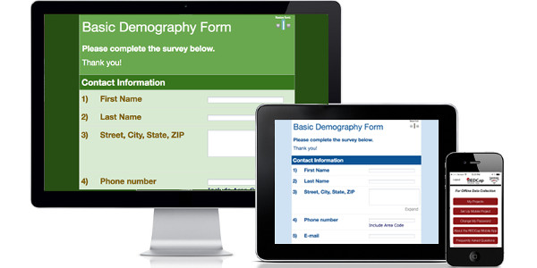
Introduction
Cross platform
Mobile friendly

Slide 6
Getting Started
- Log into REDCap
RWJMS: https://redcap.rwjms.rutgers.edu/
CINJ: https://redc.cinj.rutgers.edu/redcap/
All others: https://research.njms.rutgers.edu/redcap
Notes:
For RBHS users and non-RBHS users (Princeton, NJIT) and collaborators from other institutions.

Slide 7
Getting Started
- User Account
Has Rutgers NetID
I do not have Rutgers NetID
Notes:
Rutgers NetID login credentials
Non Rutgers local account: if you are from Princeton or NJIT, contact Han Wu to get account access, providing affiliation, email address, name.

Slide 8
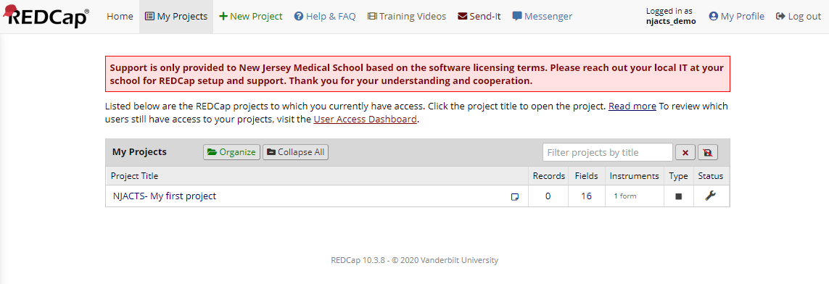
Getting Started
- Your home screen
Notes:
Get familiar with the user interface: Home, My Projects, +New Project, Help&FAQ, Training Videos, Messenger

Slide 9
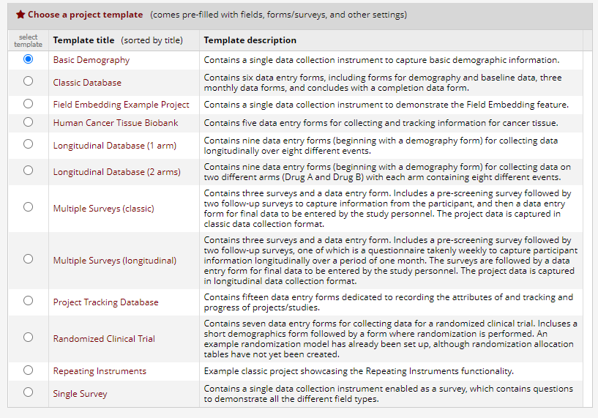
Getting Started
- Project Templates
Notes:
1.3.1 Go over templates

Slide 10
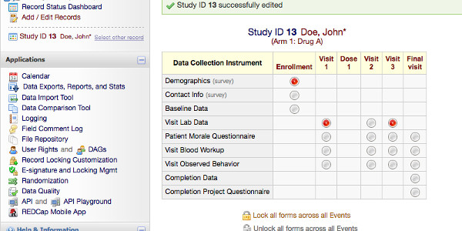
Getting Started
- Type of Projects
Classic
Longitudinal
Notes:
Classic: For single time-point data collection (when you use a form once)
Longitudinal: For many time-points data collection (when you use a form multiple times, namely forms in a longitudinal project can be completed repeatedly for a single record)

Slide 11
Getting Started
- Type of Data Collection
Data Entry Form
For research team to enter data
Surveys
When participants answer questionnaires or surveys about something
Notes:
Data entry
When would you use data entry? When the research team is entering data into REDCap, not participants of the research project
Surveys
When would you use surveys? When participants answer questionnaires or surveys about something.
More on this in “Building Data Collection Instrument for REDCap Survey”

Slide 12
Building Your First Instrument
Objective:
Create a data collection instrument
learn how to add different field types/components
Notes:
Objective: Create an instrument, learn how to add different field types and field components
Activity: add different field types, code answer choices
Text-based step-by-step instruction can be found in my separate document “Building Data Collection Instrument for REDCap Survey”
Go through steps by browser during workshop

Slide 13
Building Your First Instrument
- Options for instrument creation
Online Designer
create forms from scratch
Data Dictionary
import via Excel
REDCap Shared Library
pre-created forms (e.g., PROMIS, etc)
REDCap Shared Library is a global repository of data collection instruments that can be downloaded and used in your REDCap projects.
Zip file
copy a form from one project to another
From another REDCap
Notes:
Overview of instrument creation and import options
Online Designer – create forms online through REDCap platform
Data Dictionary – import via Excel
REDCap Shared Library – pre-created forms (e.g., PROMIS, etc), REDCap Shared Library is a global repository of data collection instruments that can be downloaded and used in your REDCap projects.
Zip file – copy a form from one project to another

Slide 14
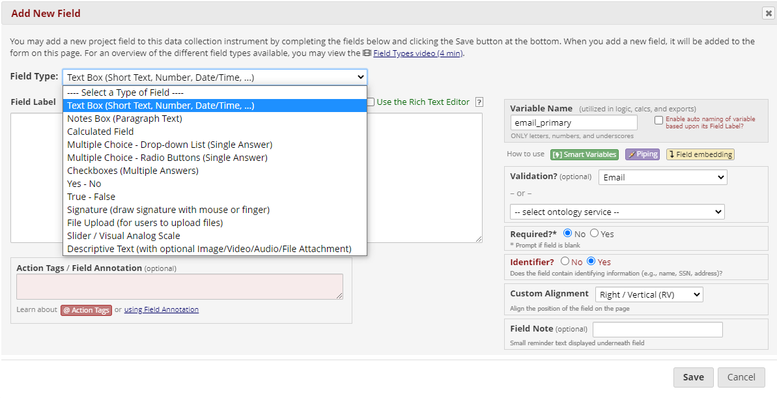
Building Your First Instrument
Notes:
Textbox for short text field
Note box for long text
Calculated field, which means you can add your mathematical or statistical equations in
Multiple choice, in the forms of dropdown or radiobutton
Checkboxes
Yes or no, true or false
Signature panel where you can draw
Descriptive text panel where you can add multimedia stuff including video, audio clip in different formats.

Slide 15
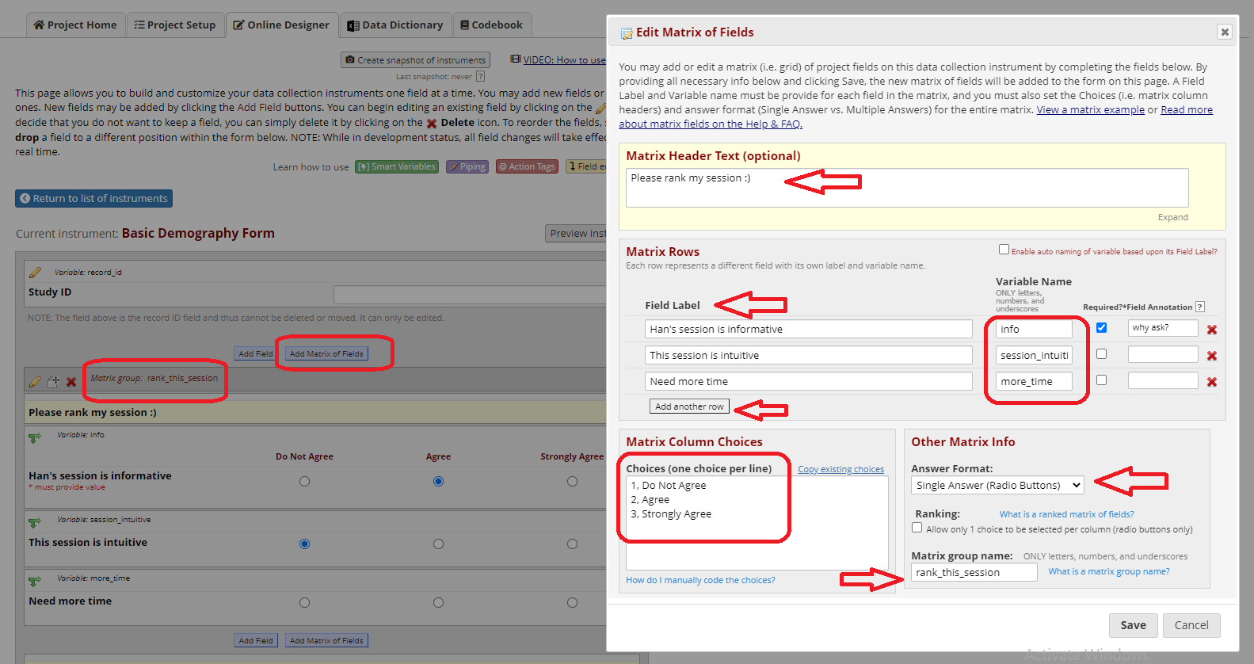
Building Your First Instrument
Notes:
Demo Yes/No
Multiple choices: checkbox, radiobutton
File upload
Define Branching Logic

Slide 16
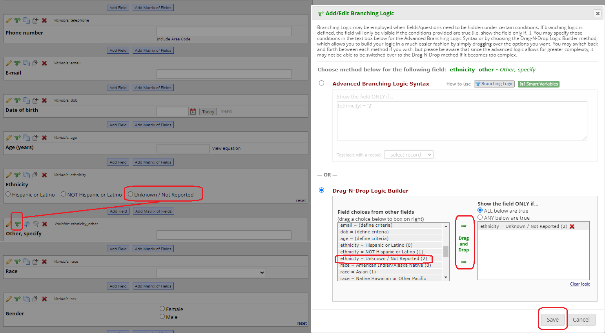
Building Your First Instrument
Notes:
Demo Yes/No
Multiple choices: checkbox, radiobutton
File upload
Define Branching Logic

Slide 17
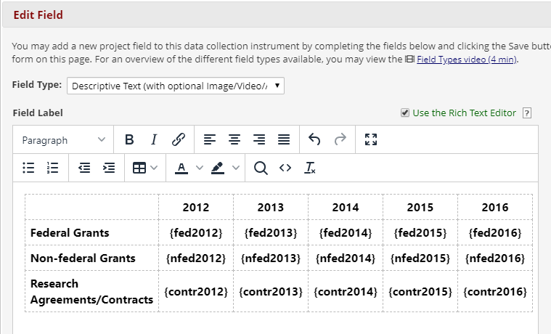
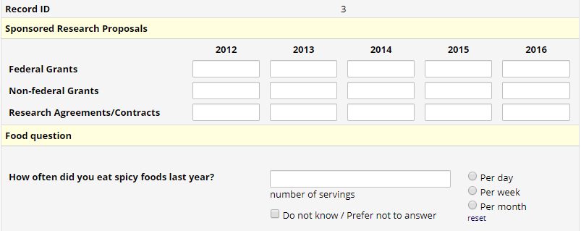
Building Your First Instrument
- Reposition fields on the form using Embedding Field with Action Tags
Notes:
Action tags and Embedding Field:
What is Field Embedding?
The 'Field Embedding' feature in REDCap is the ultimate way to customize your surveys and data collection instruments to make them look exactly how you want. Field Embedding allows you to reposition field elements on a survey page or data entry form so that they get embedded in a new location on that same page. Embedding fields gives you greater control over the look and feel of your instrument. For example, you may place fields in a grid/table for a more compact user-friendly page, or you can position some fields close together in a group if they are related. See the screenshots below for examples of what field embedding looks like and how to utilize this powerful feature.
How to embed a field
The steps below illustrate the basic template for embedding a field.
First, create the field. The field must exist first before it can be embedded elsewhere. Note: You do not necessarily have to add a Field Label to the field because that label will ultimately be hidden when the field gets relocated elsewhere on the page.
Place the REDCap variable name of the field you wish to embed inside braces/curly brackets - e.g., {date_of_birth} - and place it in the Field Label, Field Note, Section Header, or Choice Label of another field on that same instrument. Field embedding will not work across instruments but only on the current instrument/survey being viewed. If on a multi-page survey, then the embedded field must be on the same survey page as its host field. We encourage you to utilize the rich text editor heavily to get the field to look exactly how you want.

Slide 18
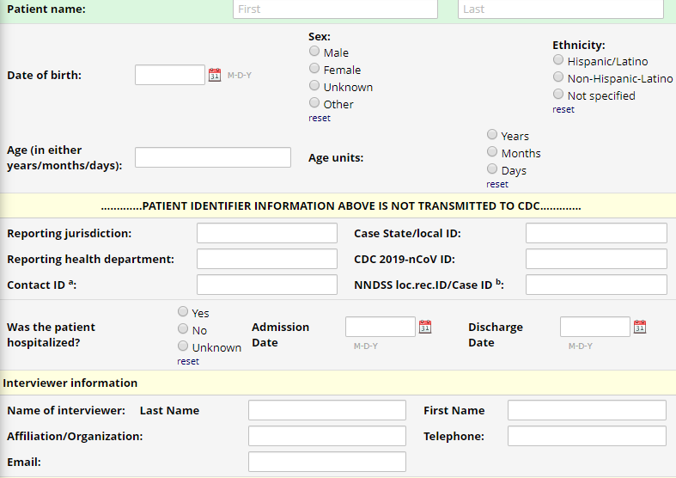
Building Your First Instrument
- Reposition fields on the form using Embedding Field with Action Tags
Notes:
Action tags and Embedding Field:
What is Field Embedding?
The 'Field Embedding' feature in REDCap is the ultimate way to customize your surveys and data collection instruments to make them look exactly how you want. Field Embedding allows you to reposition field elements on a survey page or data entry form so that they get embedded in a new location on that same page. Embedding fields gives you greater control over the look and feel of your instrument. For example, you may place fields in a grid/table for a more compact user-friendly page, or you can position some fields close together in a group if they are related. See the screenshots below for examples of what field embedding looks like and how to utilize this powerful feature.
How to embed a field
The steps below illustrate the basic template for embedding a field.
First, create the field. The field must exist first before it can be embedded elsewhere. Note: You do not necessarily have to add a Field Label to the field because that label will ultimately be hidden when the field gets relocated elsewhere on the page.
Place the REDCap variable name of the field you wish to embed inside braces/curly brackets - e.g., {date_of_birth} - and place it in the Field Label, Field Note, Section Header, or Choice Label of another field on that same instrument. Field embedding will not work across instruments but only on the current instrument/survey being viewed. If on a multi-page survey, then the embedded field must be on the same survey page as its host field. We encourage you to utilize the rich text editor heavily to get the field to look exactly how you want.

Slide 19
Building Your First Instrument
Piping
Calculated Fields
Notes:
Action tags and Embedding Field:
What is Field Embedding?
The 'Field Embedding' feature in REDCap is the ultimate way to customize your surveys and data collection instruments to make them look exactly how you want. Field Embedding allows you to reposition field elements on a survey page or data entry form so that they get embedded in a new location on that same page. Embedding fields gives you greater control over the look and feel of your instrument. For example, you may place fields in a grid/table for a more compact user-friendly page, or you can position some fields close together in a group if they are related. See the screenshots below for examples of what field embedding looks like and how to utilize this powerful feature.
How to embed a field
The steps below illustrate the basic template for embedding a field.
First, create the field. The field must exist first before it can be embedded elsewhere. Note: You do not necessarily have to add a Field Label to the field because that label will ultimately be hidden when the field gets relocated elsewhere on the page.
Place the REDCap variable name of the field you wish to embed inside braces/curly brackets - e.g., {date_of_birth} - and place it in the Field Label, Field Note, Section Header, or Choice Label of another field on that same instrument. Field embedding will not work across instruments but only on the current instrument/survey being viewed. If on a multi-page survey, then the embedded field must be on the same survey page as its host field. We encourage you to utilize the rich text editor heavily to get the field to look exactly how you want.

Slide 20
Data Collection and Project Management
Objective:
Control your data collection
Project management
Notes:
Objective: Project management, how to make changes and maintain data integrity
Activity: move to production! Collect real data

Slide 21
Data Collection and Project Management
Review Project Setup
Project Settings
Optional Modules and Customization
User Rights and Permissions
Test your project thoroughly
Move project to Production
Development vs Production
Notes:
Optional modules/customization
Development mode vs Production Mode
Only test data should be collected in Development
Move the project to production status so that real data may be collected. Once in production, you will not be able to edit the project fields in real time anymore. However, you can make edits in Draft Mode, which will be auto-approved or else might need to be approved by a REDCap administrator before taking effect.

Slide 22
Enable Survey to Collect Data
Objectives
Enable survey on existing data collection instrument
Survey settings
Survey distribution
Define automated invitation and scheduling rules
Survey reminders
Save and return later
Notes:
Optional modules/customization
Development mode vs Production Mode
Only test data should be collected in Development
Move the project to production status so that real data may be collected. Once in production, you will not be able to edit the project fields in real time anymore. However, you can make edits in Draft Mode, which will be auto-approved or else might need to be approved by a REDCap administrator before taking effect.

Slide 23
Enable Survey to Collect Data
Public Survey
Generic survey link, same for all participants
Responses are anonymous unless the form collects email/other identifiable data
Only one Public Survey link per project
All public survey responses create a new record/participant and are auto-numbered
Notes:
Optional modules/customization
Development mode vs Production Mode
Only test data should be collected in Development
Move the project to production status so that real data may be collected. Once in production, you will not be able to edit the project fields in real time anymore. However, you can make edits in Draft Mode, which will be auto-approved or else might need to be approved by a REDCap administrator before taking effect.

Slide 24
Enable Survey to Collect Data
Survey Settings
Customize survey design here
Title, Instruction, Logo, Theme, Formatting
Completion confirmation options (acknowledgement on screen, redirect, email etc.)
Survey access and termination options
Notes:
Optional modules/customization
Development mode vs Production Mode
Only test data should be collected in Development
Move the project to production status so that real data may be collected. Once in production, you will not be able to edit the project fields in real time anymore. However, you can make edits in Draft Mode, which will be auto-approved or else might need to be approved by a REDCap administrator before taking effect.

Slide 25
Enable Survey to Collect Data
Default style vs Enhance style
Notes:
Optional modules/customization
Development mode vs Production Mode
Only test data should be collected in Development
Move the project to production status so that real data may be collected. Once in production, you will not be able to edit the project fields in real time anymore. However, you can make edits in Draft Mode, which will be auto-approved or else might need to be approved by a REDCap administrator before taking effect.

Slide 26
Enable Survey to Collect Data
More
Using STOP action
Survey Notifications (for team)
Survey Queue (for multiple survey forms)
Survey Participant List
Notes:
ASI vs. Survey Queue
ASI: Emails survey link to your participants (based on conditional logic)
Survey Queue: compiles a customized link of all surveys into one link, does NOT email the link to participants
Tip: It is very common to use ASI’s and Survey Queue together: survey queue to link surveys together, and ASI to send ONE link to participant (usually first survey)
The Participant List option allows you to send a customized email to anyone in your list and track who responds to your survey.
Requires participant email address
Each participant receives a unique survey link to complete the survey
Responses can be anonymous (email address separate from data) or identified
To identify a response, provide an Identifier when adding each participant to the participant list (must click 'Enable' under ‘Participant Identifier’ first)
Participant Identifier displays as a separate field in the exported data
Use caution if using both the Participant List and ASI’s – if you add the same email to both, you may inadvertently create duplicate records in your study.
Tip: All survey responses collected are considered anonymous unless you 1) are using Participant Identifiers or 2) have enabled the designated email field for invitations.

Slide 27
Enable Survey to Collect Data
Multiple Survey per Project
Notes:
You can add more instruments and enable multiple survey forms on single project

Slide 28
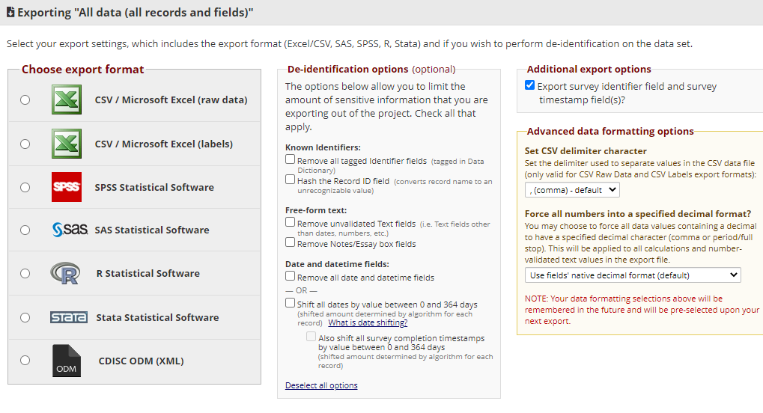
Data Export and Reporting
Notes:
ASI vs. Survey Queue
ASI: Emails survey link to your participants (based on conditional logic)
Survey Queue: compiles a customized link of all surveys into one link, does NOT email the link to participants
Tip: It is very common to use ASI’s and Survey Queue together: survey queue to link surveys together, and ASI to send ONE link to participant (usually first survey)
The Participant List option allows you to send a customized email to anyone in your list and track who responds to your survey.
Requires participant email address
Each participant receives a unique survey link to complete the survey
Responses can be anonymous (email address separate from data) or identified
To identify a response, provide an Identifier when adding each participant to the participant list (must click 'Enable' under ‘Participant Identifier’ first)
Participant Identifier displays as a separate field in the exported data
Use caution if using both the Participant List and ASI’s – if you add the same email to both, you may inadvertently create duplicate records in your study.
Tip: All survey responses collected are considered anonymous unless you 1) are using Participant Identifiers or 2) have enabled the designated email field for invitations.

Slide 29
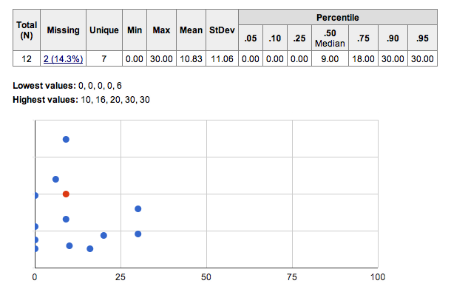
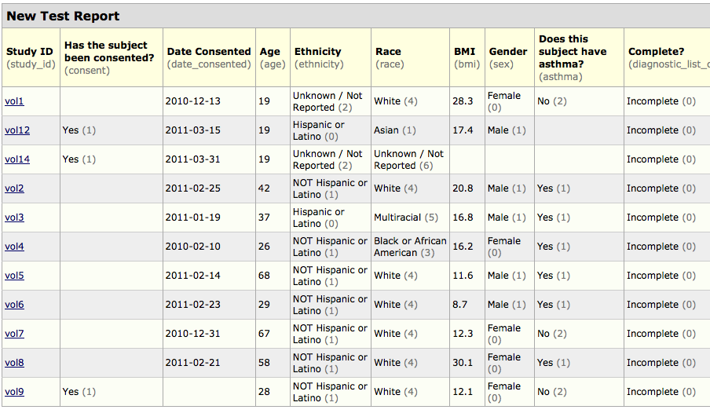
Data Export and Reporting
Graphics Data View & Stats
Notes:
ASI vs. Survey Queue
ASI: Emails survey link to your participants (based on conditional logic)
Survey Queue: compiles a customized link of all surveys into one link, does NOT email the link to participants
Tip: It is very common to use ASI’s and Survey Queue together: survey queue to link surveys together, and ASI to send ONE link to participant (usually first survey)
The Participant List option allows you to send a customized email to anyone in your list and track who responds to your survey.
Requires participant email address
Each participant receives a unique survey link to complete the survey
Responses can be anonymous (email address separate from data) or identified
To identify a response, provide an Identifier when adding each participant to the participant list (must click 'Enable' under ‘Participant Identifier’ first)
Participant Identifier displays as a separate field in the exported data
Use caution if using both the Participant List and ASI’s – if you add the same email to both, you may inadvertently create duplicate records in your study.
Tip: All survey responses collected are considered anonymous unless you 1) are using Participant Identifiers or 2) have enabled the designated email field for invitations.

Slide 30
Reminders and Recap
What we learned today
Create data collection instrument for Data Entry and Survey
Manage your projects and survey
Get your data in
Notes:
Tip: Testing your project while in Development mode is the best way for you to ensure that your survey functions as expected. These steps, no matter your survey design, allow you to test invitations, reminders, and other features. Testing allows you to verify what the survey will present to your participants and is an essential part of your project development. We always recommend testing well before you are ready to move to Production and collect real data.

Slide 31
Reminders and Recap
REDCap @ RBHS
https://research.njms.rutgers.edu/redcap
Training Videos and Tutorial
https://research.njms.rutgers.edu/redcap/index.php?action=training
https://research.njms.rutgers.edu/redcap/index.php?action=help
Cite REDCap in Papers
https://projectredcap.org/resources/citations/

Slide 32
Questions?
redcap@njms.rutgers.edu
or hw289@njms.rutgers.edu
(973) 972-5237
Office of Research MSB-F633
New Jersey Medical School​
185 S Orange Ave, Newark, NJ 07103

