Slide 1
Introduction to Data Mining and Machine Learning in Python
Dantong Yu
Associate Professor
Martin Tuchman School of Management
Guest Scientist
In Brookhaven National laboratory

Slide 2

Instructor Bio
Professor Dantong Yu is the Co-Director of the Center for Big Data at New Jersey Institute of Technology (NJIT) and was the Ph.D. program director in Business Data Science at Martin Tuchman School of Management. Dantong Yu received a BS degree in computer science from Peking University and a Ph.D. degree in Computer Science from University at Buffalo. He joined Martin Tuchman School of Management at New Jersey Institute of Technology in 2016. He works on real-world data intensive science application programs funded by Department of Energy. He has published 70 papers in leading technical journals and conferences. He has served on the review panels for NSF, DOE Early Career Investigator and DOE SBIR/STTR. He is the PC member of KDD, ICDM, CIKM, ICDE, and AAAI.

Slide 3
Outline
Motivation on Data Mining
Introduction to Data Mining: what is data mining, data mining topics, data mining process, and difference between data mining and machine learning, terminology
Data Mining Traps
Data Mining and Machine Learning Algorithms
  Unsupervised Learning
    Cluster and Principal Component Analysis
  Supervised Machine Learning
    Regress
    Logistic Regress
    Support Vector Machine
    Decision Tree
    Neural Networks

Slide 4
Schedule
12:00-2:00pm Presentation
2:00-2:15PM, Break
2:15-2:45PM, Hands-on Tutorial.
2:45-3:30PM, Breakout 3TAs (2:00)
3:30-3:45PM, Question and Answer and Fill in Survey

Slide 5


Slide 6
Value-added in predictive science analysis
Hurricane Irma
What is needed in addition to Wood board, bottle water.
What about strawberry poptarts, under-ware?
Did you hear Signet Bank in Virginia?
Customer Churn
Notes:
Wal-Mart Stores decided that the Hurricane situation offered a great opportunity for their newest data-driven decision making… predictive technology.
To ensure that local Wal-Marts are properly stocked, they need to mine the data and reveal a particular item will be sold out in the hurricane’s path.
It turns out Stawberry Poptarts are the most popular items.
The second story is about the Signet Bank that great exemplifies data science capability as a strategic asset. Around 1990, two strategic visionaries (Richard Fairbanks and Nigel Morris) realized that information technology was powerful enough that they could do more sophisticated predictive modeling and offer different terms (nowadays: pricing, credit limits, low-initial-rate balance transfers, cash back, loyalty points, and so on). These two men had no success persuading the big banks to take them on as consultants and let them try. they succeeded in garnering the interest of a small regional Virginia bank: Signet Bank.
You may not have heard of little Signet Bank, but if you’re reading this book you’ve probably heard of the spin-off: Capital One. I do not have to repeat the success of Capital One bank in customer credit industry.

Slide 7
Data Mining
A set of principles, concepts, and techniques that structure thinking and analysis of data
Extracts useful information and knowledge from large volumes of data by following a process with reasonably well defined steps
Changes the way you think about data and its role in business
    A common understanding: you have valuable data, you have an edge in competition
    Data is asset once you can extract non-obvious insight from data. It is an asset playing the vital role.

Slide 8
How It All Fits Together
High dim. data
Locality sensitive hashing
Clustering
Graph
data
PageRank, SimRank
Community
Link Prediction
Infinite
data
Filtering data streams
Web advertising
Dimensionality reduction
Graph Node Representation
Streaming Data Analytics
Machine learning
SVM
Decision Trees
Perceptron, kNN
Apps
Recommender systems
Association Rules
Duplicate document detection

Slide 9
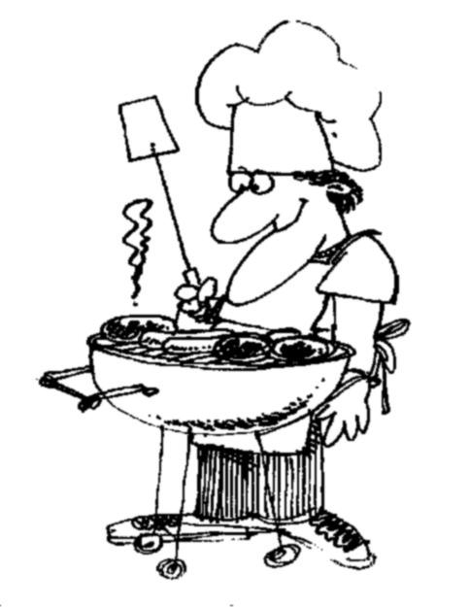
How do you want that data?
I ♥
data
Notes:
Chemistry is not test tubes and elements. Data Science is not about tools and data. Culinary is not about food and cooking utensil.
Data science commonly includes analytical skills and techniques for understanding data, popular tools used (You have to master some tools to have practical experience),
and good quality of data, most important (creation, theory, principals). Different peoples derives different results from the same set of data.

Slide 10
Business data mining is a process
science + craft + creativity + common sense
a data mining process
Notes:
The science here: complexity, data structure, algorithmic details, domains specific (market efficiency theory and efficient market hypothesis (EMH), Black-Scholes model)
Craft: Particular tools, algorithms, and data mining systems
Creative: from your business sense (which signal is essential)?
Common Sense: Whether you approach, data selection and the outcomes make sense? It is a trade-off between trivially obvious and profoundly specific.

Slide 11
Data Opportunities
Volume of data
Variety of data
Powerful computers
Better algorithms
Notes:
Everyone talks about the big data, Vs,
Powerful computers, Nvidia GPUs, Moore Laws, Neural Chips for hardware accelerations.
Better algorithms: power statistical optimization algorithms, deep neural networks for feature extractions, classifications and regressions.

Slide 12
General Learning Goals for Data Scientist
Approach Real Problems data-analytically
Hands-on experience mining data
  Every good chemist has to be a competent lab technician
  A good data scientist (business) must be proficient with certain languages, tools and software system.

Slide 13
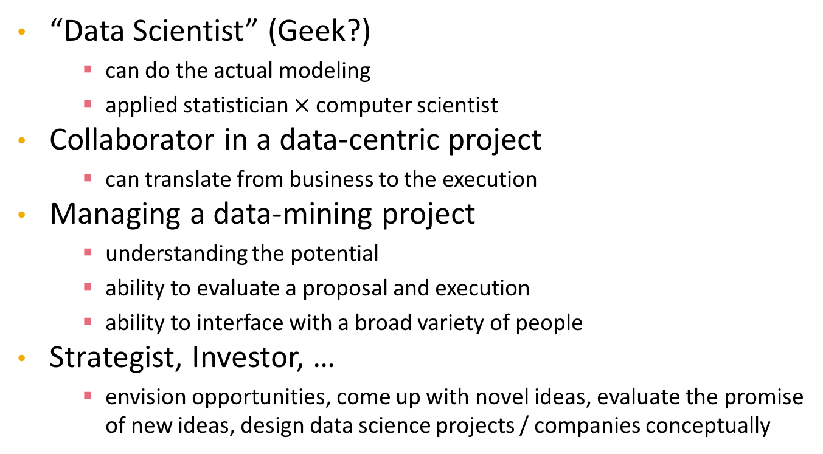
Roles in Data Mining
“Data Scientist” (Geek?)
    can do the actual modeling
    applied statistician $×$ computer scientist
Collaborator in a data-centric project
    can translate from business to the execution
Managing a data-mining project
    understanding the potential
    ability to evaluate a proposal and execution
    ability to interface with a broad variety of people
Strategist, Investor, …
    envision opportunities, come up with novel ideas, evaluate the promise of new ideas, design data science projects / companies conceptually

Slide 14
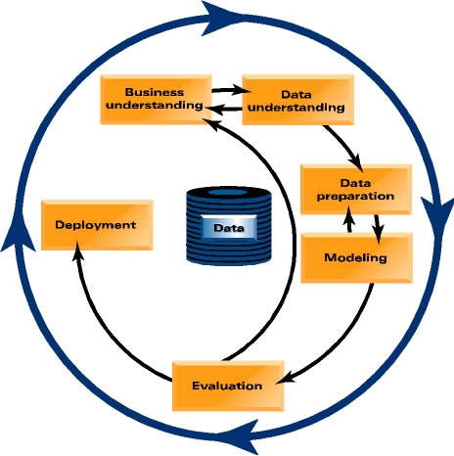
Data Mining Process
Business Understanding
Data Understanding
Data Preparation
Modeling
Evaluation
Deployment

Slide 15
Data Mining versus…
Data Warehousing / Storage
    Data warehouses coalesce data from across an enterprise, often from multiple transaction-processing systems
Querying / Reporting (SQL, Excel, QBE, other GUI-based querying)
    Very flexible interface to ask factual questions about data
    No modeling or sophisticated pattern finding
    Most of the cool visualizations
OLAP – On-line Analytical Processing
    OLAP provides easy-to-use GUI to explore large data collections
    Exploration is manual; no modeling
    Dimensions of analysis preprogrammed into OLAP system

Slide 16
Data Mining versus…
Traditional statistical analysis
    Mainly based on hypothesis testing or estimation / quantification of uncertainty
    Should be used to follow-up on data mining’s hypothesis generation
Automated statistical modeling (e.g., advanced regression)
    This is data mining, one type – usually based on linear models
    Massive complex databases allow non-linear alternatives

Slide 17
Answering business questions with these techniques
Who are the most profitable customers?
    Database querying
Is there really a difference between profitable customers and the average customer?
    Statistical hypothesis testing
But who really are these customers? Can I characterize them?
    OLAP (manual search), Data mining (automated pattern finding)
Will some particular new customer be profitable? How much revenue should I expect this customer to generate?
    Data mining (predictive modeling)

Slide 18
Different Between Data Mining and Machine Learning
Mining/Extractions/Distill
Learning/Fitting
Data Mining
Machine Learning
Data Mining normally produces models/rules/patterns that tender to be self-explainable
Machine Learning produces a model that best fits with data (neural networks) and might be a black box.

Slide 19
Terminology
Model:
    A simplified representation of reality created to serve a purpose
Predictive Model:
    A formula for estimating the unknown value of interest: the target
      The formula can be mathematical, logical statement (e.g., rule), etc.
Prediction:
    Estimate an unknown value (i.e. the target)
Instance / example:
    Represents a fact or a data point
    Described by a set of attributes (fields, columns, variables, or features)

Slide 20
Terminology
Model induction:
    The creation of models from data
Training data:
    The input data for the induction algorithm
    Consists of attributes
    Which attributes (features) are informative, correlates with what you want to know (targets)?

Slide 21
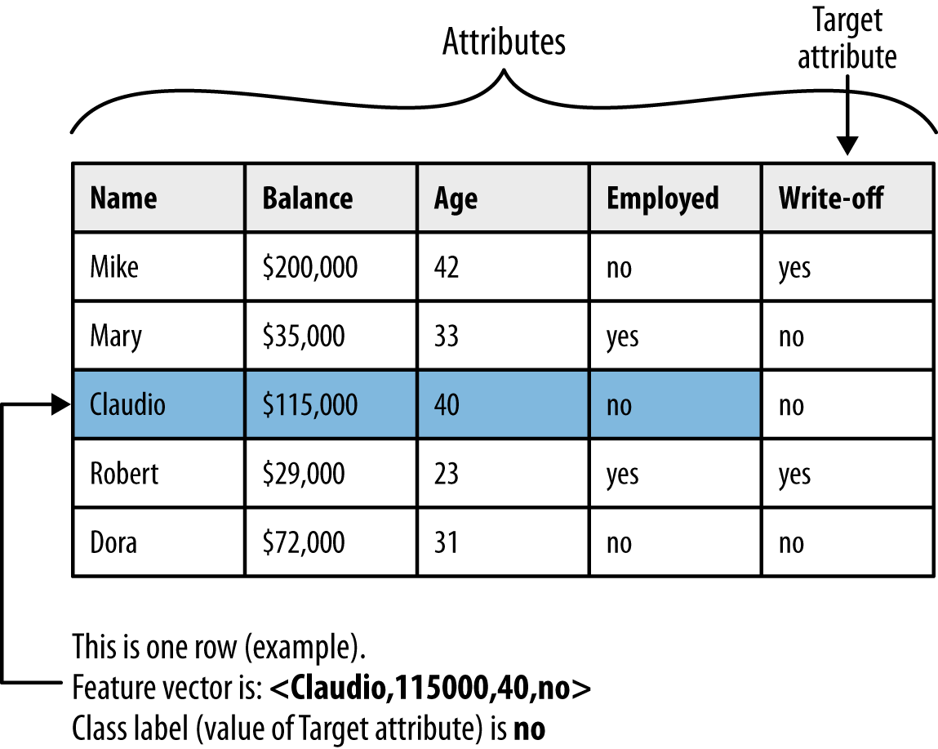
Terminology

Slide 22
What is a model?
A simplified* representation of reality created for a specific purpose
*based on some assumptions
Examples: map, prototype, Black-Scholes model, etc.
Data Mining example:
  “formula” for predicting probability of customer attrition at contract expiration
  → “classification model” or “class-probability estimation model”
Notes:
The procedure to create models is the model induction algorithm and learning

Slide 23
Feature Types
Numeric: anything that has some order
    Numbers (that mean numbers)
    Dates (that look like numbers …)
    Dimension of 1
Categorical: stuff that does not have an order
    Binary
    Text
    Dimension = number of possible values (-1)
Food for thought: Names, Ratings (good, excellent, diamond), Standard Industry Classification (https://en.wikipedia.org/wiki/Standard_Industrial_Classification)

Slide 24
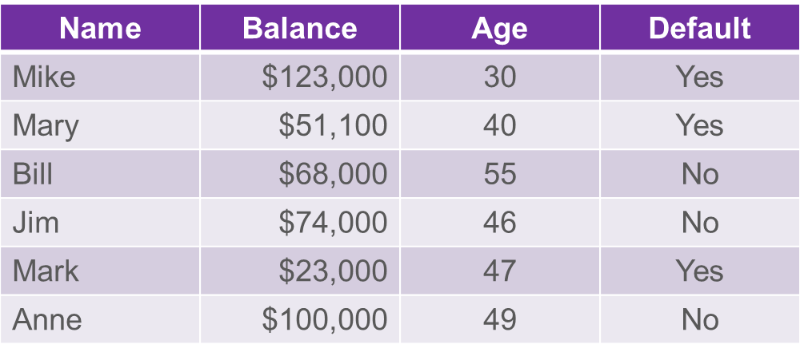
Dimensionality of the data?
Attributes / Features
Dimensionality of a dataset is the sum of the dimensions of the features
    The sum of the number of numeric features and ~ the number of values of categorical features

Slide 25
Common Data Mining Tasks
Classification and class probability estimation
    How likely is this consumer to respond to our campaign?
Regression
    How much will she use the service?
Similarity Matching
    Can we find consumers similar to my best customers?
    Serves as the base for many other data mining tasks.
Clustering
    Do my customers form natural groups?

Slide 26
Common Data Mining Tasks
Co-occurrence Grouping
    Also known as frequent item set mining, association rule discovery, and market-basket analysis
    What items are commonly purchased together?
Profiling (behavior description)
    What does “normal behavior” look like? (for example, as baseline to detect fraud)
    What is characteristic of a population, subgroup, and even individual
    How do you describe a credit card fraud?
Data Reduction
    Explicit Feature Selections
    Which latent dimensions describe the consumer taste preferences?

Slide 27
Common Data Mining Tasks
Link Prediction
    Since John and Jane share 2 friends, should John become Jane’s friend?
Causal Modeling
    Why are my customers leaving?
    Target Ad: is my treatment (targeting) effective, or is my model that identify whom will purchase anyway (regardless targeted or not)?
    Assumption: For example, Viral market: consumers actually influence each other.
Notes:
targeted ad is relevant to the audience

Slide 28
Supervised versus Unsupervised Methods
“How do our customers naturally fall into different groups?”
    No guarantee that the results are meaningful or will be useful for any particular purpose
“Can we find groups of customers who have particularly high likelihoods of canceling their service soon after contracts expire?”
    A specific purpose
    Much more useful results (usually)
    Different techniques
    Requires data with the target
      The individual’s label

Slide 29
Supervised Data Mining & Predictive Modeling
Is there a specific, quantifiable target that we are interested in or trying to predict?
    Think about the decision
Do we have data on this target?
    Do we have enough data on this target?
      Need a min ~500 of each type of classification
Do we have relevant data prior to decision?
    Think timing of decision and action
The result of supervised data mining is a model that predicts some quantity
A model can either be used to predict or to understand

Slide 30
Subclasses of Supervised Data Mining
Classification
    Categorical target
      Often binary
    Includes “class probability estimation”
Regression
    Numeric target

Slide 31
Subclasses of Supervised Data Mining
“Will this customer purchase service $S1$”
    Classification problem
      Binary target (the customer either purchases or does not)
“Which service package ($S1$, $S2$, or none) will a customer likely purchase?”
    Classification problem
      Three-valued target
“How much will this customer use the service?”
    Regression problem
      Numeric target
      Target variable: amount of usage per customer

Slide 32
Data Mining Model in Use
What is probability of attrition of this customer with characteristics $X, Y, Z$?
$$p(C|X,Y,Z) = 0.85$$

Slide 33
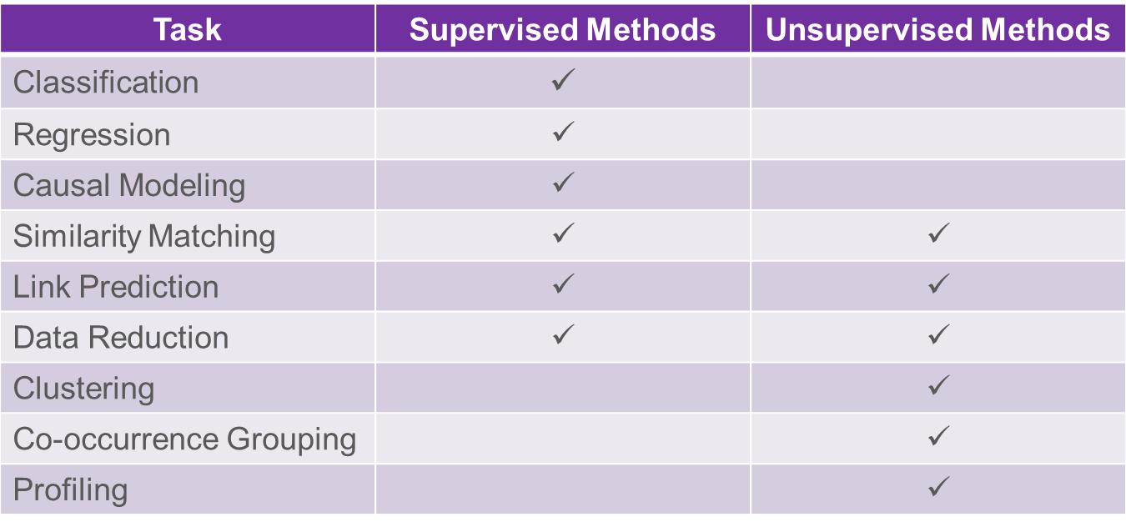
Common Data Mining Tasks

Slide 34
Data Mining versus Use of the Model
“Supervised” modeling:
“Training” data have all
values specified
Model in use:
New data item has some value unknown (e.g., will she leave?)

Slide 35
Classical Pitfalls in DM setup
The training data is NOT consistent with the use
Bad sample
Bad features

Slide 36
Sample: “Looking Under the Streetlight”
Target Proxy
    I do not see if a person after seeing an ad bought the book, so lets model clicks …
Sample Proxy
    I want to run a campaign in Spain but only have data on US customers

Slide 37
Sample: “Survivorship issues”
Lending club wants to have a model to take over the screening process that selects applications and deny those that are likely to default
Data of past loans and the outcomes are provided
Bad:
    Use the data they currently have to predict default

Slide 38
Sample: Different Sources
Things go really bad if the positive and negative are treated differently
Looking for drivers of diabetes: how do you assemble the training data?
Bad:
    Go to a specialized hospital and get records from people treated for diabetes
    Go somewhere else to get records for healthy people

Slide 39
Summary on bad habits
You are missing all the applications that were turned down already
The sick people came from a very artificial subset
Your target is NOT really your target
No way of telling how the model will perform
    No way of testing either
The training sample should be as similar as possible to the USE data

Slide 40
Machine Learning
Supervised v.s. Unsupervised
Unsupervised Algorithm
Cluster Algorithm
Principal Component Analysis
Spectrum analysis and Manifold learning

Slide 41
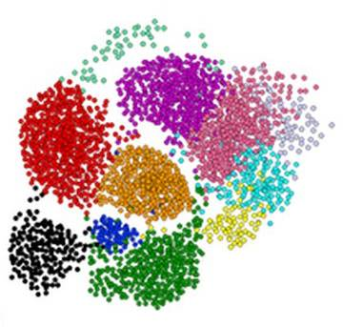
Clustering is a hard problem!

Slide 42
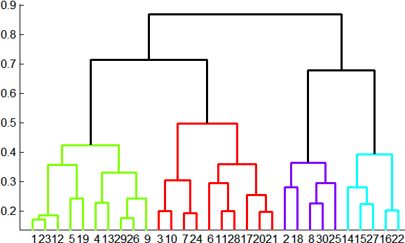
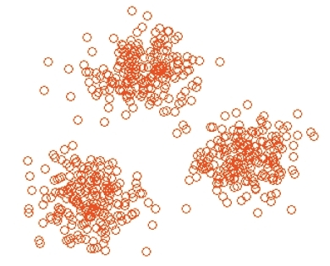


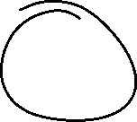
Overview: Methods of Clustering
Hierarchical:
  Agglomerative (bottom up):
    Initially, each point is a cluster
    Repeatedly combine the two
    “nearest” clusters into one
  Divisive (top down):
    Start with one cluster and recursively split it
Point assignment:
  Maintain a set of clusters
  Points belong to “nearest” cluster

Slide 43
k-means clustering

Slide 44
k–means Algorithm(s)
Assumes Euclidean space/distance
Start by picking k, the number of clusters
Initialize clusters by picking one point per cluster
  Example: Pick one point at random, then k-1 other points, each as far away as possible from
  the previous points

Slide 45
Populating Clusters
1) For each point, place it in the cluster whose current centroid it is nearest
2) After all points are assigned, update the locations of centroids of the k clusters
3) Reassign all points to their closest centroid
  Sometimes moves points between clusters
Repeat 2 and 3 until convergence
  Convergence: Points don’t move between clusters and centroids stabilize

Slide 46
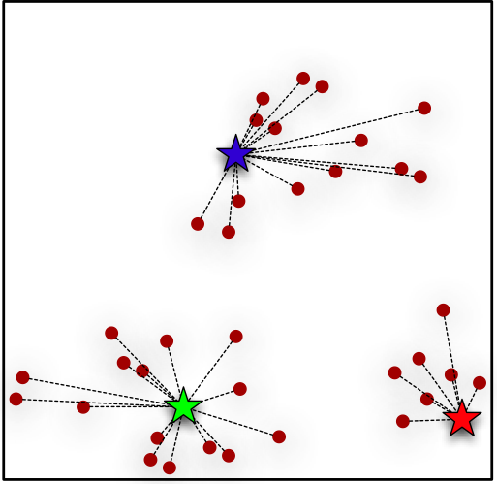
Clustering Around Centroids

Slide 47
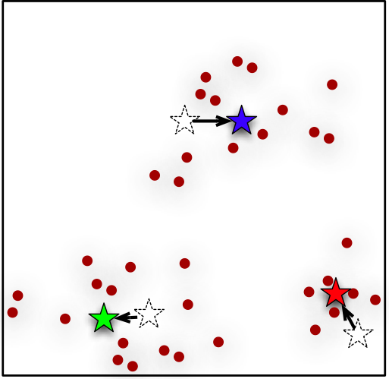
Clustering Around Centroids

Slide 48
Example: Assigning Clusters
x
x
x
x
x
x
x
x
x
x
x
x … data point
… centroid
Clusters after round 1

Slide 49
Example: Assigning Clusters
x
x
x
x
x
x
x
x
x
x
x
x … data point
… centroid
Clusters after round 2

Slide 50
Example: Assigning Clusters
x
x
x
x
x
x
x
x
x
x
x
x … data point
… centroid
Clusters at the end

Slide 51
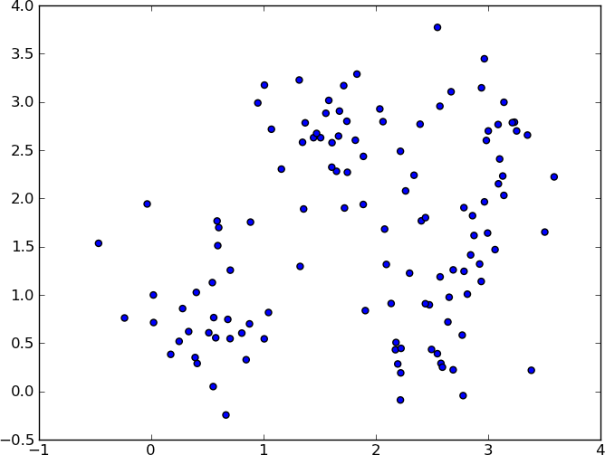
Example: $k$-means Clustering

Slide 52
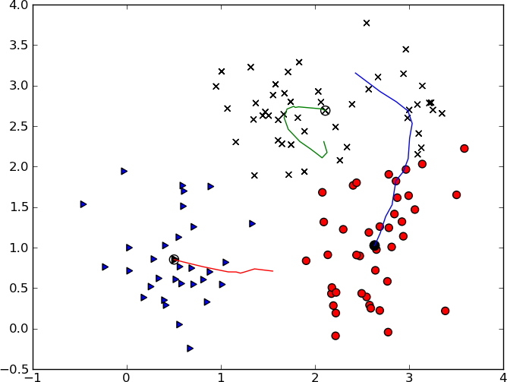
Example: $k$-means Clustering

Slide 53
Getting the k right
How to select k?
Try different k, looking at the change in the average distance to centroid as k increases
Average falls rapidly until right k, then changes little
Best value
of k
Average
distance to
centroid
k

Slide 54
Example: Picking k
x
xx x
x x
x x x
x
x x x
x
Too few;
many long
distances
to centroid.
x
x x
x x x x
x x x x
x x x
x x
x x
x x x x
x x x
x
x

Slide 55
Example: Picking k
x
xx x
x x
x x x
x
x x x
x
x
Just right;
distances
rather short.
x x
x x x x
x x x x
x x x
x x
x x
x x x x
x x x
x
x

Slide 56
Example: Picking k
Too many;
little improvement
in average
distance.
x
xx x
x x
x x x
x
x x x
x
x
x x
x x x x
x x x x
x x x
x x
x x
x x x x
x x x
x
x

Slide 57
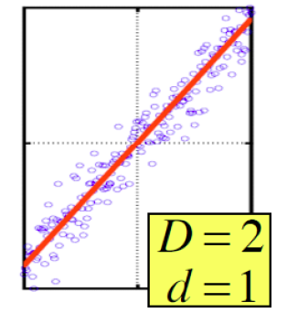
Dimensionality Reduction
Goal of dimensionality reduction is to
discover the axis of data!
Rather than representing
every point with 2 coordinates
we represent each point with
1 coordinate (corresponding to
the position of the point on
the red line).
By doing this we incur a bit of
error as the points do not
exactly lie on the line

Slide 58
Principal Components Analysis
PCA produces a low-dimensional representation of a dataset. It finds a sequence of linear combinations of the variables that have maximal variance, and are mutually uncorrelated.
Apart from producing derived variables for use in supervised learning problems, PCA also serves as a tool for data visualization.
Notes:
PCA is the most widely used data preprocessing technique.

Slide 59
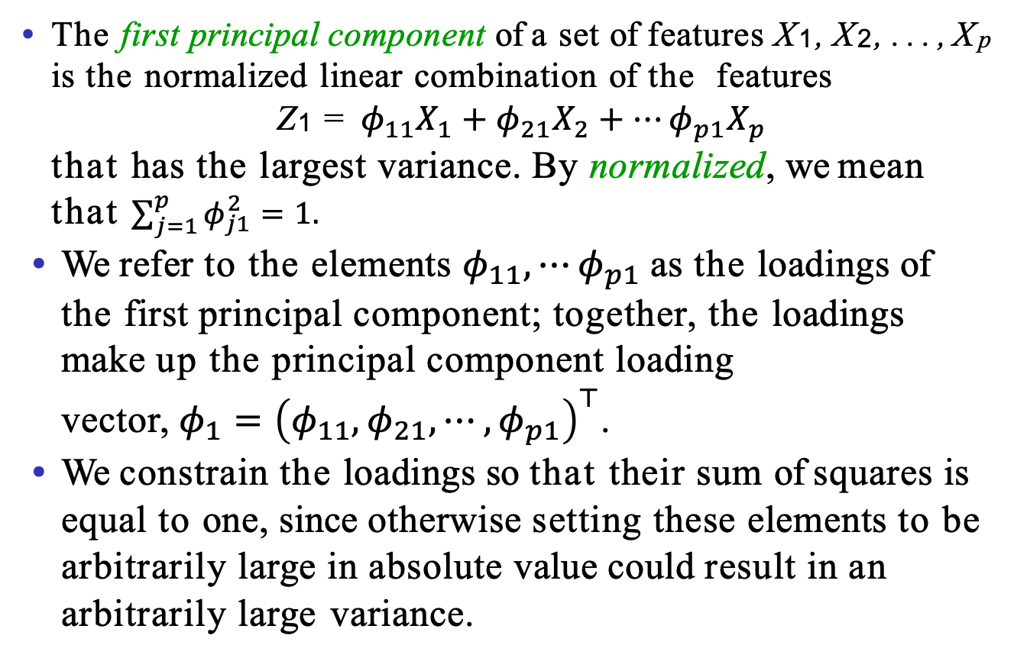
Principal Components Analysis: details
The first principal component of a set of features X₁, X₂, . . . , X_{p} is the normalized linear combination of the features
Z₁ = $φ_{11}X_{1}+φ_{21}X_{2}+⋯φ_{p1}X_{p}$
that has the largest variance. By normalized, we mean that $\sum_{j=1}^{p}{φ_{j1}^{2}=1. }$
We refer to the elements $φ_{11},⋯φ_{p1}$as the loadings of the first principal component; together, the loadings make up the principal component loading vector,${ φ_{1}=\left(φ_{11}, φ_{21}, ⋯, φ_{p1}\right)}^{⊤}$.
We constrain the loadings so that their sum of squares is equal to one, since otherwise setting these elements to be arbitrarily large in absolute value could result in an arbitrarily large variance.

Slide 60
PCA: example
The population size (pop) and ad spending (ad) for 100 different cities are shown as purple circles. The green solid line indicates the first principal component direction, and the blue dashed line indicates the second principal component direction.

Slide 61
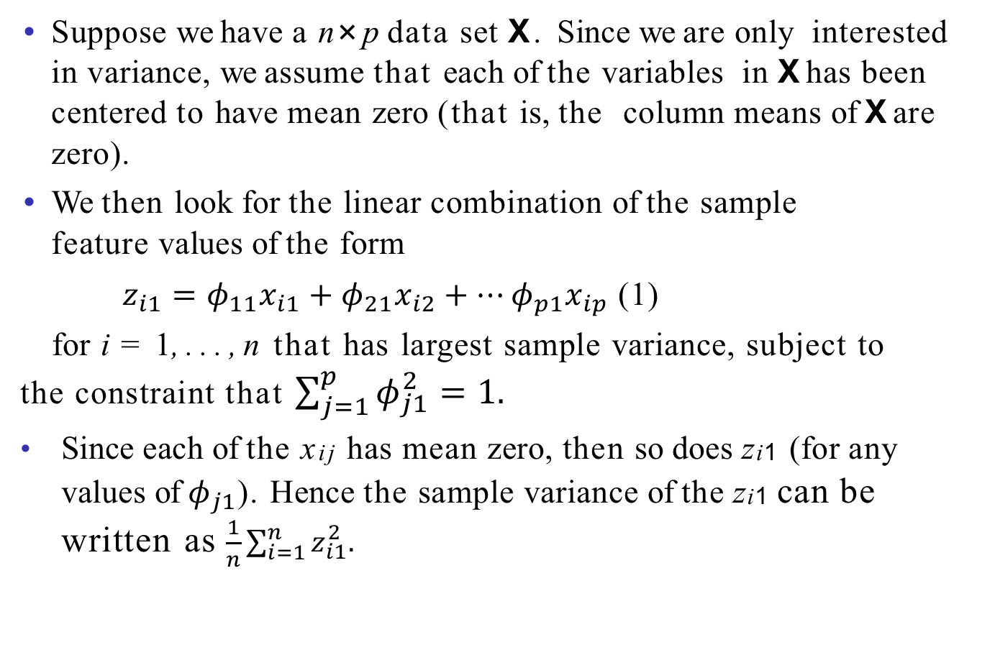
Computation of Principal Components
Suppose we have a n×p data set X. Since we are only interested in variance, we assume that each of the variables in Xhas been centered to have mean zero (that is, the column means of Xare zero).
We then look for the linear combination of the sample feature values of the form
$z_{i1}=φ_{11}x_{i1}+φ_{21}x_{i2}+⋯φ_{p1}x_{ip}$ (1)
for i = 1, . . . , n that has largest sample variance, subject to the constraint that $\sum_{j=1}^{p}{φ_{j1}^{2}=1. }$
Since each of the x_{ij} has mean zero, then so does z_{i1} (for any values of $φ_{j1}$). Hence the sample variance of the z_{i1} can be written as $\frac{1}{n}\sum_{i=1}^{n}{z_{i1}^{2}. }$

Slide 62
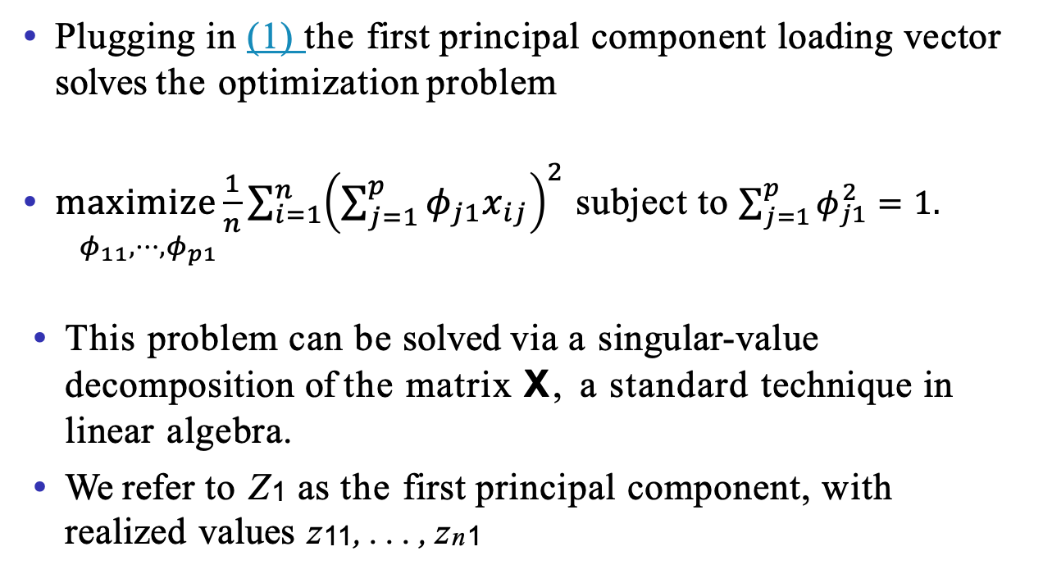
Computation: continued
Plugging in (1) the first principal component loading vector solves the optimization problem
$\underset{φ_{11}, ⋯, φ_{p1}}{maximize\frac{1}{n}}{\sum_{i=1}^{n}{\left(\sum_{j=1}^{p}{φ_{j1}x_{ij}}\right)}}^{2}$ subject to $\sum_{j=1}^{p}{φ_{j1}^{2}=1. }$
This problem can be solved via a singular-value decomposition of the matrix X, a standard technique in linear algebra.
We refer to Z₁ as the first principal component, with realized values z₁₁, . . . , z_{n1}

Slide 63
Geometry of PCA
The loading vector φ1 with elements φ₁₁, φ₂₁, . . . , φ_{p1} defines a direction in feature space along which the data vary the most.
If we project the n data points x₁, . . . , x_{n} onto this direction, the projected values are the principal component scores z₁₁, . . . , z_{n1} themselves.

Slide 64
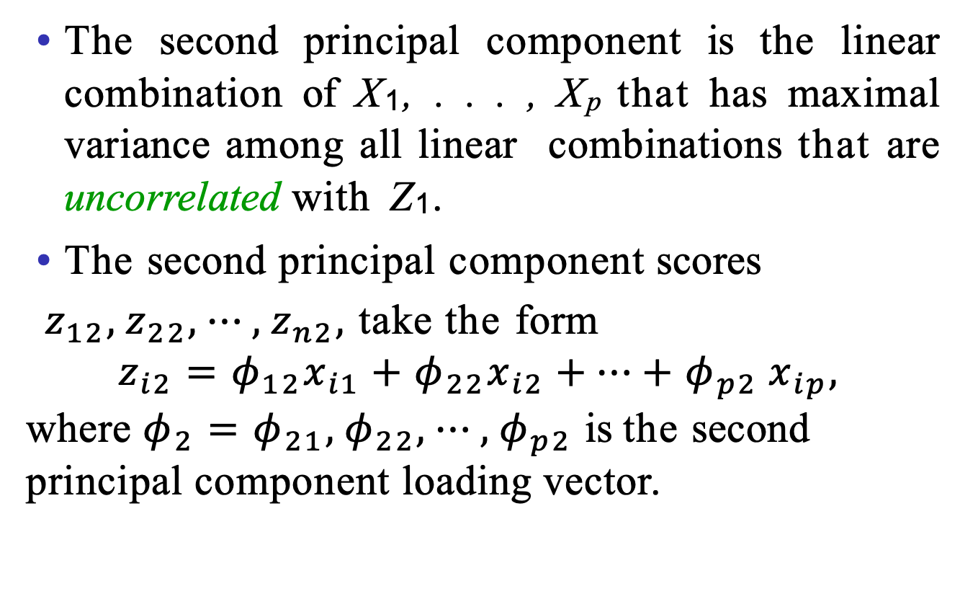
Further principal components
The second principal component is the linear combination of X₁, . . . , X_{p} that has maximal variance among all linear combinations that are uncorrelated with Z₁.
The second principal component scores
$z_{12},z_{22}, ⋯, z_{n2},$take the form
$$z_{i2}=φ_{12}x_{i1}+φ_{22}x_{i2}{+⋯+φ}_{p2}x_{ip},$$
where $φ_{2}=φ_{21},φ_{22}, ⋯, φ_{p2}$is the second principal component loading vector.
Notes:
You have to put into constraints: the direction must be uncorrelated with the first one.

Slide 65
Further principal components: continued
It turns out that constraining Z₂ to be uncorrelated with Z₁ is equivalent to constraining the direction φ₂ to be orthogonal (perpendicular) to the direction φ₁. And so on.
The principal component directions φ₁, φ₂, φ₃, . . . are the ordered sequence of right singular vectors of the matrix X, and the variances of the components are 1/n times the squares of the singular values. There are at most min(n−1,p) principal components.
Notes:
Uncorrelated orthogonal

Slide 66
Illustration
USAarrests data: For each of the fifty states in the United States, the data set contains the number of arrests per 100,000 residents for each of three crimes: Assault, Murder, and Rape. We also record UrbanPop (the percent of the population in each state living in urban areas).
The principal component score vectors have length n = 50, and the principal component loading vectors have length p = 4.
PCA was performed after standardizing each variable to have mean zero and standard deviation one.

Slide 67
USAarrests data: PCA plot
Notes:
Bi-plot.

Slide 68
Figure details
The first two principal components for the USArrests data.
The blue state names represent the scores for the first two principal components.
The orange arrows indicate the first two principal component loading vectors (with axes on the top and right). For example, the loading for Rape on the first component is 0.54, and its loading on the second principal component 0.17 [the word Rape is centered at the point (0.54, 0.17)].
This figure is known as a biplot, because it displays both the principal component scores and the principal component loadings.

Slide 69
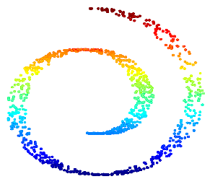

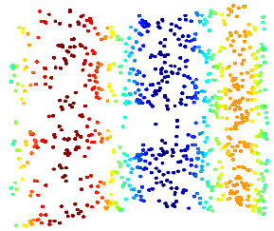
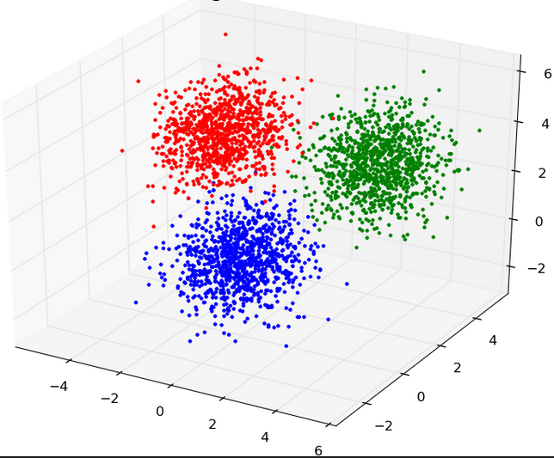
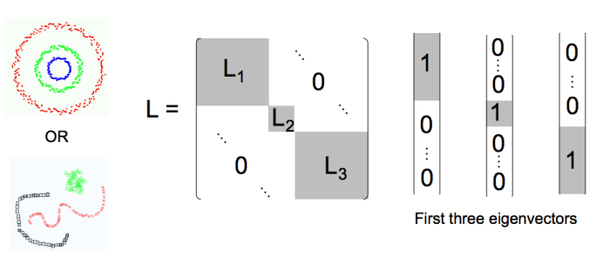
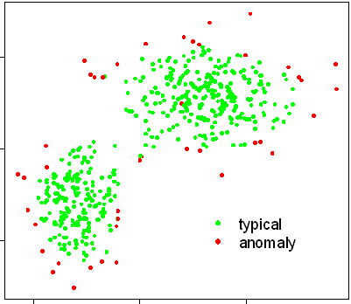
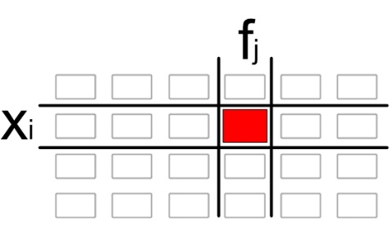
Local-rank Spectral Embeddings
High-dimensional
Observation Space
Low-ranks
Embedding Space
Big Data
“Unfolding”
Clustering
Anomaly Detection
Feature
Selection

Slide 70
Supervised Learning
Linear Regression. (target is a continuous value)
y
X

Slide 71
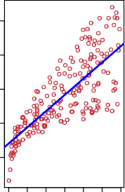
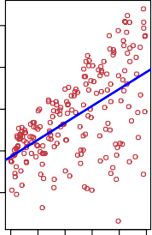
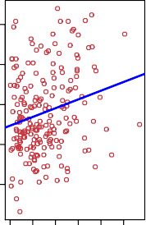
Single Linear Regress
25
25
25
20
20
20
Sales
15
Sales
15
Sales
15
10
10
10
5
5
5
0 50 100
200
300
0 10 20 30 40 50
0 20 40 60 80 100
TV Radio Newspaper
Shown are Sales vs TV, Radio and Newspaper, with a blue linear-regression line fit separately to each.
Can we predict Sales using these three? Perhaps we can do better using a model
Sales ≈ f (TV, Radio, Newspaper)

Slide 72
Notation
Here Sales is a response or target that we wish to predict. We generically refer to the response as Y .
TV is a feature, or input, or predictor; we name it X₁. Likewise name Radio as X₂, and so on.
We can refer to the input vector collectively as
$$X=\left({\text{X}\text{1} \atop \begin{aligned}\text{X}\text{2} \\ \text{X}\text{3}\end{aligned}}\right)$$
Now we write our model as
Y = f (X) + ε
where ε captures measurement errors and other discrepancies.

Slide 73
What is f(X)good for?
With a good f we can make predictions of Y at new points
X= x.
We can understand which components of
X = (X₁, X₂, . . . , X_{p}) are important in explaining Y , and which are irrelevant. e.g. Seniority and Years of Education have a big impact on Income, but Marital Status typically does not.
Depending on the complexity of f, we may be able to understand how each component X_{j} of X affects Y.

Slide 74
The regression function f (x)
Is also defined for vector X; e.g.
f (x) = f (x₁, x₂, x₃) = E(Y|X₁ =x₁, X₂ = x₂, X₃ = x₃)
Is the ideal or optimal predictor of Y with regard to
mean-squared prediction error: f(x) =E(Y|X = x) is the function that minimizes E[(Y −g(X))²|X =x] over all functions g at all points X=x.
ε =Y−f(x) is the irreducible error — i.e. even if we knew f(x), we would still make errors in prediction, since at each X=x there is typically a distribution of possible Y values.
For any estimate f^{ˆ}(x) of f(x), we have
E[(Y − f^{ˆ}(X))²|X = x] = [f(x) − f^{ˆ}(x)]² + Var(ε)
Red u cible Irreducible

Slide 75
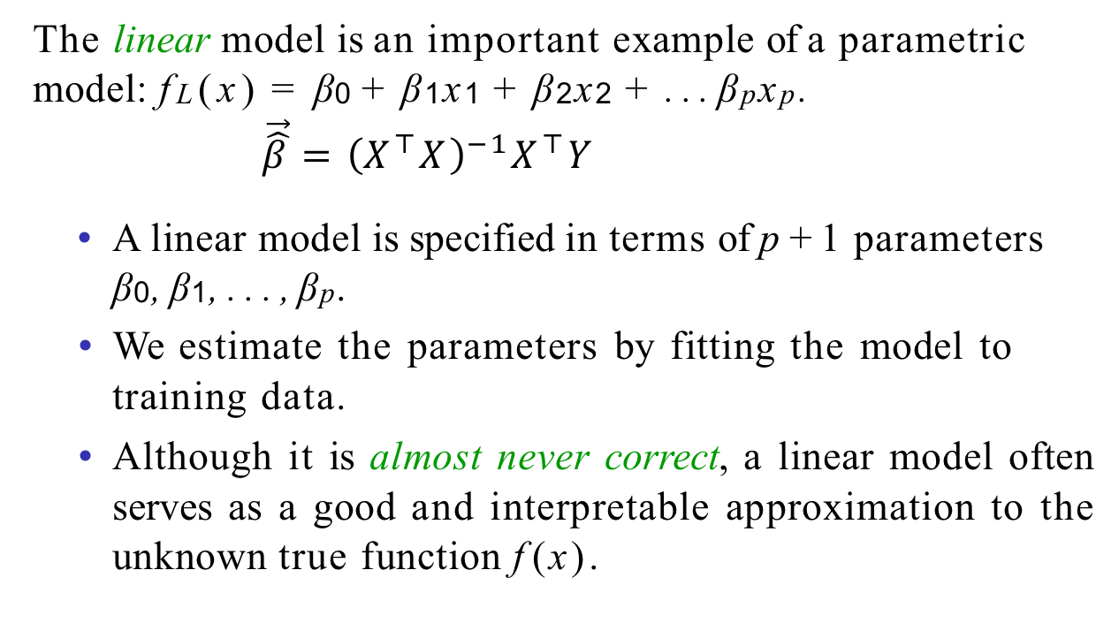
Parametric and structured models
The linear model is an important example of a parametric model: f_{L}(x) = β₀ + β₁x₁ + β₂x₂ + . . . β_{p}x_{p}.
$$\vec{\hat{β}}={\left(X^{⊤}X\right)}^{−1}X^{⊤}Y$$
A linear model is specified in terms of p +1 parameters
β₀, β₁, . . . , β_{p}.
We estimate the parameters by fitting the model to training data.
Although it is almost never correct, a linear model often serves as a good and interpretable approximation to the unknown true function f(x).

Slide 76
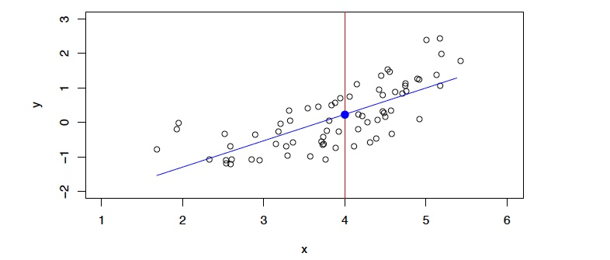
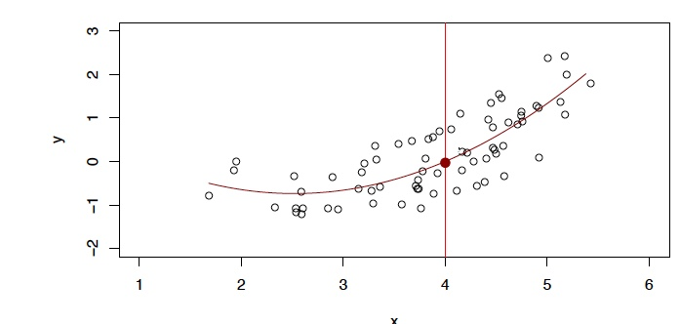
A linear model f^{ˆ}_{L}(X) = β^{ˆ}₀ + β^{ˆ}₁X gives a reasonable fit here
A quadratic model f^{ˆ}_{Q}(X) =β^{ˆ}₀ +β^{ˆ}₁X +β^{ˆ}₂X² fits slightly better.

Slide 77
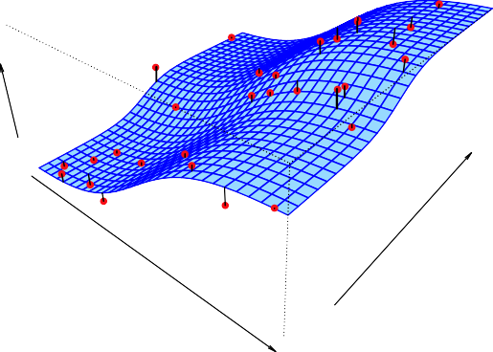
Income
Seniority
Years of Education
Simulated example. Red points are simulated values for income
from the model
income = f (education, seniority) +ε f is the blue surface.

Slide 78
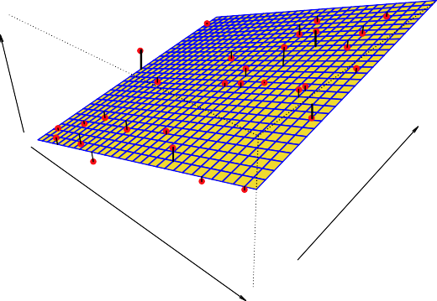
Income
Seniority
Years of Education
Linear regression model fit to the simulated data.
f^{ˆ}_{L}(education, seniority) = β^{ˆ}₀ + β^{ˆ}₁ × education + β^{ˆ}₂ × seniority

Slide 79
Some trade-offs
Prediction accuracy versus interpretability.
  Linear models are easy to interpret; thin-plate splines are not.
Good fit versus over-fit or under-fit.
  How do we know when the fit is just right?
Parsimony versus black-box.
  We often prefer a simpler model involving fewer variables over a black-box predictor involving them all.

Slide 80
Classification (target is a label)
Logistic Regression. (target is a discrete value)
y

Slide 81
Classification
Qualitative variables take values in an unordered set C, such as:
eye color ∈ {brown, blue, green}
Email ∈ {spam, ham}.
Given a feature vector X and a qualitative response Y taking values in the set C, the classification task is to build a function C(X) that takes as input the feature vector X and predicts its value for Y ; i.e. C(X) ∈ C.
Often we are more interested in estimating the probabilities
that X belongs to each category in C.
For example, it is more valuable to have an estimate of the probability that an insurance claim is fraudulent, than a classification fraudulent or not.

Slide 82
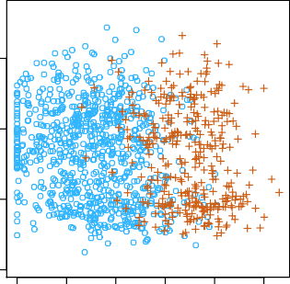
Example: Credit Card Default
2500
60000
2000
Income
40000 60000
Balance
1500
Income
40000
1000
20000
20000
500
0
0
0
0
500 1000 1500 2000 2500
Balance
No Yes
Default
No Yes
Default

Slide 83
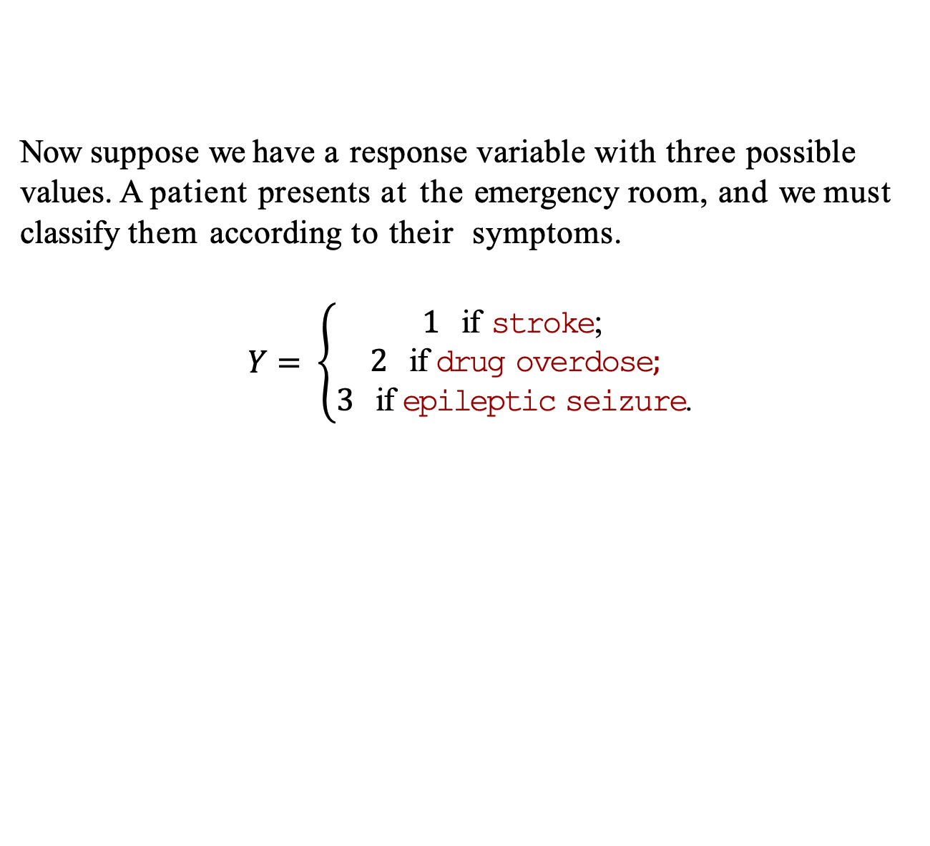
Linear Regression continued
Now suppose we have a response variable with three possible values. A patient presents at the emergency room, and we must classify them according to their symptoms.
$$Y= \left\{\begin{aligned}1 \text{if} \text{stroke}\text{;} \\ \text{2 }\text{if} \text{drug} \text{overdose}; \\ 3 \text{if} \text{epileptic} \text{seizure}\text{.}\end{aligned}\right.$$
This coding suggests an ordering, and in fact implies that the difference between stroke and drug overdose is the same as between drug overdose and epileptic seizure.
Linear regression is not appropriate here.
Multiclass Logistic Regression or Discriminant Analysis are more appropriate.

Slide 84
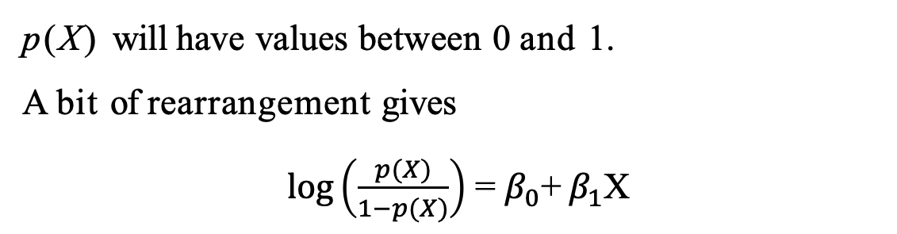
Logistic Regression
Let’s write p(X) = Pr(Y = 1|X) for short and consider using
balance to predict default. Logistic regression uses the form
_{e}β0+β1X
p(X) = .
_{1 + e}β0+β1X
(e ≈ 2.71828 is a mathematical constant [Euler’s number.])
It is easy to see that no matter what values β₀, β₁ or X take,
p(X) will have values between 0 and 1.
A bit of rearrangement gives
$\log\left(\frac{p(X)}{1−p(X)}\right)$ = $β_{0}$+ $β_{1}$X
This monotone transformation is called the log odds or logit
transformation of p(X). (by log we mean natural log: ln.)

Slide 85
Linear versus Logistic Regression
Logistic regression ensures that our estimate for p(X) lies between 0 and 1.

Slide 86
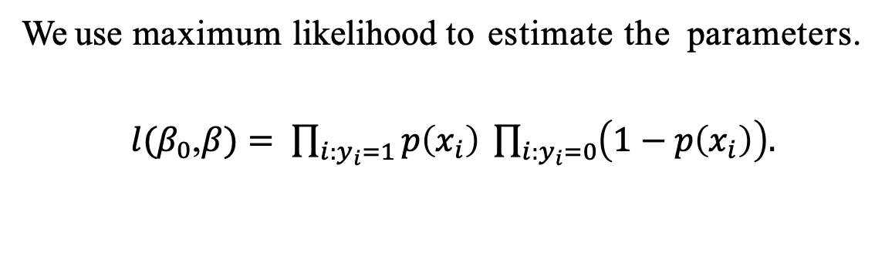
Maximum Likelihood
We use maximum likelihood to estimate the parameters.
$l(β_{0}$,$β)= \prod_{i:y_{i}=1}{p\left(x_{i}\right) \prod_{i:y_{i}=0}{\left(1−p\left(x_{i}\right)\right).}}$
This likelihood gives the probability of the observed zeros and ones in the data. We pick β₀ and β₁ to maximize the likelihood of the observed data.

Slide 87
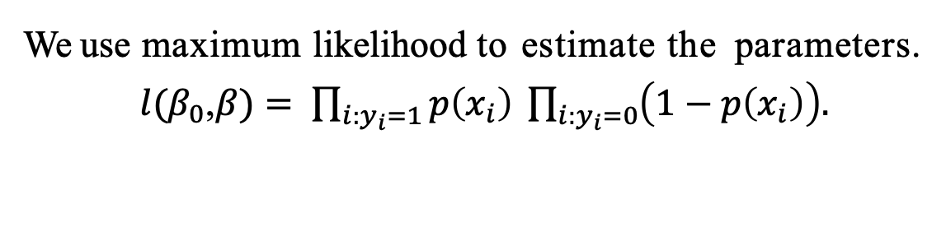
Maximum Likelihood
We use maximum likelihood to estimate the parameters.
$l(β_{0}$,$β)= \prod_{i:y_{i}=1}{p\left(x_{i}\right) \prod_{i:y_{i}=0}{\left(1−p\left(x_{i}\right)\right).}}$
This likelihood gives the probability of the observed zeros and ones in the data. We pick β₀ and β₁ to maximize the likelihood of the observed data.
Most statistical packages can fit linear logistic regression models by maximum likelihood.
 | Coefficient | Std. | Error | Z-statistic | P-value
Intercept | -10.6513 | 0.3612 |  | -29.5 | < 0.0001
balance | 0.0055 | 0.0002 |  | 24.9 | < 0.0001

Slide 88
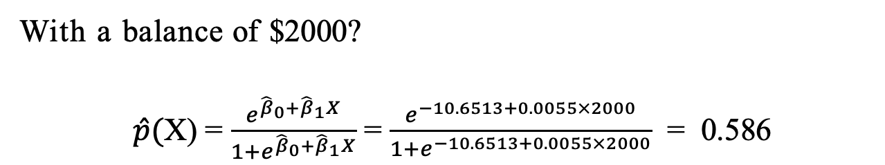
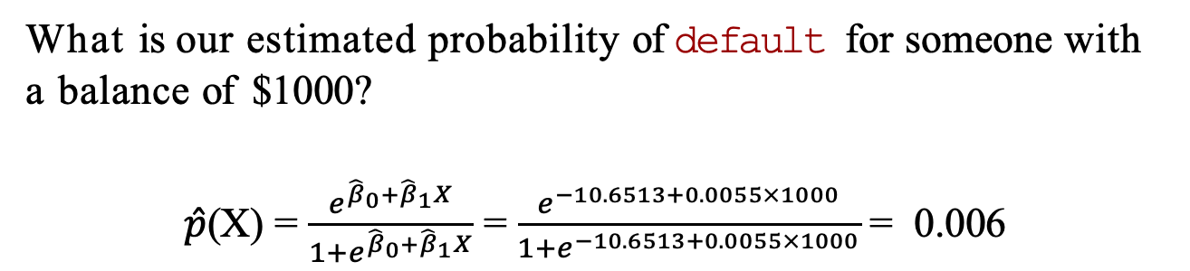
Making Predictions
What is our estimated probability of default for someone with a balance of $1000?
$\hat{p}$(X) = $\frac{e^{{\hat{β}}_{0}+{\hat{β}}_{1}X}}{1+e^{{\hat{β}}_{0}+{\hat{β}}_{1}X}}$ = $\frac{e^{−10.6513+0.0055×1000}}{1+e^{−10.6513+0.0055×1000}}$ = 0.006
With a balance of $2000?
$\hat{p}($X) = $\frac{e^{{\hat{β}}_{0}+{\hat{β}}_{1}X}}{1+e^{{\hat{β}}_{0}+{\hat{β}}_{1}X}}$ = $\frac{e^{−10.6513+0.0055×2000}}{1+e^{−10.6513+0.0055×2000}}$ = 0.586

Slide 89
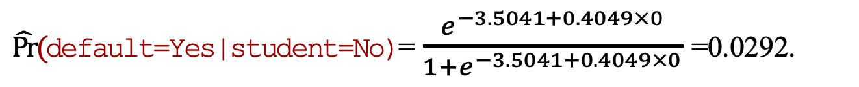
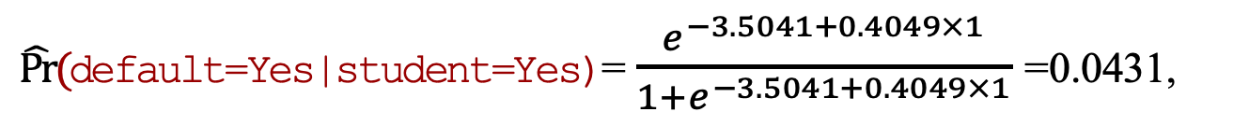
Lets do it again, using student as the predictor.
 | Coefficient | Std. | Error | Z-statistic | P-value
Intercept | -3.5041 | 0.0707 |  | -49.55 | < 0.0001
student[Yes] | 0.4049 | 0.1150 |  | 3.52 | 0.0004
$\hat{Pr}(\text{default}\text{=}\text{Yes}\text{|}\text{student}\text{=}\text{Yes}$)= $\frac{e^{−3.5041+0.4049×1}}{1+e^{−3.5041+0.4049×1}}$ =0.0431,
$\hat{Pr}(\text{default}\text{=}\text{Yes}\text{|}\text{student}\text{=}\text{No}$)= $\frac{e^{−3.5041+0.4049×0}}{1+e^{−3.5041+0.4049×0}}$ =0.0292.

Slide 90
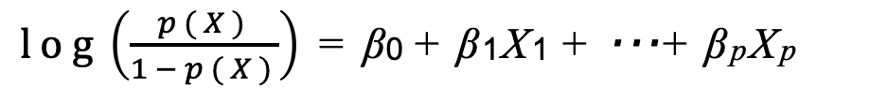
Logistic regression with multiple variables
$log\left(\frac{p(X)}{1−p(X)}\right)$ = β₀ + β₁X₁ + · · · + β_{p}X_{p}
_{e}β0+β1X1+···+βpXp
p(X) =
_{1 + e}β0+β1X1+···+βpXp
 | Coefficient | Std. | Error | Z-statistic | P-value
Intercept | -10.8690 | 0.4923 |  | -22.08 | < 0.0001
balance | 0.0057 | 0.0002 |  | 24.74 | < 0.0001
income | 0.0030 | 0.0082 |  | 0.37 | 0.7115
student[Yes] | -0.6468 | 0.2362 |  | -2.74 | 0.0062
Why is coefficient for student negative, while it was positive before?

Slide 91
Example: South African Heart Disease
160 cases of MI (myocardial infarction) and 302 controls (all male in age range 15-64), from Western Cape, South Africa in early 80s.
Overall prevalence very high in this region: 5.1%.
Measurements on seven predictors (risk factors), shown in scatterplot matrix.
Goal is to identify relative strengths and directions of risk factors.
This was part of an intervention study aimed at educating the public on healthier diets.

Slide 93
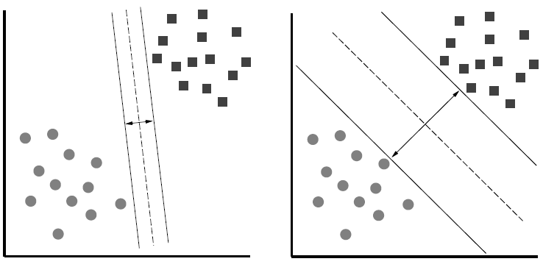
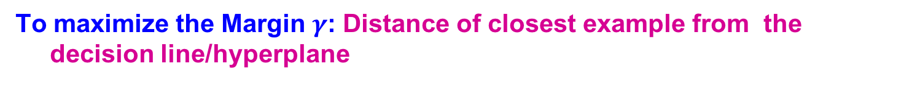
Support Vector Machine
To maximize the Margin $γ$: Distance of closest example from the decision line/hyperplane
Notes:
Why define margin as distance to the closest example, why not avg. or something else?
Purely theoretical

Slide 94

Support Vector Machines
Want to separate “+” from “-” using a line
Data:
Training examples:
  (x₁, y₁) … (x_{n}, y_{n})
Each example i:
  x_{i} = ( x_{i}⁽¹⁾,… , x_{i}^{(d)} )
    x_{i}^{(j)} is real valued
  y_{i} ∈ { -1, +1 }
Inner product:
$w⋅x=\sum_{j=1}^{d}{w^{(j)}⋅x^{(j)}}$
+
+
+
-
+
+
-
+
-
-
-
-
-
Which is best linear separator (defined by w)?

Slide 95
Largest Margin
Distance from the separating hyperplane corresponds to the “confidence”
of prediction
Example:
  We are more sure about the class of A and B than of C
A
C
+
+
+
+
-
+
B
-
+
+
-
+
-
-
+
-
-
-
-

Slide 96

Largest Margin
Margin $γ$: Distance of closest example from the decision line/hyperplane
The reason we define margin this way is due to theoretical convenience and existence of generalization error bounds that depend on the value of margin.
Notes:
Why define margin as distance to the closest example, why not avg. or something else?
Purely theoretical

Slide 97
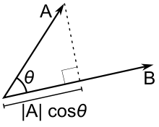
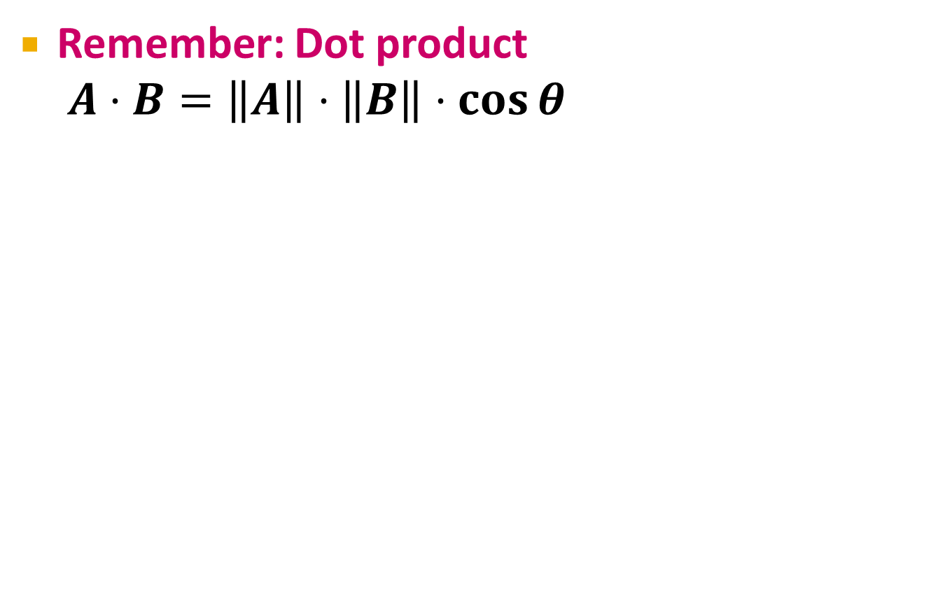
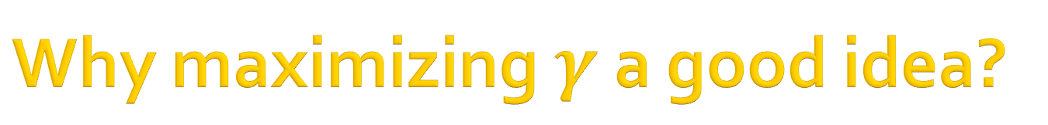

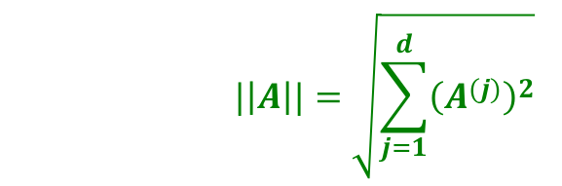
Why maximizing $γ$ a good idea?
Remember: Dot product
$A⋅B=\left\|A\right\|⋅\left\|B\right\|⋅\cos{θ}$
      $$|\left|A\right||=\sqrt{\sum_{j=1}^{d}{{\left(A^{(j)}\right)}^{2}}}$$
$$\left\|A\right\|cosθ$$

Slide 98






Why maximizing $γ$ a good idea?
Dot product
$A⋅B=\left\|A\right\|\left\|B\right\|\cos{θ}$
What is $w⋅x_{1}$ , $w⋅x_{2}$?
So, $γ$ roughly corresponds to the margin
  Bigger $γ$ bigger the separation
$$w$$
x₂
+
+
w ⋅ x + b = 0
x₁
x₂
x₂
+
+
+
+
x₁
x₁
$$w$$
$$w$$
In this case
$$γ_{1}≈{\left\|w\right\|}^{2}$$
In this case
$$γ_{2}≈{2\left\|w\right\|}^{2}$$

Slide 99

What is the margin?
Distance from a
point to a line
L
Note we assume ${\left\|w\right\|}_{2}=1$
Let:
  Line L: w∙x+b = w⁽¹⁾x⁽¹⁾+w⁽²⁾x⁽²⁾+b=0
  w = (w⁽¹⁾, w⁽²⁾)
  Point A = (x_{A}⁽¹⁾, x_{A}⁽²⁾)
  Point M on a line = (x_{M}⁽¹⁾, x_{M}⁽²⁾)
w
A (x_{A}⁽¹⁾, x_{A}⁽²⁾)
w ∙ x + b = 0
+
d(A, L)
H
d(A, L) = |AH|
= |(A-M) ∙ w|
= |(x_{A}⁽¹⁾ – x_{M}⁽¹⁾) w⁽¹⁾ + (x_{A}⁽²⁾ – x_{M}⁽²⁾) w⁽²⁾|
= |x_{A}⁽¹⁾ w⁽¹⁾ + x_{A}⁽²⁾ w⁽²⁾ + b|
= |w ∙ A + b|
(0,0)
M (x₁, x₂)
Remember x_{M}⁽¹⁾w⁽¹⁾ + x_{M}⁽²⁾w⁽²⁾ = - b
since M belongs to line L

Slide 100

Largest Margin
So How to do the prediction if we know all parameters!
Prediction = sign(w⋅x + b)
$$w$$
+
+
+
+
w ⋅ x + b = 0
-
+
-
+
+
-
-
-
-
-

Slide 101

Largest Margin
Prediction = sign(w⋅x + b)
“Confidence” = (w⋅ x + b) y
For i-th datapoint:
$γ_{i} = \left(w⋅ x_{i}+b\right)y_{i}$
Want to solve:
$$\max_{w}{\min_{i}{γ_{i}}}$$
Can rewrite as
$$w$$
+
+
+
+
w ⋅ x + b = 0
-
+
-
+
+
-
-
-
-
-

Slide 102

Support Vector Machine
Maximize the margin:
  Good according to intuition & practice
  $γ$ is margin, the minimum distance from the separating hyper-plane
+
+
w⋅x+b=0
+
+
+
-
+
γ
+
γ
-
-
-
+
γ
-
-
-
Maximizing the margin

Slide 103

Support Vector Machines
Separating hyperplane
is defined by the
support vectors
  Points on +/- planes
  from the solution
  If you knew these
  points, you could
  ignore the rest
  Generally,
  d+1 support vectors (for d dim. data)

Slide 104


Canonical Hyperplane: Problem
w⋅x+b=-1
w⋅x+b=0
Problem:
  Let $\left(w⋅x+b\right)y=γ$
  then $\left(2w⋅x+2b\right)y=2γ$
    Scaling w increases margin!
Solution:
  Work with normalized w:
  $γ=\left(\frac{w}{\left\|w\right\|}⋅x+\frac{b}{\left\|w\right\|}\right)y$
  Let’s also require support vectors $x_{j}$ to be on the plane defined by: $w⋅x_{j}+b=±1$
w⋅x+b=+1
      $$|\left|w\right||=\sqrt{\sum_{j=1}^{d}{{\left(w^{(j)}\right)}^{2}}}$$

Slide 105

Canonical Hyperplane: Solution
Want to maximize margin $γ$!
What is the relation
between x₁ and x₂?
  $x_{1}=x_{2}+2γ\frac{w}{||w||}$
  We also know:
    $w⋅x_{1}+b=+1$
    $w⋅x_{2}+b=−1$
So:
  $w⋅x_{1}+b=+1$
  $w\left(x_{2}+2γ\frac{w}{||w||}\right)+b=+1$
  $w⋅x_{2}+b+2γ\frac{w⋅w}{\left|\left|w\right|\right|}=+1$
w⋅x+b=-1
w⋅x+b=0
w⋅x+b=+1
2γ
Note:
-1

Slide 106

Maximizing the Margin
We started with
But w can be arbitrarily large!
We normalized and...
Then:
w⋅x+b=-1
w⋅x+b=0
w⋅x+b=+1
2γ
$$γ$$
This is called SVM with “hard” constraints

Slide 107
Non-linearly Separable Data
If data is not separable introduce penalty:
  Minimize ǁwǁ² plus the
  number of training mistakes
  Set C using cross validation
How to penalize mistakes?
  All mistakes are not
  equally bad!
+
+
w⋅x+b=0
+
-
+
+
-
+
-
-
+
-
+
-
-
-
-

Slide 108

Support Vector Machines
Introduce slack variables ξ_{i}
If point x_{i} is on the wrong
side of the margin then
get penalty ξ_{i}
+
w⋅x+b=0
+
+
-
+
ξ_{i}
+
+
ξ_{j}
-
-
+
+
-
-
-
For each data point:
If margin ≥ 1$×γ$ , don’t care
If margin < 1 $×γ$, pay linear penalty
Notes:
ksi

Slide 109

Slack Penalty $C$
small C
+
“good” C
+
What is the role of slack penalty C:
  C=∞: Only want to w, b
  that separate the data
  C=0: Can set ξ_{i} to anything,
  then w=0 (basically
  ignores the data)
+
+
+
big C
+
-
-
+
+
-
-
-
-
(0,0)

Slide 110
Support Vector Machines
SVM in the “natural” form
SVM uses “Hinge Loss”:
Margin
Regularization
parameter
Empirical loss L (how well we fit training data)
penalty
0/1 loss
Hinge loss: max{0, 1-z}
-1 0 1 2

Slide 111
Support Vector Machines:
How to compute the margin?

Slide 112


SVM: How to estimate w?
Want to estimate w, b!
Alternative approach:
  Want to minimize f(w,b):
Side note:
  How to minimize convex functions $g(z)$?
  Use gradient descent: min_{z} g(z)
  Iterate: z_{t+1} ← z_{t} – η ∇g(z_{t})
g(z)
z

Slide 113

SVM: How to estimate w?
Want to minimize f(w,b):
Compute the gradient ∇(j) w.r.t. w^{(j)}
Empirical loss $L(x_{i} y_{i})$

Slide 114
SVM: How to estimate w?
Gradient descent:
Problem:
  Computing ∇f^{(j)} takes O(n) time!
    n … size of the training dataset
Iterate until convergence:
For j = 1 … d
  Evaluate:
  Update:
  w^{(j)} ← w^{(j)} - η∇f^{(j)}
η…learning rate parameter
C… regularization parameter

Slide 115
SVM: How to estimate w?
We just had:
Stochastic Gradient Descent
  Instead of evaluating gradient over all examples evaluate it for each individual training example
Stochastic gradient descent:
Notice: no summation
over i anymore
Iterate until convergence:
For i = 1 … n
  For j = 1 … d
    Compute: ∇f^{(j)}(x_{i})
    Update: w^{(j)} ← w^{(j)} - η ∇f^{(j)}(x_{i})

Slide 116
Decision Tree Induction: An Example
Training data set: Buys_computer
The data set follows an example ID3
Resulting tree:
age?
<=30
overcast
>40
31..40
student?
yes
credit rating?
no
yes
excellent
fair
no
yes
no
yes

Slide 117
Selecting Informative Attributes
Objective: Based on customer attributes, partition the customers into subgroups that are less impure – with respect to the class (i.e., such that in each group as many instances as possible belong to the same class)
How?
No
Yes
Yes
Yes
Yes
No
Yes
No

Slide 118


Selecting Informative Attributes
The most common splitting criterion is called information gain (IG)
    It is based on a purity measure called entropy
    $entropy =−p_{1}\log_{2}\left(p_{1}\right)−p_{2}\log_{2}\left(p_{2}\right)− ..$
    Measures the general disorder of a set -(½ log2_ (2^-1) + ½ (log (1/2) )) = 1
    Eight items , each item belongs to a different group, we have eight classes. What is the entropy
    $−\sum_{i=1}^{8}{p_{i}}log p_{i}$=-$\sum_{i=1}^{8}{\frac{1}{8}}log\frac{1}{8}$= 3

Slide 119
Attribute Selection
Reasons for selecting only a subset of attributes:
  Better insights and business understanding
  Better explanations and more tractable models
  Reduced cost
  Faster predictions
  Better predictions!
      Over-fitting (to be continued..)
    and also determining the most informative attributes..

Slide 120
Example: Attribution Selection with Information Gain
This dataset includes descriptions of hypothetical samples corresponding to 23 species of gilled mushrooms in the Agaricus and Lepiota Family
Each species is identified as definitely edible, definitely poisonous, or of unknown edibility and not recommended
    This latter class was combined with the poisonous one
The Guide clearly states that there is no simple rule for determining the edibility of a mushroom; no rule like “leaflets three, let it be” for Poisonous Oak and Ivy

Slide 121


Example: Attribution Selection with Information Gain

Slide 122

Example: Attribution Selection with Information Gain

Slide 123

Example: Attribution Selection with Information Gain

Slide 124

Example: Attribution Selection with Information Gain

Slide 125
Multivariate Supervised Segmentation
If we select the single variable that gives the most information gain, we create a very simple segmentation
If we select multiple attributes each giving some information gain, how do we put them together?

Slide 126


Tree-Structured Models

Slide 127
Tree-Structured Models
Classify ‘John Doe’
    Balance=115K, Employed=No, and Age=40

Slide 128
Tree-Structured Models: “Rules”
No two parents share descendants
There are no cycles
The branches always “point downwards”
Every example always ends up at a leaf node with some specific class determination
    Probability estimation trees, regression trees (to be continued..)

Slide 129
Tree Induction
How do we create a classification tree from data?
    divide-and-conquer approach
    take each data subset and recursively apply attribute selection to find the best attribute to partition it
When do we stop?
    The nodes are pure,
    there are no more variables, or
    even earlier (over-fitting – to be continued..)

Slide 130
Why trees?
Decision trees (DTs), or classification trees, are one of the most popular data mining tools
    (along with linear and logistic regression)
They are:
    Easy to understand
    Easy to implement
    Easy to use
    Computationally cheap
Almost all data mining packages include DTs
They have advantages for model comprehensibility, which is important for:
    model evaluation
    communication to non-DM-savvy stakeholders

Slide 131

Visualizing Segmentations

Slide 132

Visualizing Segmentations

Slide 133
Trees as Sets of Rules
The classification tree is equivalent to this rule set
Each rule consists of the attribute tests along the path connected with AND

Slide 134
Trees as Sets of Rules
IF (Employed = Yes) THEN Class=No Write-off
IF (Employed = No) AND (Balance < 50k) THEN Class=No Write-off
IF (Employed = No) AND (Balance ≥ 50k) AND (Age < 45) THEN Class=No Write-off
IF (Employed = No) AND (Balance ≥ 50k) AND (Age ≥ 45) THEN Class=Write-off

Slide 135
What are we predicting?
Classification tree
Split over income
Income
Age
<50K
>=50K
NO
Age
45
Split over age
<45
>=45
?
NO
YES
50K
Did not buy life insurance
Income
Bought life insurance
Interested in LI? = NO

Slide 136
What are we predicting?
Classification tree
Split over income
Income
Age
<50K
>=50K
p(LI)=0.15
Age
45
Split over age
<45
>=45
?
p(LI)=0.43
p(LI)=0.83
Did not buy life insurance
Income
50K
Bought life insurance
Interested in LI? = 3/7

Slide 137
Comparing Attribute Selection Measures
The three measures, in general, return good results but
  Information gain (ID3):
    biased towards multivalued attributes
  Gain ratio (C4.5):
    tends to prefer unbalanced splits in which one partition is much smaller than the others
  Gini index (CART):
    If more than two branches are allowed, this approach is biased to multivalued attributes
    has difficulty when # of values in an attribute is large
    tends to favor tests that result in equal-sized partitions and purity in both partitions

Slide 138

Neurons

Slide 139

Artificial Neuron
Figure 5.4 Processing Information in an Artificial Neuron
From Real-World Data Mining: Applied Business Analytics and Decision Making by Dursun Delen, Ph.D. (0133551075) Copyright © 2015 Pearson Education, Inc. All rights reserved.

Slide 140

Artificial Neural Networks
Figure 5.5 Structure of a Feed-Forward Neural Network

Slide 141
Deep Neural Networks

Slide 142
Summary
Introduce to Data Mining and Machine Learning
Clustering/K-Mean Clustering
Principal Component Analysis
Regression/Linear Regression
Logistic Regression
Support Vector Machines
Decision Trees
Neural Networks and Deep Neural Networks

Slide 143
R and Python Comparison
R Notebook
  https://drive.google.com/file/d/1LgkEv_5KwvzkTx4JJKLBcZuen5OogsRV/view?usp=sharing
  Python Notebook
  https://drive.google.com/file/d/1C8p7VuM-6gLUInK-tmvLpDgIwQEgIPm7/view?usp=sharing

Slide 144
Exercise
https://drive.google.com/drive/folders/1uQi7fWxcvtUzdvKY8dafvi_oo1a0aIpr?usp=sharing

Slide 145
Support Vector Machines:
How to compute the margin?

Slide 146
SVM: How to estimate w?
Want to estimate w, b!
Alternative approach:
  Want to minimize f(w,b):
Side note:
  How to minimize convex functions $g(z)$?
  Use gradient descent: min_{z} g(z)
  Iterate: z_{t+1} ← z_{t} – η ∇g(z_{t})
g(z)
z

Slide 147
SVM: How to estimate w?
Want to minimize f(w,b):
Compute the gradient ∇(j) w.r.t. w^{(j)}
Empirical loss $L(x_{i} y_{i})$

Slide 148
SVM: How to estimate w?
Gradient descent:
Problem:
  Computing ∇f^{(j)} takes O(n) time!
    n … size of the training dataset
Iterate until convergence:
For j = 1 … d
  Evaluate:
  Update:
  w^{(j)} ← w^{(j)} - η∇f^{(j)}
η…learning rate parameter
C… regularization parameter

Slide 149
SVM: How to estimate w?
We just had:
Stochastic Gradient Descent
  Instead of evaluating gradient over all examples evaluate it for each individual training example
Stochastic gradient descent:
Notice: no summation
over i anymore
Iterate until convergence:
For i = 1 … n
  For j = 1 … d
    Compute: ∇f^{(j)}(x_{i})
    Update: w^{(j)} ← w^{(j)} - η ∇f^{(j)}(x_{i})

