Slide 1
Rutgers Connect
Microsoft Office 365

Slide 2
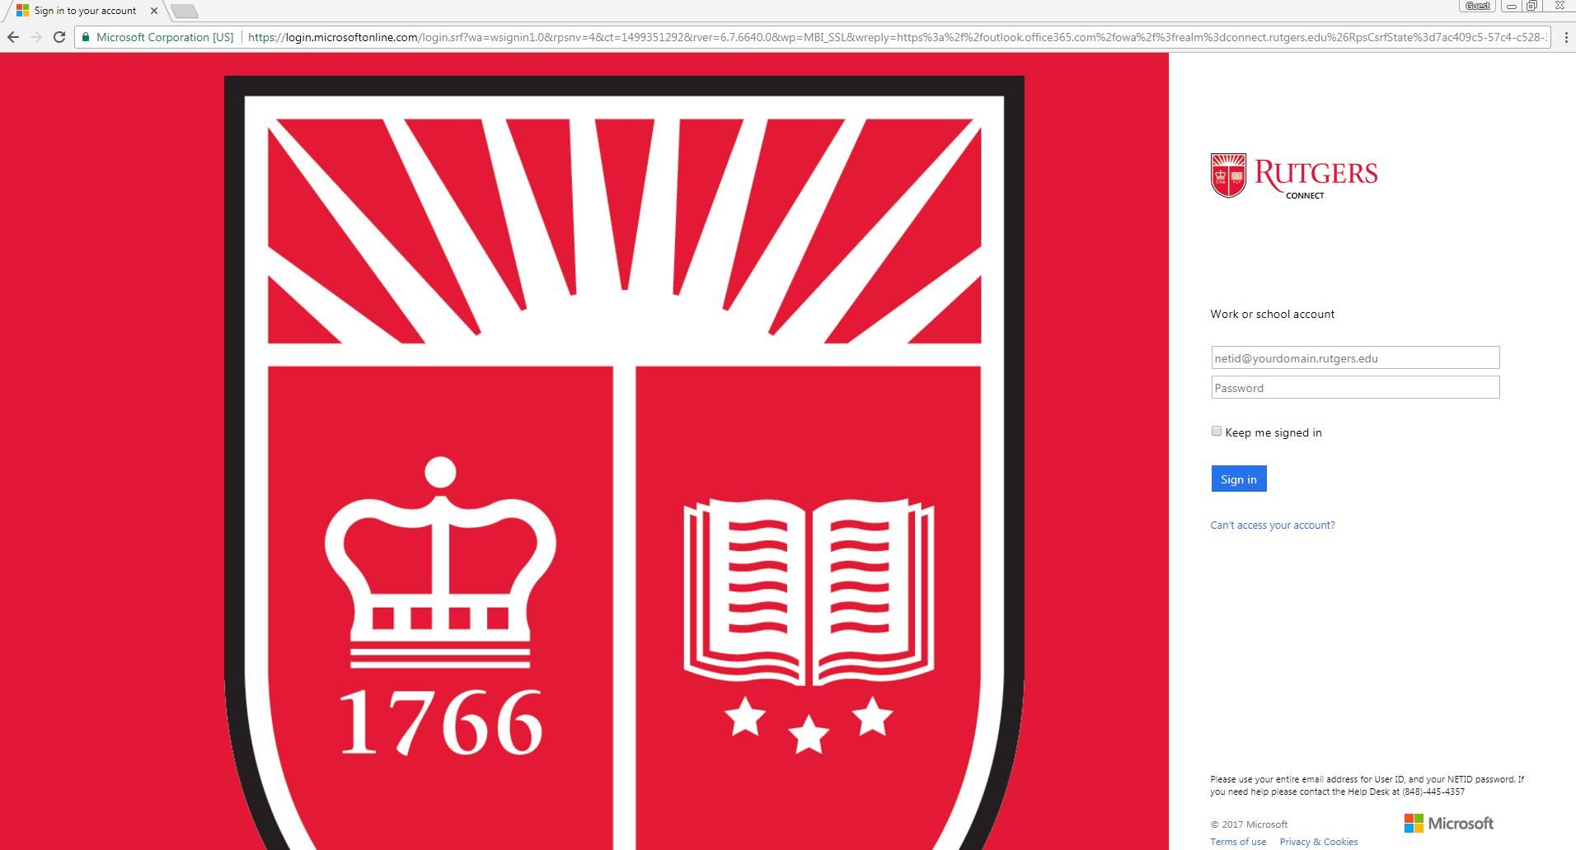
Rutgers COnnect
What is it?
Cloud based system for centralized email, calendar, and Microsoft applications
How to get there?
www.connect.rutgers.edu
Logging in:
Net ID & password

Slide 3
App Launcher / Waffle
O365 Mail & Calendar

Slide 4
OneDrive for Business
Cloud-based storage
Device-agnostic
Streamlined workflow
Share and collaborate with others in the cloud

Slide 5
Navigating OneDrive
Create a variety of file types
Upload files from Desktop
Creating, editing, and accessing files through your Rutgers Connect OneDrive allows you to work on the go!
Access files shared with you
Sync cloud files with your Desktop

Slide 6
Sharing Permissions
Invite people to view or edit your files or entire folders, or share a link!

