Slide 1
What’s next – Careers in Public Health
Speaker: Prof. Amy Abruzzi, Public Health Program Coordinator, Undergraduate Programs
Public Health Degrees: MPH, PhD (epidemiology)
Certifications: Certified Public Health, Master Certified Health Education Specialist

Slide 2
Where do you work, what kinds of jobs do you do?
Public health professionals work on a wide range of services:
infectious disease control
health problems of children, older adults and the medically under-served
chronic disease management
health monitoring and surveillance
environmental/occupational health and safety
emergency preparedness.

Slide 3
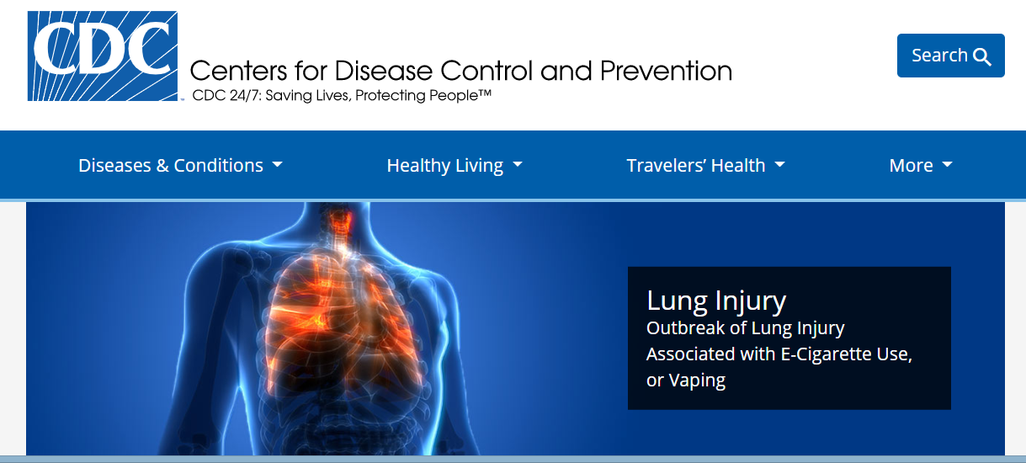
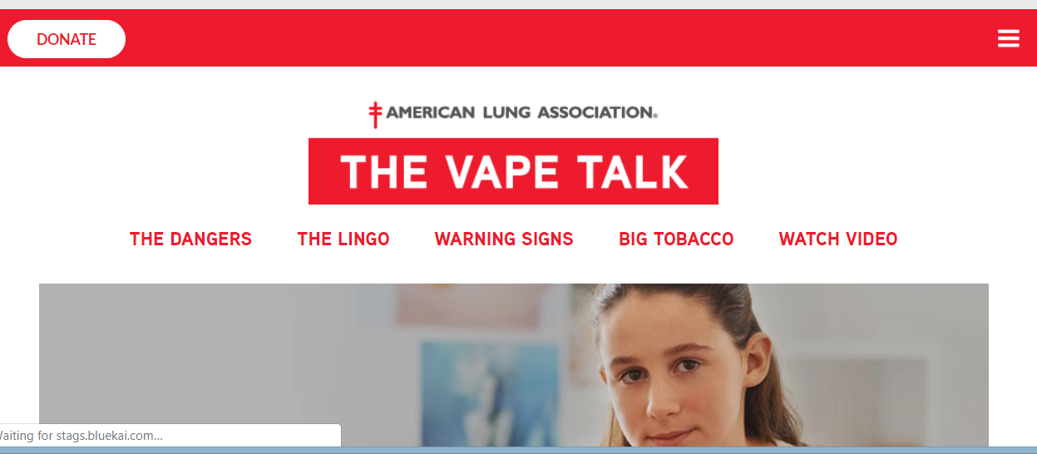
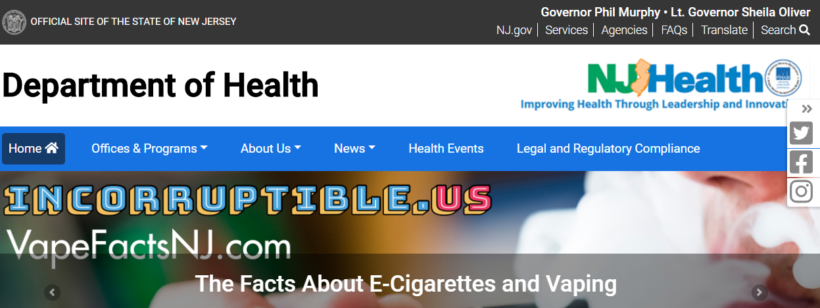
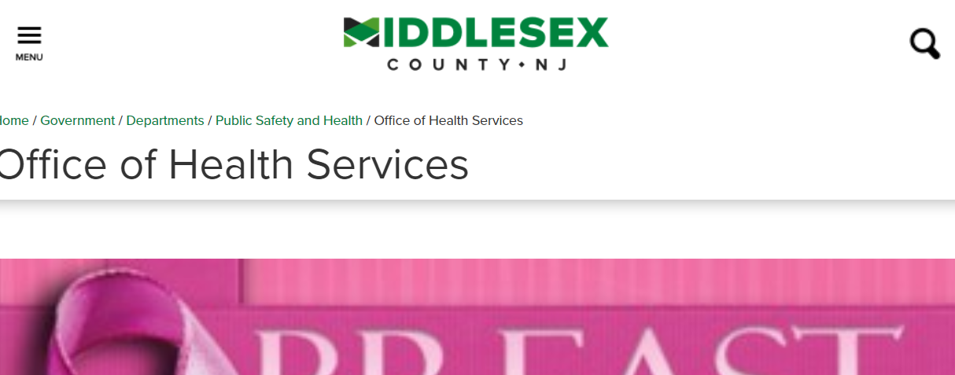
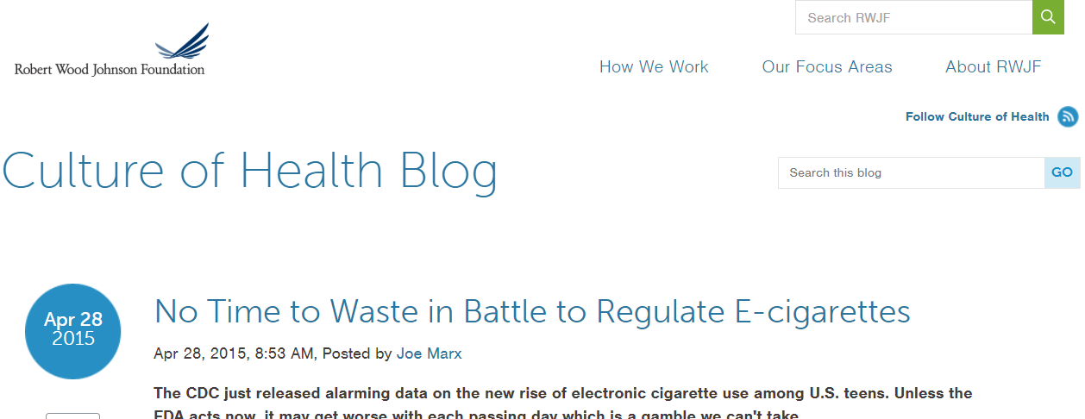
Worksites include all levels of government, non-profits, the business sector, and colleges and universities
Notes:
Common worksites includes health agencies at all levels of government (local, state, national, international), non-profit organizations, the business sector, and colleges and universities.

Slide 4
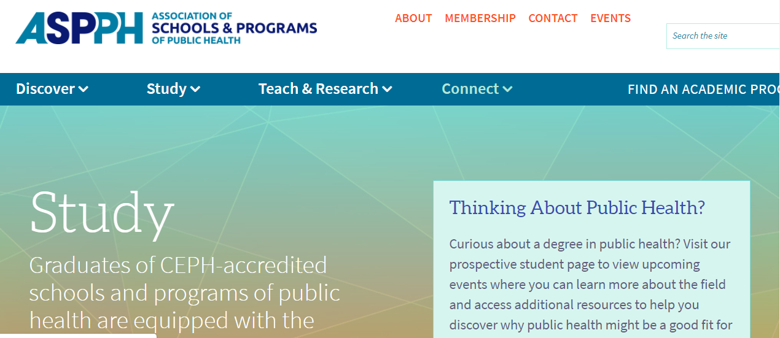
What kinds of places can you work, what kinds of jobs can you do?
ASPPH guide to public health:
http://Aspph.org/study
A handy guide from one of our top associations!

Slide 5
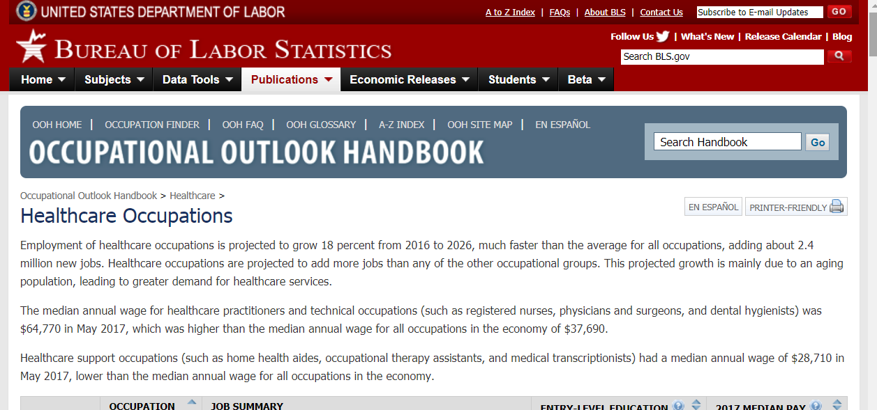
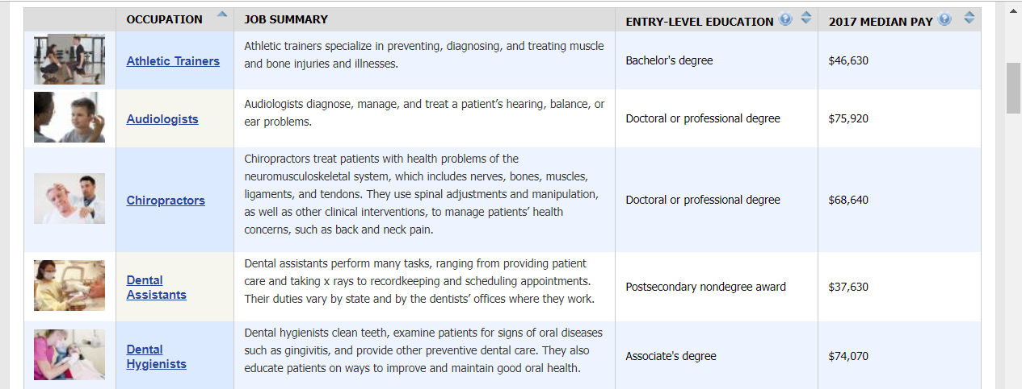
Occupational Outlook Handbook
From the U.S. Bureau of Labor Statistics
Research and compare occupations
Broader description
Entry-level requirements
Median pay
Workforce Projections
Links to -professional associations
Accredited program directories
Membership can lead to job banks
Occupational outlook handbook
https://www.bls.gov/ooh/
Another handy guide, this time from the government.

Slide 6
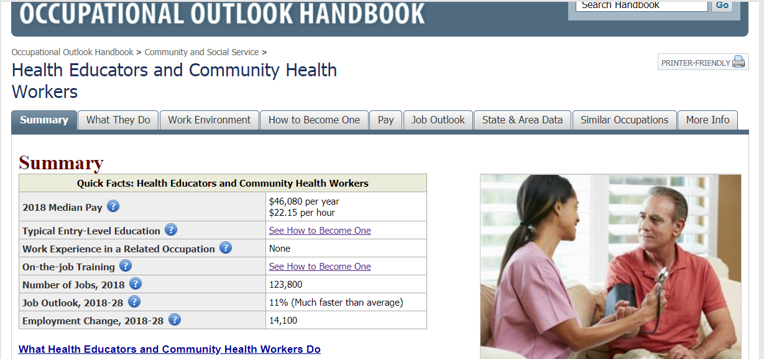

Slide 7
What’s the most desirable degree(s) or credentials for an entry level job?
Usually a master’s degree is preferred (Master of Public Health or equivalent) especially for administrative jobs, but some public health positions may be available with a bachelor’s degree, appropriate certifications plus some related experience.
….It’s a changing workforce
Commons certifications for public health practitioners in NJ include:
Certified Health Education Specialist (CHES)
Registered Environmental Health Specialist (REHS)
Notes:
Many of our students ask about governmental public health. Here, practitioners can work within Federal, State, County/Municipal levels (local). County/Municipal Health (local) generally provide direct services to the public. Every department is required to be led by a Health Officer and then the general make up of the department can vary but each department is required to have or assure access through consultants or staff to: Registered Environmental Health Specialist, Health Educator, Public Health Nurse, and Epidemiologist. In NJ these positions are all hired through the State Department of Health and made available to local health. Various certifications or licenses are required (Links to an external site.). County Health Departments are also charged with HazMat (Hazardous Materials) which is generally staffed by REHS and Emergency Preparedness (multiple specialties involved: Health Officers, Nurses, Health Educators/Risk Communicators, REHS).

Slide 8
Explore job sites in public health
Association of Schools & Programs in Public Health: https://publichealthjobs.org/
Emory School of Public Health: https://apps.sph.emory.edu/PHEC/
University of Washington School of Public Health - Public health Jobs: http://sph.washington.edu/careers/jobs.asp

Slide 9
At least three ways to use job banks
Learn about current job openings
Explore “dream jobs” and get ideas for career development
Shadow potential employers and look for entry level jobs
Set up a search alert: Indeed.com: http://indeed.com
Notes:
Good for exploring current job openings
What can you get with a Bachelor’s?
Use it to explore “dream jobs” and get ideas for self development
What jobs appeal to you?
What degrees are required?
What does it pay?
What kind of other experience might you need?
Use it explore potential employers
Example: search for Rutgers University
What kinds of entry level jobs open up regularly?
Explore the work environment
Make connections

Slide 10
What’s most important when looking at grad programs in public health?
Are they accredited by CEPH?
What’s their program concentrations or areas?
Do they have a specialty?
Affiliations with other programs/employers?
Highest degree offered?
Examples of areas or concentrations:
Health education and promotion
Epidemiology, chronic/infectious diseases
Biostatistics, informatics
Health policy and management
Environmental/occupational health
Health disparities
Urban/Global health
Maternal child health

Slide 11
What’s most important when looking at grad programs in public health?
Faculty and program size
Number of faculty supporting your area of interest
Student-faculty ratio
Faculty expertise, research, professional involvement
Ratings or rankings
How do schools or programs compare?
Specialties, overall quality of program
https://www.usnews.com/education

Slide 12
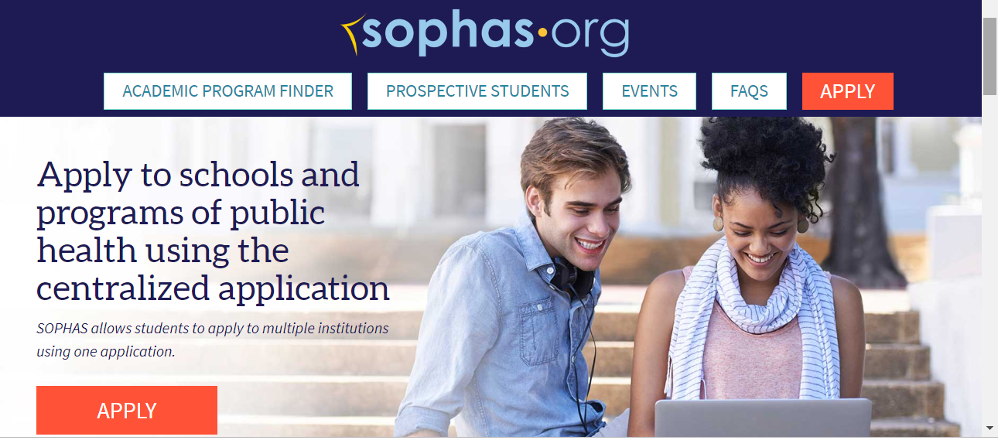
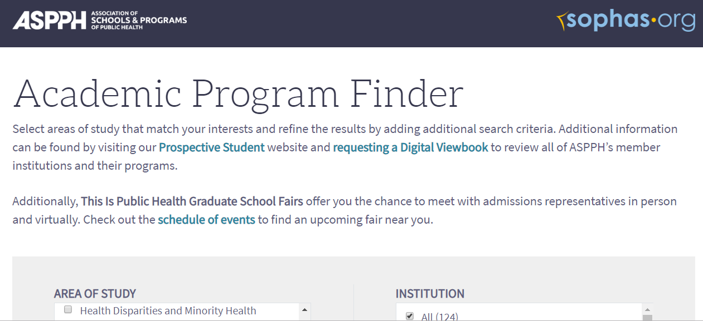
Investigating and applying to schools and programs in public health
https://sophas.org/
https://programfinder.aspph.org/

Slide 13
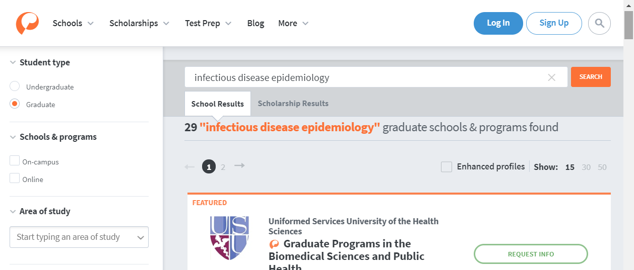
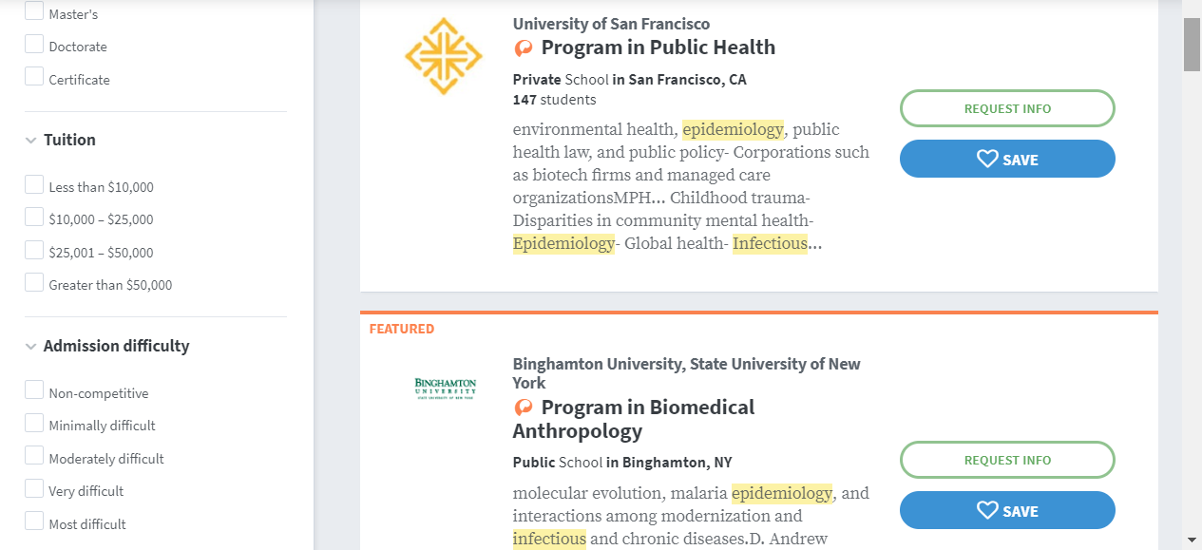
Resources: Peterson’s guides
https://www.petersons.com
Notes:
Explore specific program website/social media pages
Program pages, faculty profiles
Locate and read some publications by key faculty

Slide 14
What personal characteristics do you think makes someone successful in this field?
It’s a huge area, but common to all:
Desire to work towards better population health and well-being
Social conscience, greater good, public servant
Likes problem solving
Good communication skills, ability to work in groups
Some areas of public health involve more contact with the general public, while others are more behind-the-scenes

Slide 15
Example
Epidemiologist
Health Educator
Loves data!
Excellent attention to detail and strong puzzle solving skills
Likes methods courses, biostats
Enjoys doing research, writing, analyzing data – spend lots of time in front of the computer
A people person!
Warm, outgoing personality
Likes doing outreach, networking
Enjoys programing, crafting educational materials, working with different populations, tailoring materials to audience

Slide 16
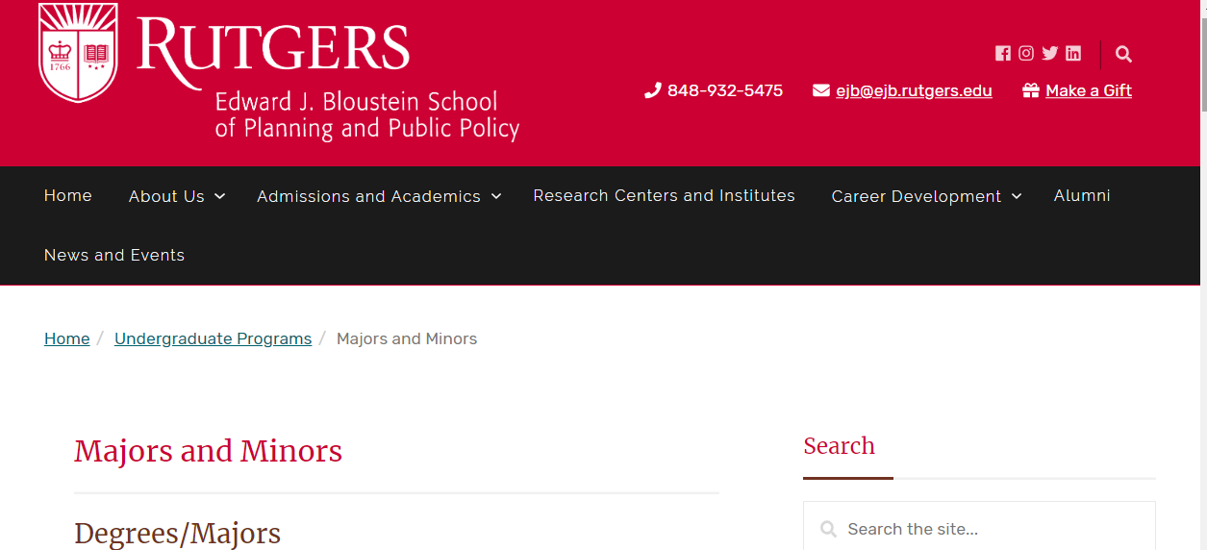
Certificate programs and other educational opportunities
Bloustein certificates for public health majors:
Health Disparities
Public Health Advocacy/Education (eligible for CHES exam)
Public Health Management
Public Health Preparedness
Minors/electives:
EJB Urban Studies minor, EJB Health Administration minor, EJB Public Policy minor
Explore electives in related fields such as psychology sociology, anthropology, nutrition, economics, human ecology, etc. Second language is also very useful for some areas.

Slide 17
Certificate programs and other educational opportunities
More on Certified Health Education Specialist:
National Commission on Health Education Credentialing (NCHEC): https://www.nchec.org/
Other programs of interest:
Registered Environmental Health Specialist (REHS) – science/math coursework + special program: http://www.cpe.rutgers.edu/EPH/environment-and-public-health.html
After being in workforce for several years, you might consider:
Certified in Public Health (CPH) – National Board of Public Health Examiners: https://www.nbphe.org/

Slide 18
Recap: for more on grad schools
Tap these sources
Areas to investigate
Academic advisors, Professors
Alumni, Current students
Career services
School directories and specialty guides, school web sites
Practicing professionals
Academic journal articles
Educational rankings
Program strengths and weaknesses
Accreditation
Student-faculty ratio
Degrees conferred (FT,PT)
Faculty in your area of interest
Reputation and ranking
Awards or other merit-based aid
Unique considerations

Slide 19
Other tips: Get involved
Join Student organizations and clubs at Bloustein/Rutgers
Some include: NJ Public Health Association- Rutgers, Rutgers UNICEF,
Consider joining a professional organization – reduced rates for students, access to materials including some publications, networks, job banks, etc.
Ask your professors for suggestions given your area of interest
Shadow, volunteer, interview professionals, look for internships or other opportunities

