Slide 1
“Should I go to grad school?”: Weighing your options
Speaker: Prof. Amy Abruzzi, Public Health Program Coordinator, Undergraduate Programs
“What’s Next- Grad School?”
October 18, 2019

Slide 2
Should I go to grad school?

Slide 3
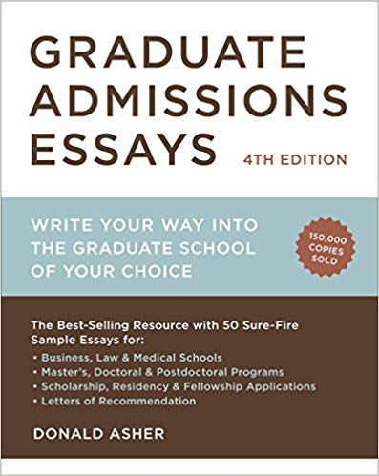
“Good reasons to go to grad school”
You have a passionate interest in a narrow topic or an usual combination of topics.
You have a vocational interest that carries a graduate degree credential as an entrance requirement.
You want to earn more money than you otherwise would have.
You want to ensure continued career advancement.
You seek a richer and more satisfying life.
You like to do research.
School is easy for you and you like it.
From: Asher, Donald. “Graduate Admission Essays: write your way into the graduate school of your choice.” 4th ed. Berkeley: Ten Speed Press, 2012.

Slide 4
“Reasons not to go to grad school right now”
You’re going to grad school to please someone else.
You’re clueless about a subject to study.
You’re secretly trying to avoid the job market.
From: Asher, Donald. “Graduate Admission Essays: write your way into the graduate school of your choice.” 4th ed. Berkeley: Ten Speed Press, 2012.
Notes:
Is what you really want?
Requires commitment and focus
Can add to your debt
Add to your debt, especially if you drop out.

Slide 5
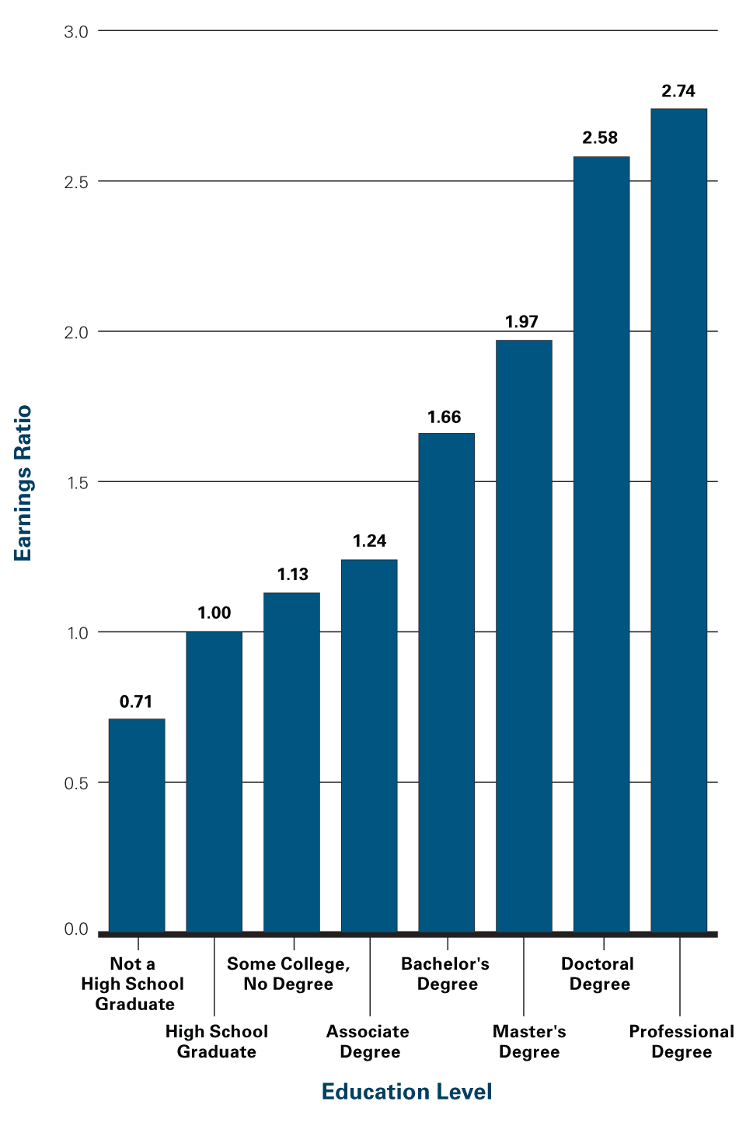
Lifetime Earnings by Education Level
A very good reason to go, eventually:
Expected Lifetime Earnings Relative to High School Graduates, by Education Level
Source: CollegeBoard, 2017
Notes:
Notes & Sources available at: https://trends.collegeboard.org/education-pays/figures-tables/lifetime-earnings-education-level
Note: Based on the sum of median 2008 earnings for full-time year-round workers at each age from 25 to 64 for each education level. No allowance is made for the shorter work life resulting from time spent in college or out of the labor force for other reasons. Future earnings are discounted at a 3% annual rate to account for the reality that, because of forgone interest, dollars received in the future are not worth as much as those received today. This represents real interest, as all earnings are in 2008 dollars. Discounting does not have a large impact on the lifetime earnings ratios.
Sources: U.S. Census Bureau, 2009; calculations by the authors.
Key Points
The calculations in Figure 1.2 are based on earnings of individuals working full-time year-round. Because the proportion of adults working full-time year-round increases with education level (for example, 67% of college graduates and 55% of high school graduates between the ages of 45 and 54 worked full-time in 2008), the lifetime earnings differentials would be larger if all adults — or all adult workers — were included in these calculations.
As Figure 1.1 reports, higher earnings correspond to higher tax payments. If after-tax earnings were used in this calculation, the ratio of lifetime earnings for individuals with more than a high school diploma to lifetime earnings for high school graduates would decline slightly.
Also Important
There are a variety of ways to estimate lifetime earnings for people with different levels of education. Although some reasonable assumptions would lower the ratios shown here and other reasonable assumptions would increase those ratios, the results consistently reveal significantly higher earnings levels associated with higher levels of education.
A number of careful studies show that people who are kept out of college by barriers like a shortage of funds or the absence of nearby appropriate colleges earn higher than average returns when the barriers are lowered. In other words, the idea that students who are not enrolling in college would be unlikely to enjoy the average benefits reported here is not supported by the evidence (Brand and Xie, 2010).

Slide 6
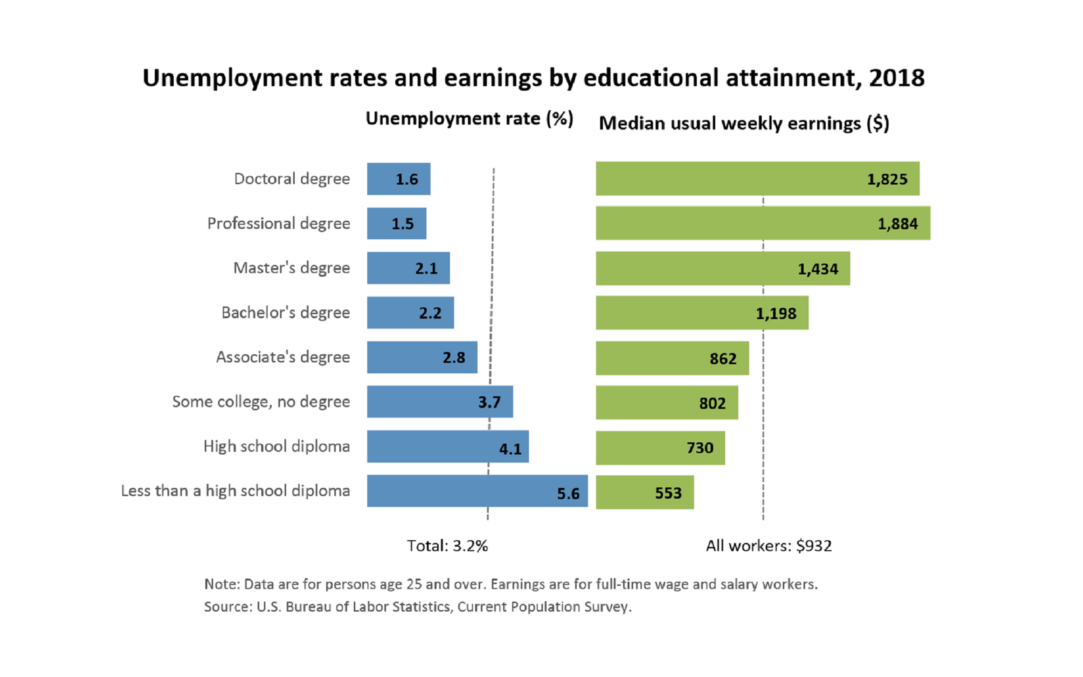
Notes:
Available at: https://www.bls.gov/emp/home.htm

Slide 7
When should I go to grad school?

Slide 8
Work first, then go to school?
Pros
Cons
May not be your dream job or pay very well
Some employers want a 1 or 2 year commitment
Lifestyle changes
Payback time for loans
Gain experience
Earn money
Motivate, clarify your goals
Explore new environments
Network

Slide 9
Should I study part-time or full-time?

Slide 10
Part-time graduate study
Pros
Cons
Gain experience while working towards advancement
Offset costs of further study
Some employers offer tuition reimbursement/waivers for part-time study
Professional programs may offer summer courses and/or online options
Takes longer to graduate
May not be practical for all jobs
Limits your options
May be lower in admission priority
May not be eligible for merit-based aid
Requires extra effort to gain program experience

Slide 11
Full-time graduate study
Typical aid sources
Key considerations
Teaching assistantships
Research assistantships
Fellowships
Grants
Tuition waivers
Loans
Source (internal, external)
Amount
Restrictions or other requirements
Availability for professional programs
Early Deadlines

Slide 12
Final thoughts
It takes time to figure things out!
Many students work for a few years before going on to grad school, and this seems best for most
Talk to people you know and admire for advice
Family, teachers, friends, employers, community leaders
Take advantage of opportunities that come your way

