Slide 1
What’s Next Fall 2022 program
November 16, 2022
6:30 – 8:00 PM
Via ZOOM
This program will be recorded and available on our “What’s Next? Bloustein Undergraduates?” site on Canvas. Join us at: https://go.rutgers.edu/ejbwhatsnext

Slide 2
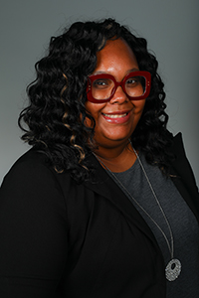
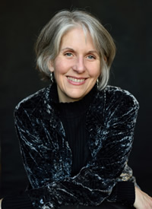
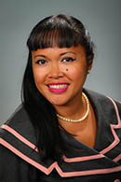
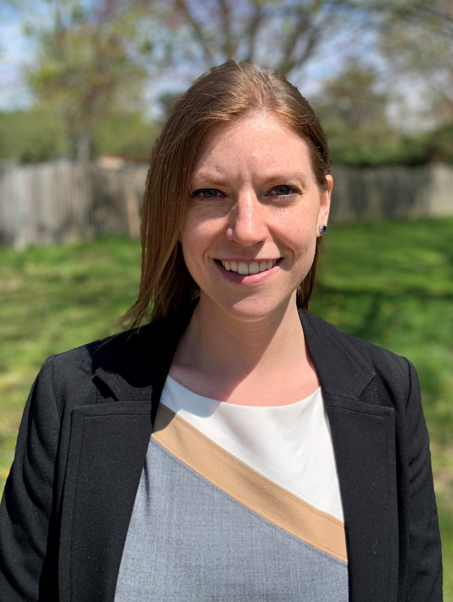
Tonight’s program
Moderator: Natashia Huff, Student Counselor, Student and Academic Services, BSPPP
Speaker: Amy Abruzzi, Undergraduate Public Health Program Coordinator, BSPPP
Weighing your options & other tips
Speaker: Lynn Astorga, Associate Director of Student Recruitment, BSPPP
Graduate study at the Bloustein School of Planning and Public Policy
Speaker: Brittany Gerstik, Graduate Admissions Counselor, SPH
Graduate study at the Rutgers School of Public Health
Discussion with recent alumni/current students
Panel style question & answer
Breakout rooms

Slide 3
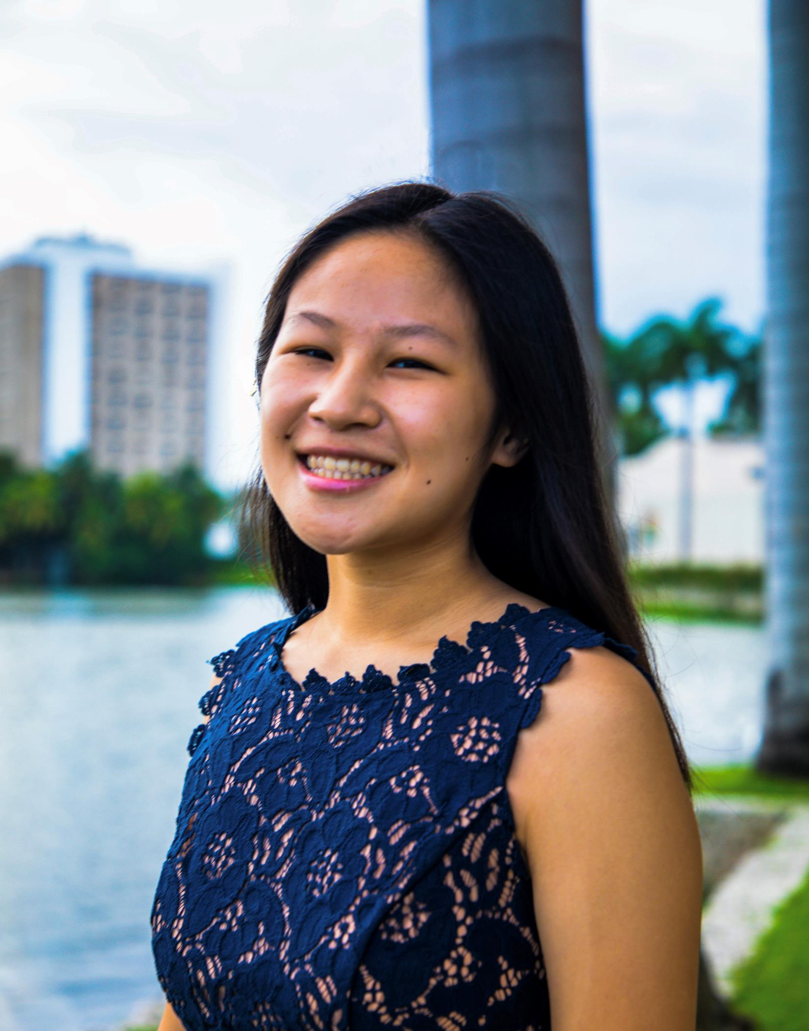
Alumni/current student panelist
Arina Zeng
Bachelor’s: Health Sciences, Univ of Miami ’20
Master’s: Master of Public Health (MPH) candidate at Rutgers, School of Public Health, concentration in Public Health Nutrition
Currently completing MPH and working as a community health worker in Jersey City.

Slide 4
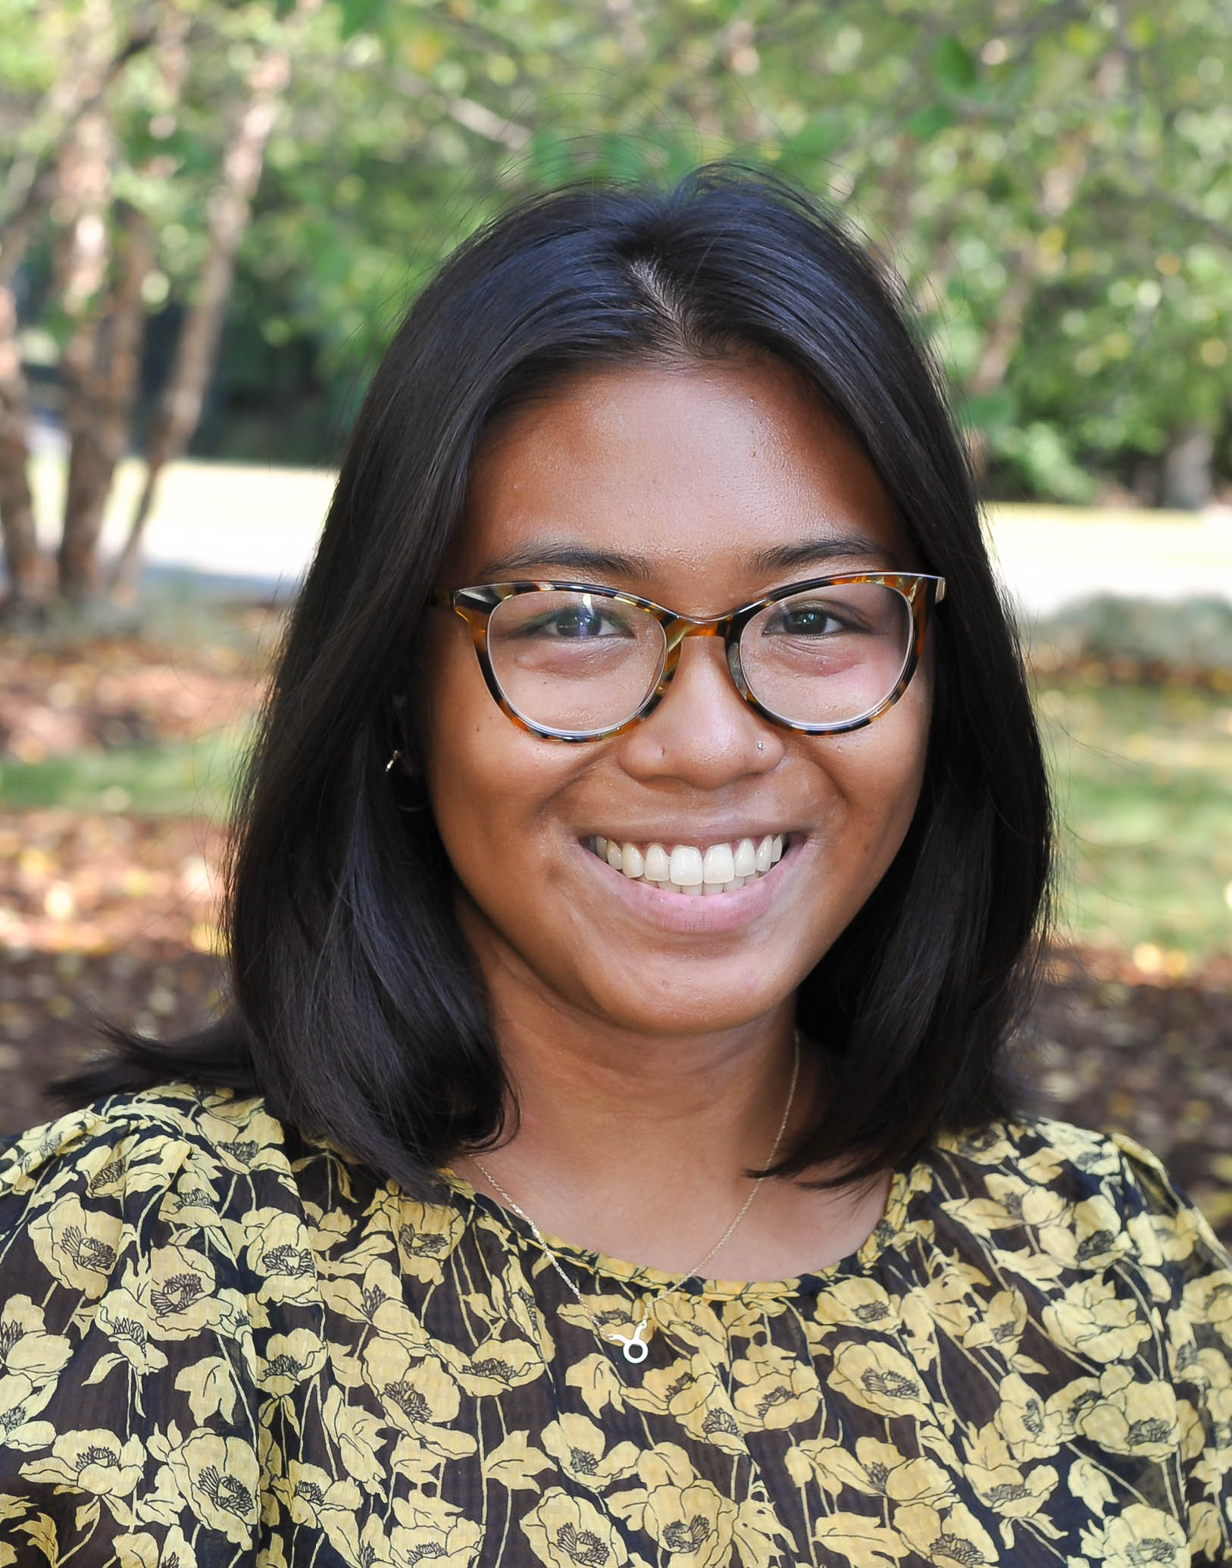
Alumni/current student panelist
Tracey Prescilla Glove
Bachelor’s: Political Science, Temple ‘20
Master’s: Master of Public Policy (MPP), Rutgers, Bloustein ‘22
Currently working as program coordinator for Policy and Planning at Sustainable Jersey.

Slide 5
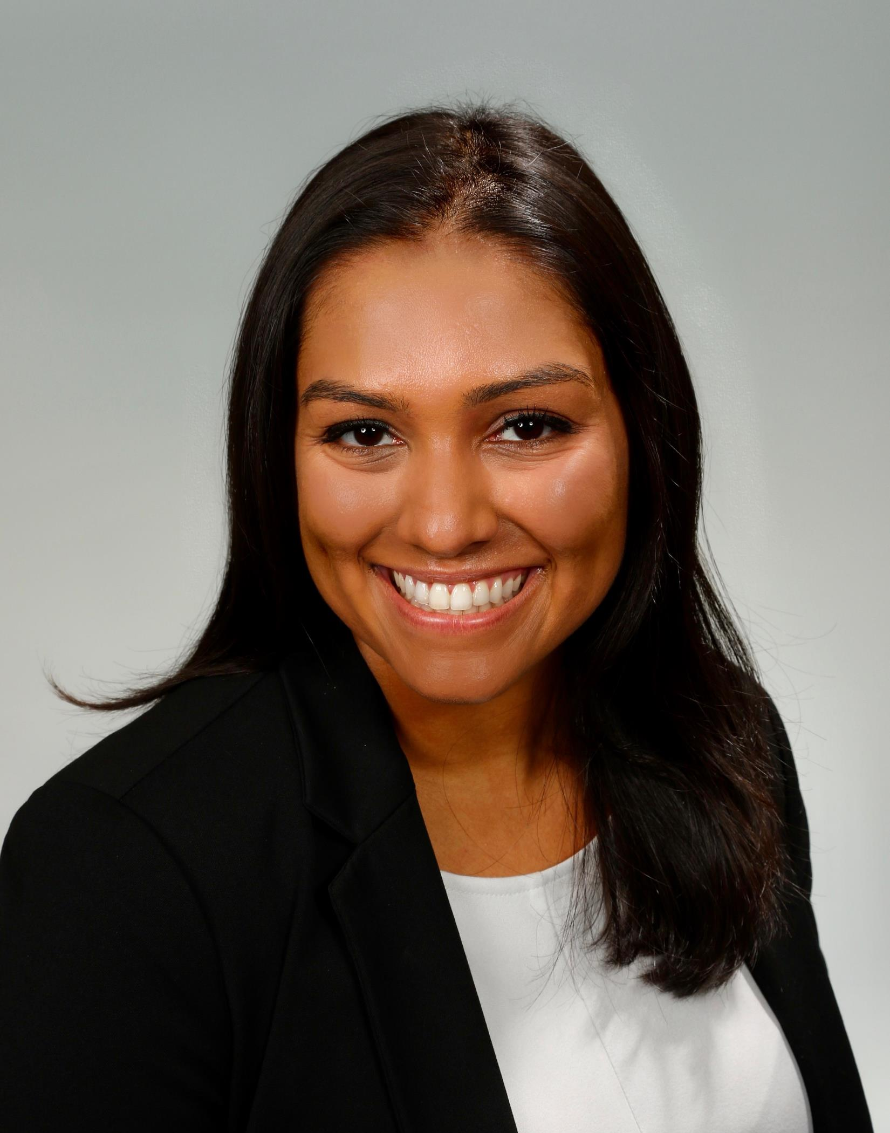
Alumni/current student panelist
Nisha Desai
Bachelor’s: Health Administration, Rutgers ’20
Master’s: Master of Health Administration, Rutgers, Bloustein ’22
Currently working as a Healthcare Consulting Analyst and living in New York City.

Slide 6
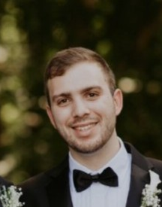
Alumni/current student panelist
Ben Nechmad
Bachelor’s: Urban Planning and Design, Bloustein ‘20
Master’s: Master of City and Regional Planning (MCRP), Rutgers, Bloustein ’21
Currently a land use planner at Topology.

Slide 7
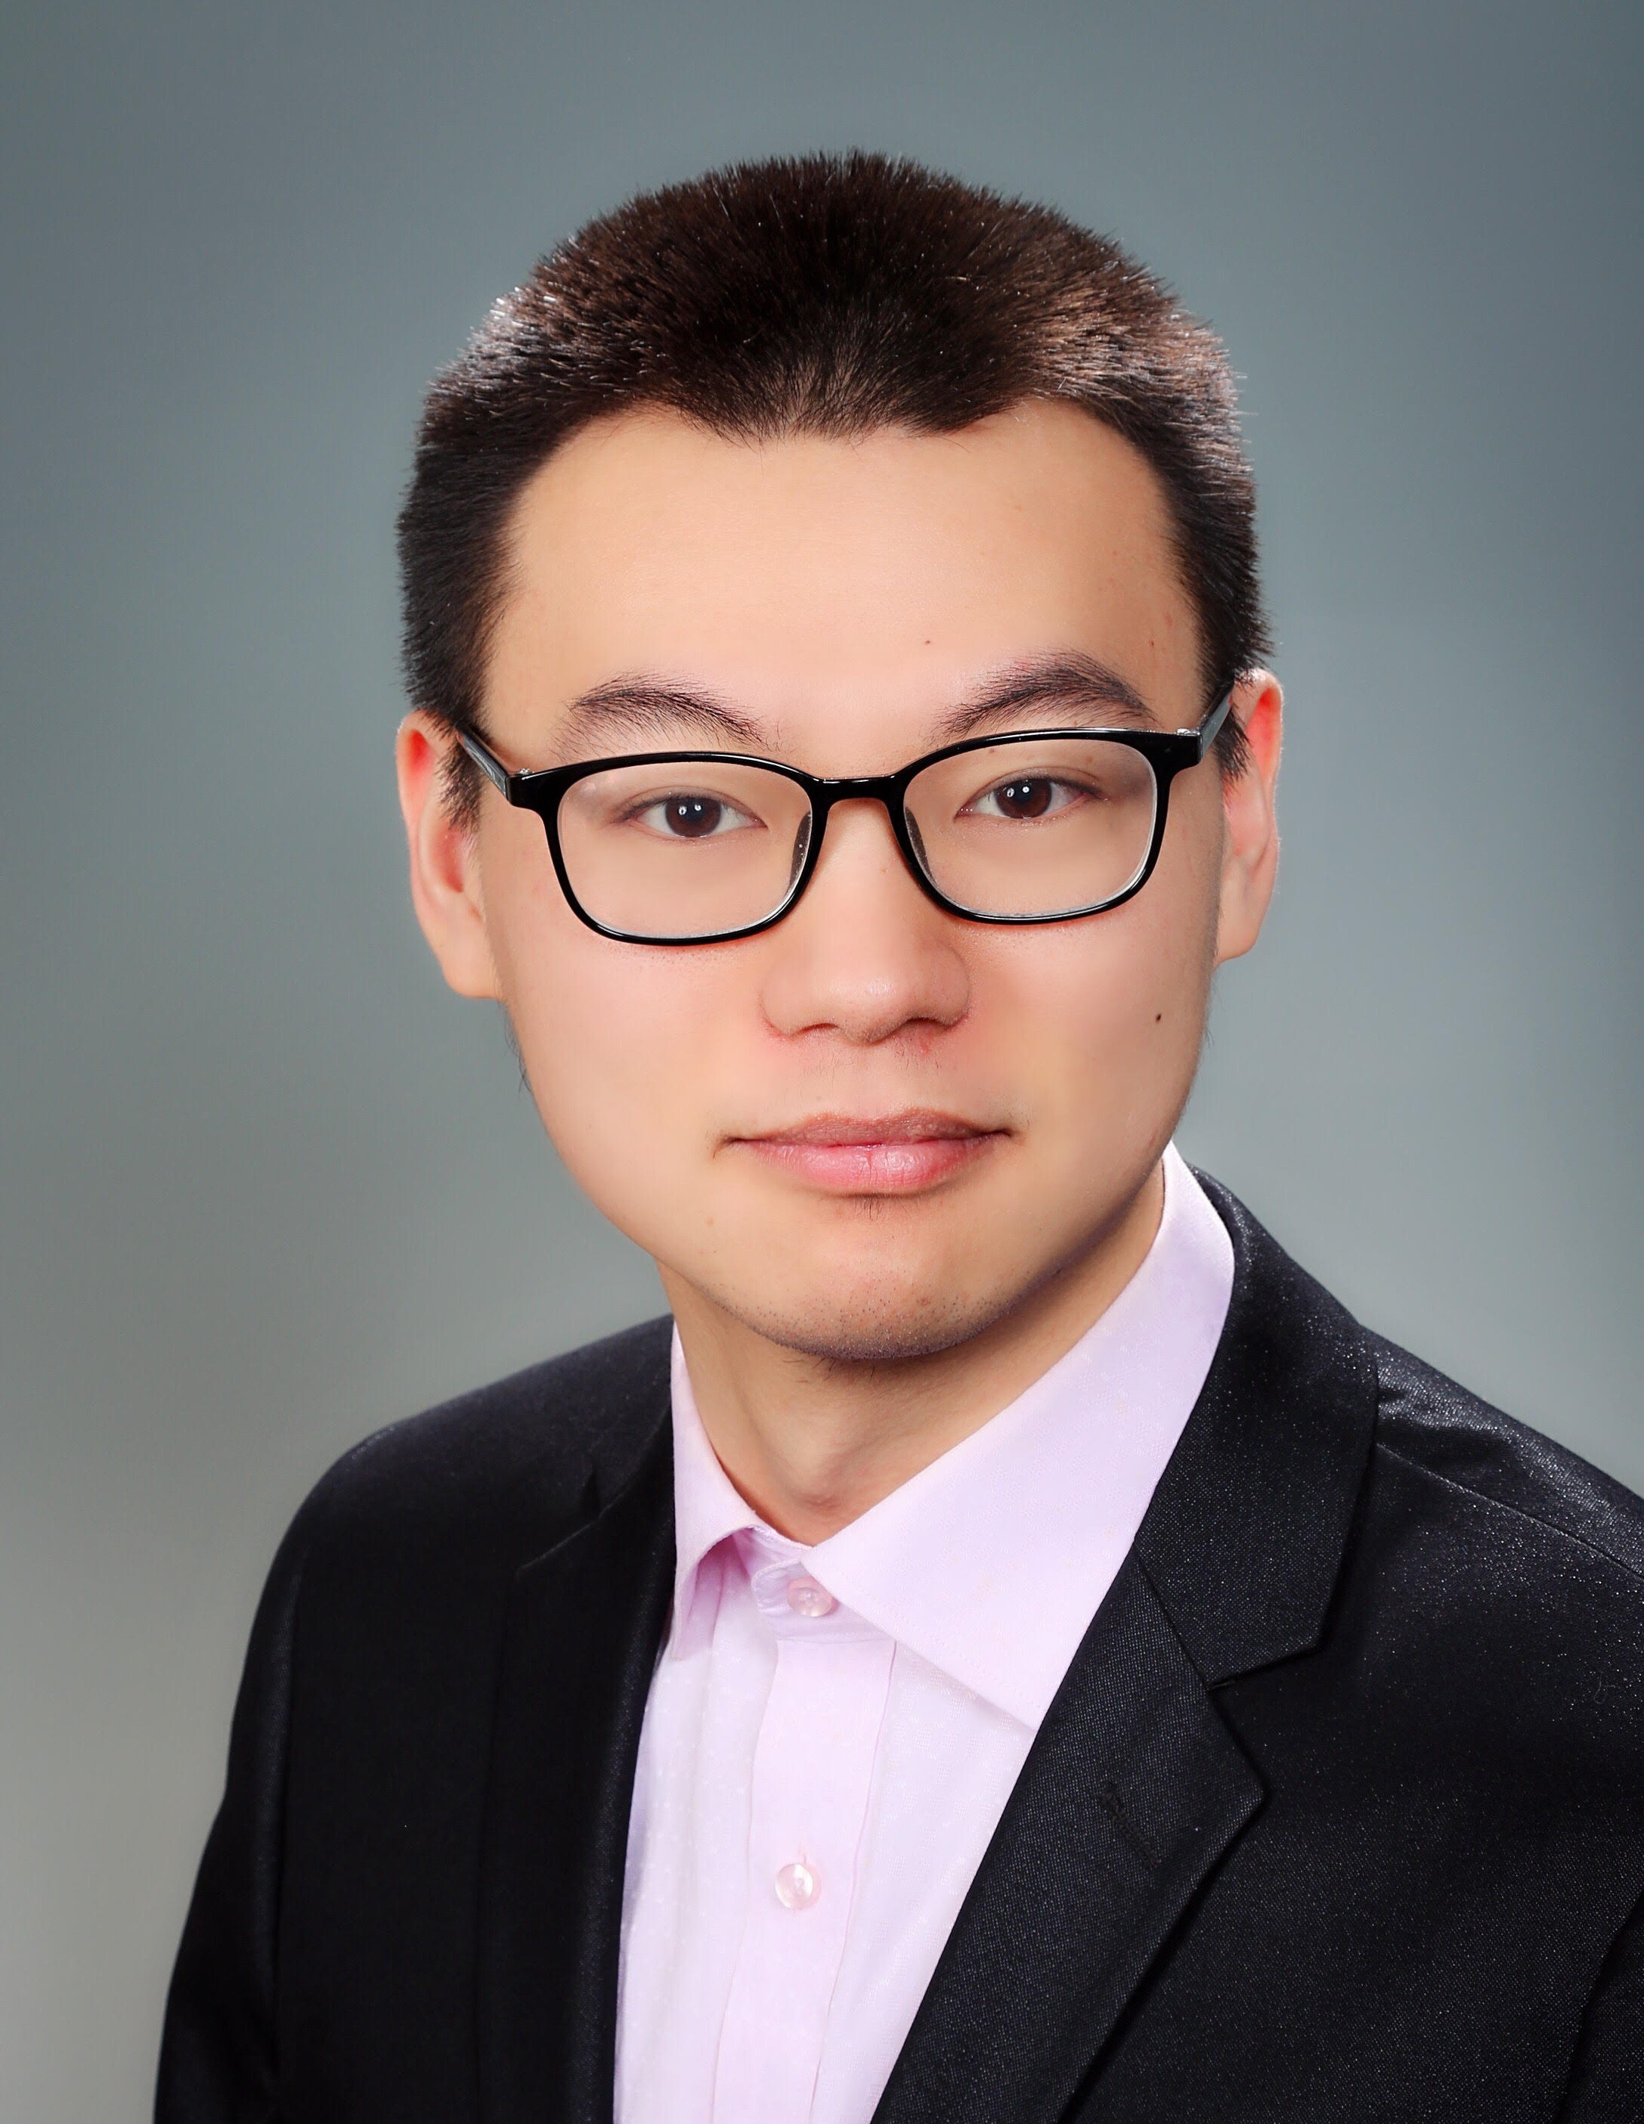
Alumni/current student panelist
Haoyun Wang
Bachelor’s: Urban Planning, Nanjing University, China
Master’s: Master of City and Regional Planning (MCRP) and Master of Public Informatics (MPI), Rutgers, Bloustein ’20
Currently: GIS consultant focusing on transportation planning and GIS applications, WSP.

Slide 8
Connect with our faculty, staff and panelists through LinkedIn!

