Slide 1
What’s Next: Focus on Epidemiology
March 30st, 2021
6:30 – 8:00 PM
Via ZOOM
This program will be recorded and available on our “What’s Next? Bloustein Undergraduates?” site on Canvas. Join us at: https://go.rutgers.edu/ejbwhatsnext

Slide 2
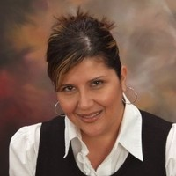
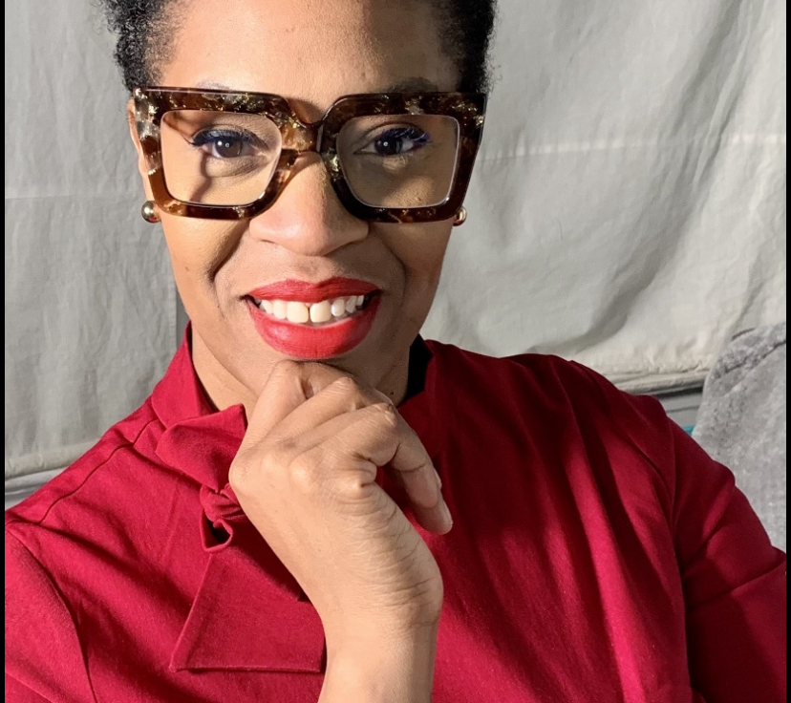
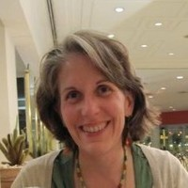
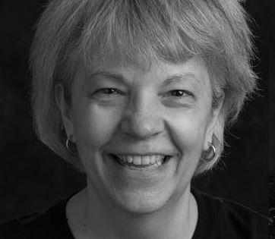
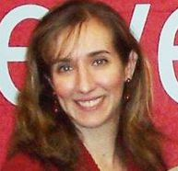
Our faculty
Introduction: Prof. Abruzzi
Panel moderator: Prof. Lopez
Wrap-up: Prof. Obrien-Richardson
Final comments: Prof. Franzione
Prof Lopez
Prof Obrien-Richardson
And a very special thanks to Chery Egan, who is helping us run this program!
Prof Abruzzi
Prof Franzione

Slide 3
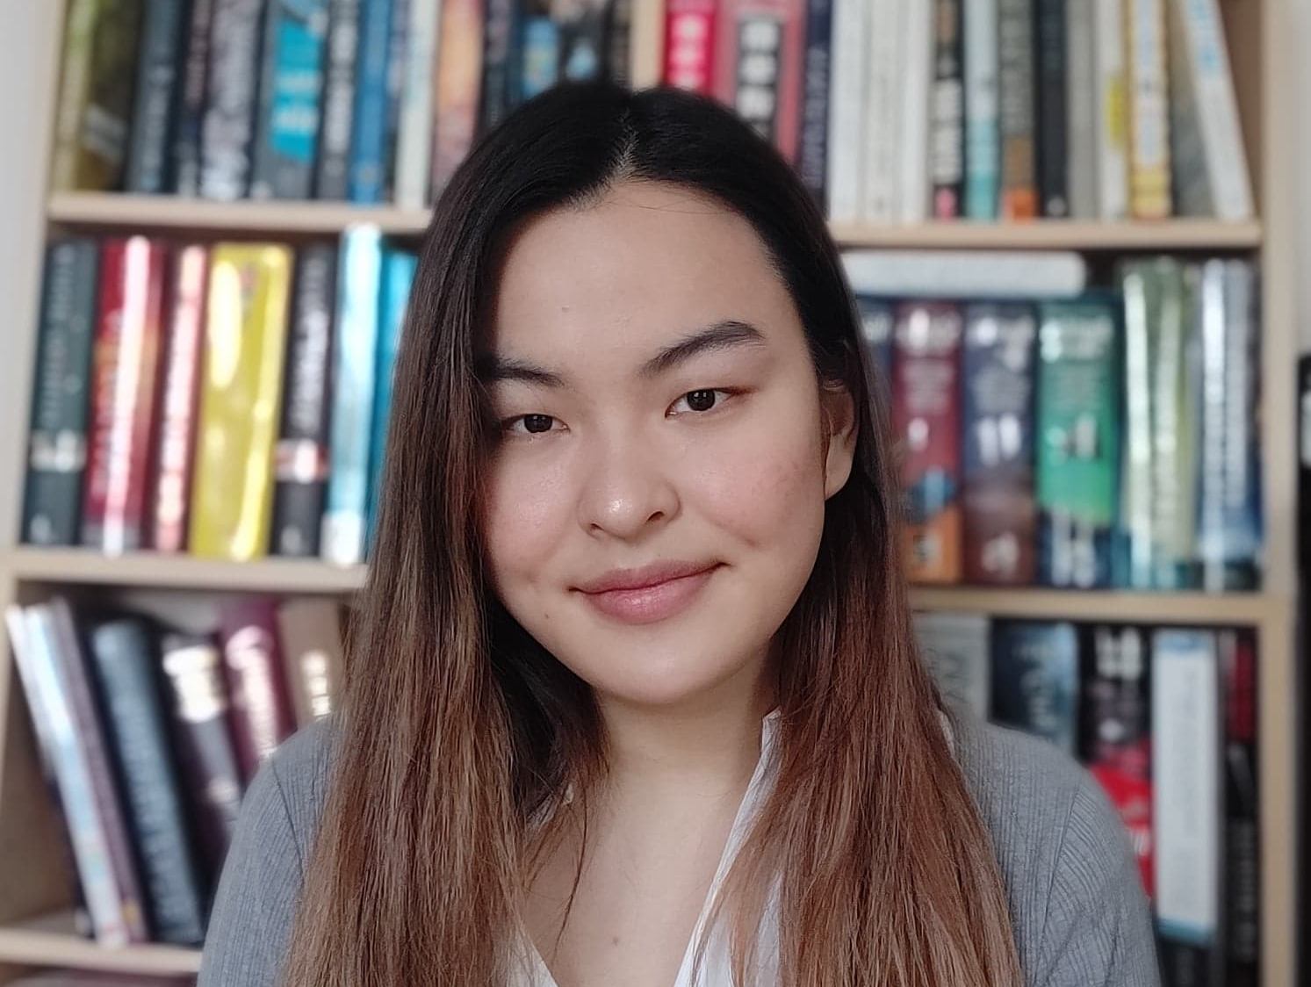
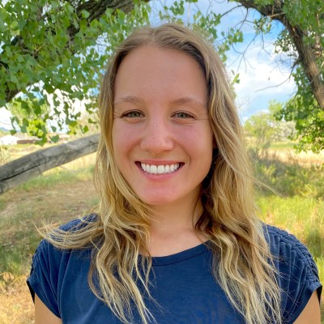
Our panelists
Eileen Zhu, MPH candidate (Yale)
BS Genetics; Public Health minor ‘21 (Rutgers)
Currently: Genetic Epidemiology graduate student, Yale University
Areas: Genetic and Molecular Epidemiology, Social Epigenomics, Chronic Disease Epidemiology
Hannah Fryczynski, MPH’20 (Rutgers)
BS Public Health ‘19 (Rutgers)
Currently: Epidemiologist at CDC Foundation, Denver area
Areas: COVID-19, sexual health advocate, HIV testing, gun violence

Slide 4
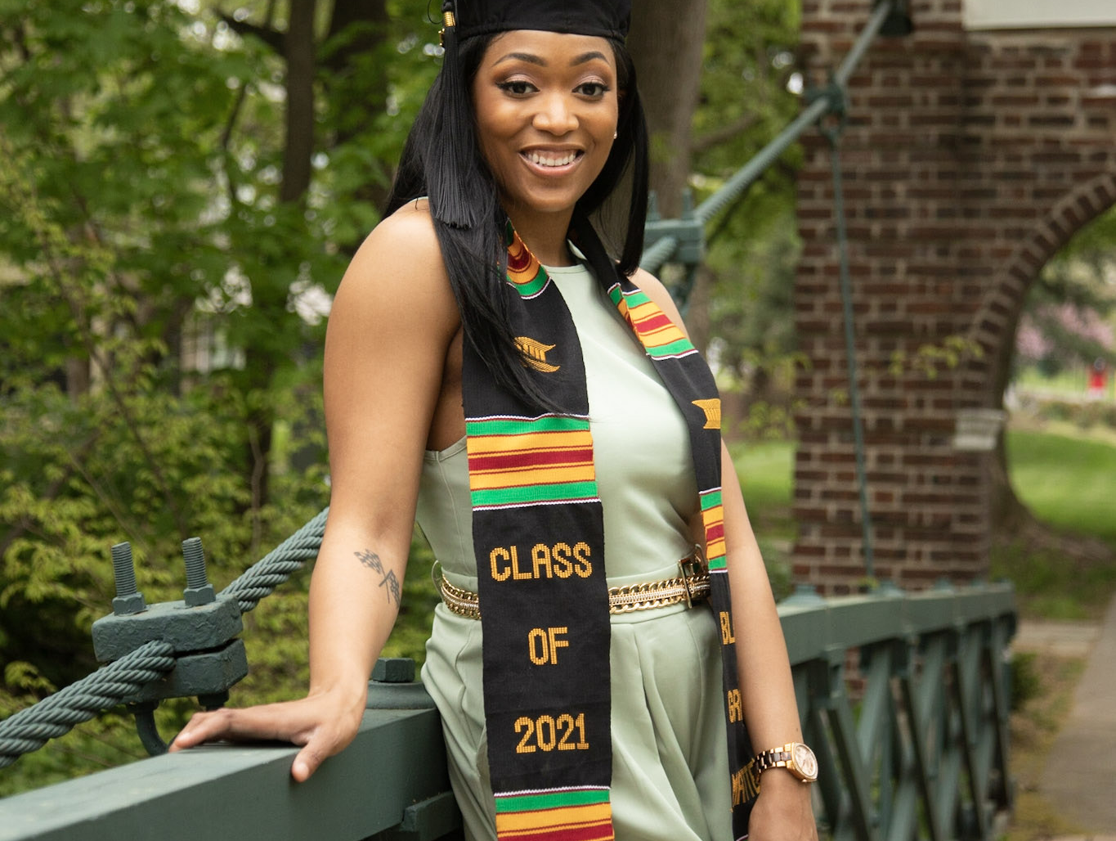
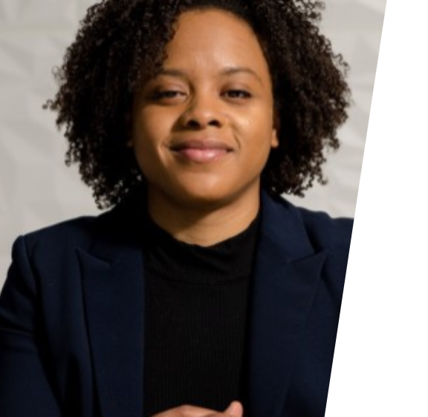
Our panelists
Chelsea Gray, MPH’21(Rutgers)
BS Public Health ‘18 (Rutgers)
Future: Health Data Scientist 1, NJDOH and GIS Analyst, U.S. Dept. of Health and Human Services
Areas: Maternal & Child Health with some experience in infectious disease, data visualization
Nicole JoneApplied Stats Certificate ’21 (Rutgers)
BS Mathematics s, MPH ’20, ‘17 (Spelman College)
Currently: Statistical Programmer, Merck
Areas: Pharmaceutical research, clinical research, R and Shiny

Slide 5
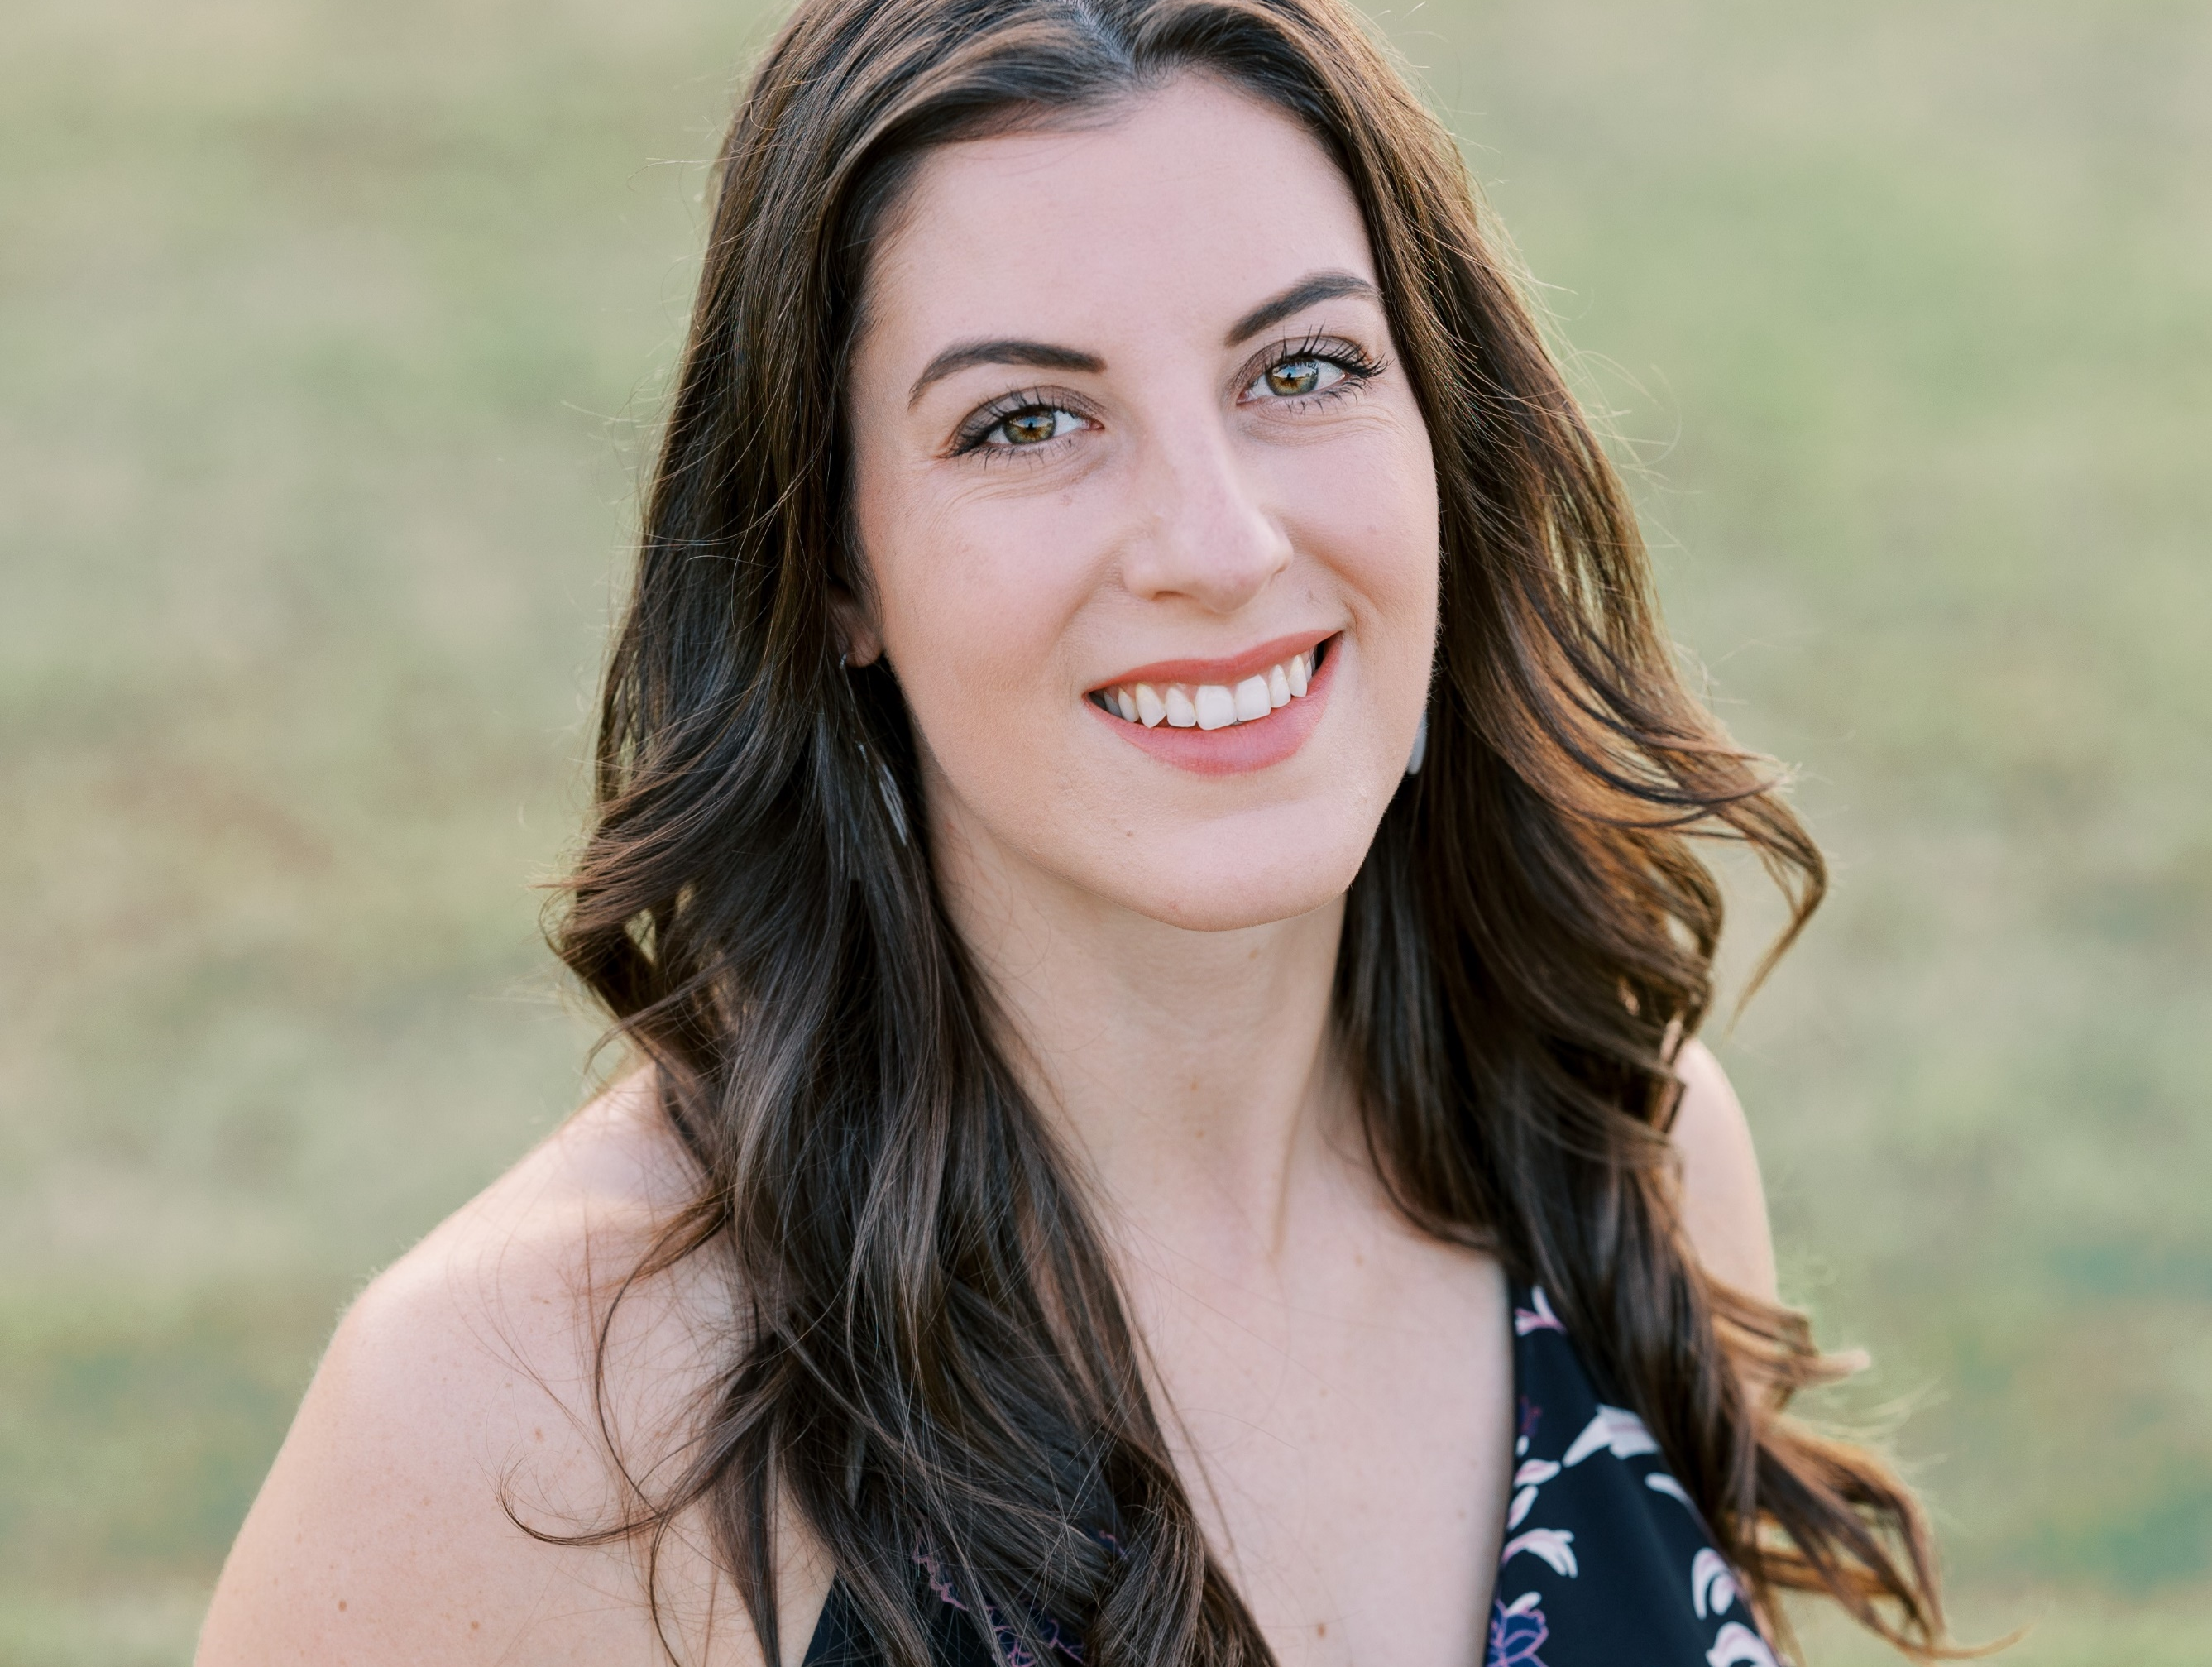
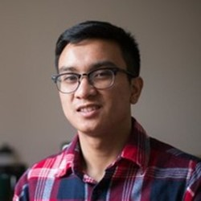
Our panelists
Cora Stewart, MPH (Rutgers ‘17) , CSP (Certified Safety Professional)
BS Public Health ‘16 (Rutgers)
Currently: Safety Manager, L'Oréal, Little Rock, Arkansas
Areas: Occupational health/safety, Epidemiology
Enrico Cabredo, MPH’16 (Tulane), REHS
BS Public Health ‘14 (Rutgers)
Currently: Public Health Epidemiologist, Monmouth County Health Dept.
Areas: Communicable Disease, Local Public Health

Slide 6
Connect with our panelists on Linked In!
Eileen Zhu https://www.linkedin.com/in/eileen-zhu1/
Hannah Fryczynski https://www.linkedin.com/in/hannahfryczynski/
Chelsea Gray https://www.linkedin.com/in/chelseamgray/
Nicole Jones https://www.linkedin.com/in/nicole-jones-mph-68a007174/
Cora Stewart https://www.linkedin.com/in/corastewart/
Enrico Cabredo https://www.linkedin.com/in/enrico-cabredo-a4448766

