Slide 1
What’s Next: Inside Your Health Department
Thursday, November 11th, 2021
Via Zoom
A recording will be posted to the What’s Next? site on Canvas.
Join us at: https://go.rutgers.edu/ejbwhatsnext

Slide 2
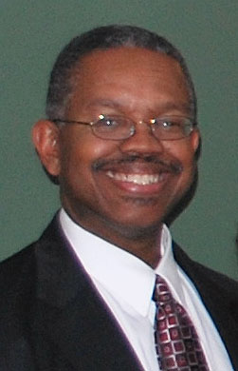
David Henry, MPH
Title: Health Officer
Location: Monmouth County Regional Health Commission #1,
Tinton Falls, NJ
Rutgers University affiliation
Rutgers/Cook College – BS, 1983
UMDNJ/Rutgers – MPH, 1991
Bloustein Instructor:
Principles of Public Health

Slide 3
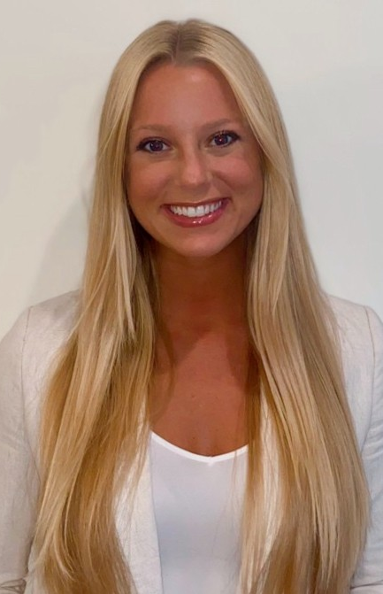
Brett Nance, MPH
Title: Epidemiologist
Location: Freehold Area Health Department, Freehold, NJ
Rutgers University affiliation
Rutgers School of Public Health - MPH, 2017
Bloustein Instructor:
Epidemiology

Slide 4
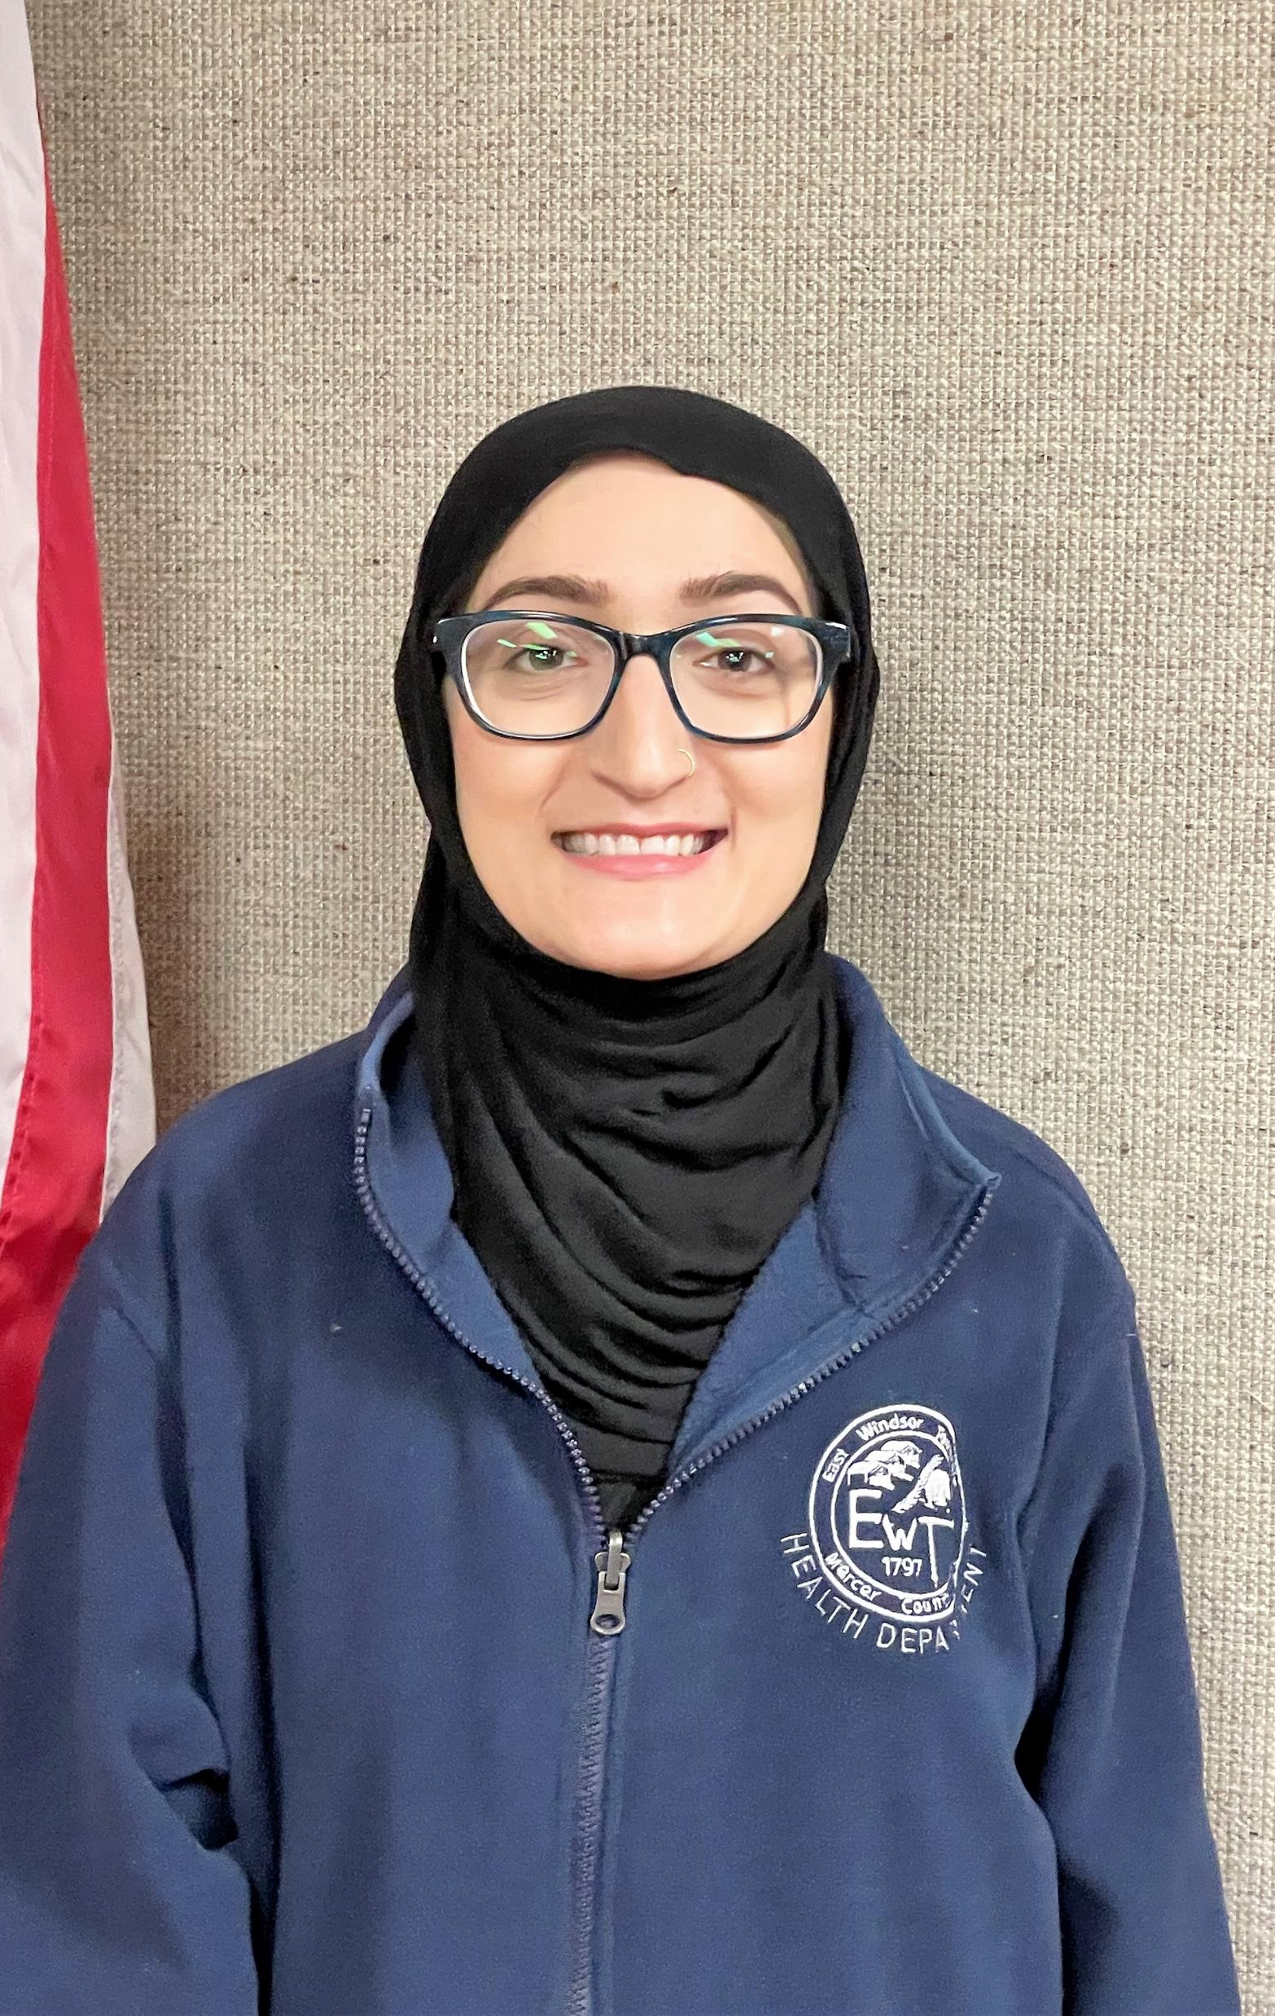
Shereen Naqvi, BS, BSN, RN
Title: Public Health Nurse
Location: East Windsor Township Health Department, East Windsor, NJ
Rutgers University affiliation
Douglass College and Bloustein School - BS, 2007

Slide 5
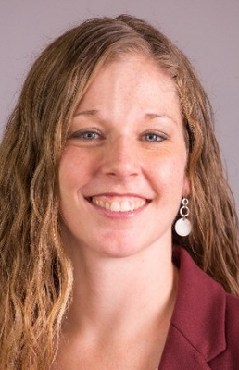
Linda Brown, MPH, MCHES
Title: Executive Director at Neighborhood Connections to Health
Location: Hillsborough, NJ
Formerly: Health Educator
Locations: Freehold Area Health Department, other health departments
Rutgers University affiliation
Bloustein Instructor:
Community Health Promotion
Health Program Administration
CHES Prep
other courses

Slide 6
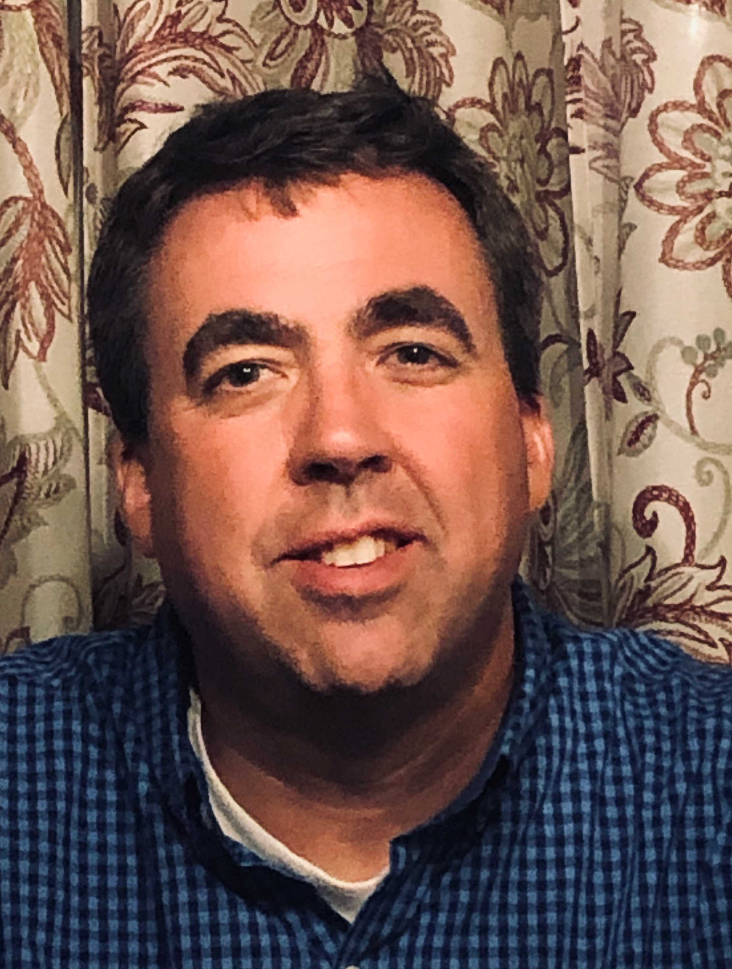
James Breiten, REHS, MPH
Title: Registered Environmental Health Specialist
Location: Rockaway Township Division of Health, Rockaway, NJ
Rutgers University affiliation:
Environment and Public Health summer program, Office of Continuing Professional Education, Summer 2001 http://www.cpe.rutgers.edu/EPH/environment-and-public-health.html

