Slide 1
What’s Next: Navigating your first year out
March 31st, 2021
6:00 – 8:00 PM
Via ZOOM

Slide 2
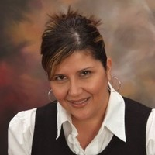
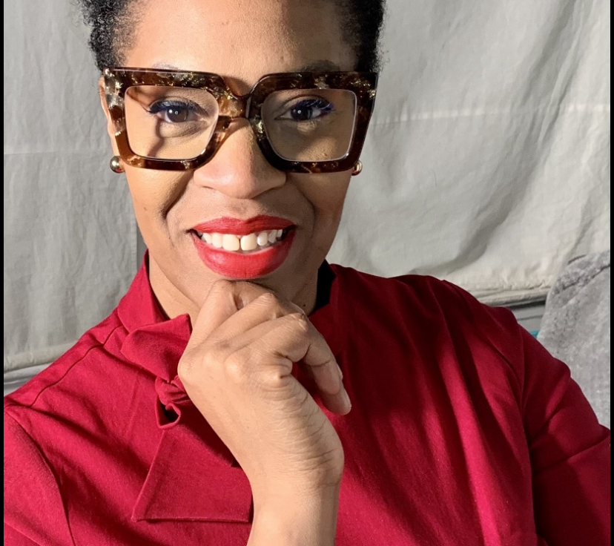
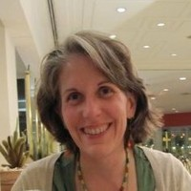
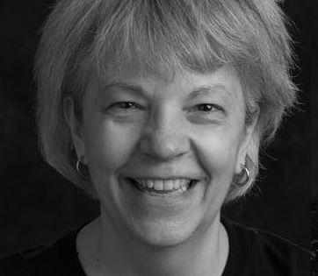
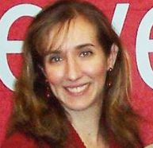
Our faculty
Introductions: Prof. Abruzzi and Prof. Franzione
Panel moderator: Prof. Lopez
Wrap-up: Prof. Obrien-Richardson
Prof Lopez
Prof Obrien-Richardson
And a very special thanks to Cheryl Egan, who is helping us run this program!
Prof Abruzzi
Prof Franzione

Slide 3
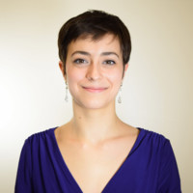
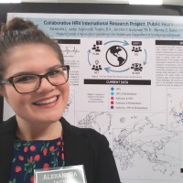
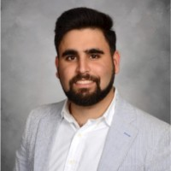
Our panelists
Alexandra Jacko: BS ‘21 (January), Public Health major, Statistics minor
Currently: Independent Consultant, Renew360 Rehabilitation Center; STEM Academic Leader, Douglass Project for Women in STEM; MPH student at RU SPH in biostatistics.
Celine LaBelle: BS ‘20, Public Health major, Health Disparities Certificate, Statistics minor; Certified Health Education Specialist (CHES)
Currently: Health Education Assistant, Montgomery Township Health Department
David Abayev: BS ‘19, Public Health major, Biology minor
Currently: DDS candidate at New York University – College of Dentistry
Celine
Alexandra
David

Slide 4
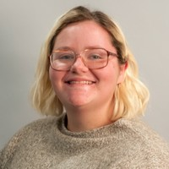
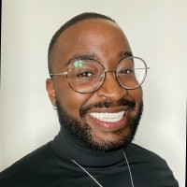
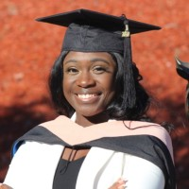
Our panelists
Margaret Haskopoulos: BS ‘18, Public Health and Journalism double major
Currently: MPH student in Humanitarian Health at George Washington University- Milken Institute of Public Health
Marquis Johnson: BS’15, Public Health; MHA’20 Health/Health Care Administration/Management (Rutgers- Bloustein), Lean Six Sigma Green Belt Certification
Currently: Overdose Detection Mapping Application Program Coordinator at Washington/Baltimore High Intensity Drug Trafficking Area
Auriel Tarty: BS’12, Public Health; MPH’20 Epidemiology (Georgia State University)
Currently: Contact Tracer/Case Investigator, Georgia Department of Public Health
Margaret
Marquis
Auriel

Slide 5
What’s Next for our Panelists?
Alexandra
Finish MPH in Biostatistics
Dream job: work at SAMHSA Center for Behavioral Health Statistics and Quality specializing in addiction services
Celine
Identify specialty area in PH
Undertake MPH
David
Finish school, complete residency and practice dentistry
Margaret
Finish MPH
Work in the fields of disaster relief and/or emergency response
Marquis
Undertake a PhD in Behavioral and Community Health at the University of Maryland, College Park
Auriel
Work in research and surveillance on under-served populations in the area of mental health as a chronic disease

Slide 6
Connect with our panelists on LinkedIn!
Alexandra Jacko: https://www.linkedin.com/in/alexandra-jacko-b3524b17a/
Celine LaBelle: https://www.linkedin.com/in/celinemlabelle/
David Abayev: https://www.linkedin.com/in/david-abayev/
Margaret Haskopoulos: https://www.linkedin.com/in/margarethaskopoulos/
Marquis Johnson: https://www.linkedin.com/in/marquisj/
Auriel Tarty: https://www.linkedin.com/in/aurieltarty-mph/

